Slide 1
IRIS Internals
Jungwon Kim
IRIS mini workshop 2022
January 4, 2022

Slide 2
IRIS
A unified framework across multiple programming platforms
https://iris-programming.github.io/
An open-source software under the BSD 3-Clause license
https://github.com/ORNL/iris
A user-level library written in C++11
A node-level programming system

Slide 3
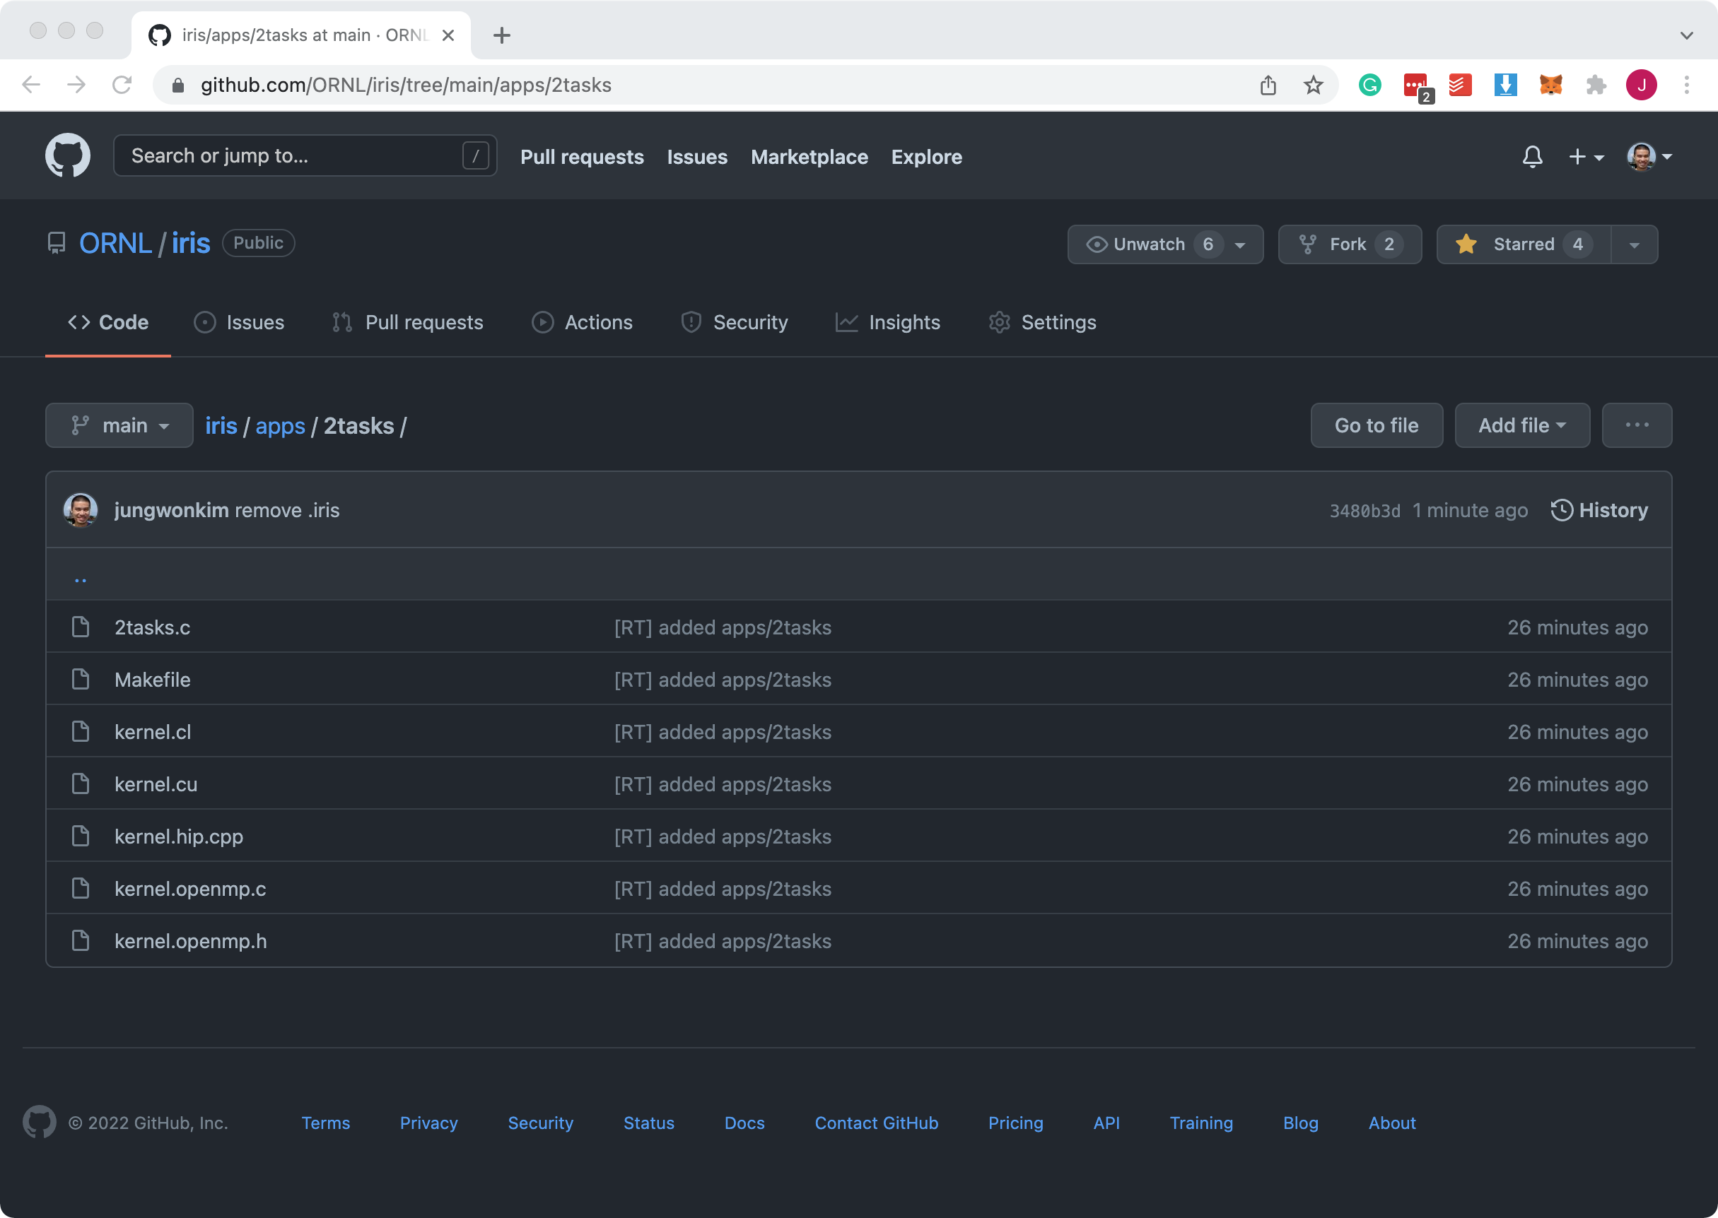
Application: apps/2tasks
https://github.com/ORNL/iris/tree/main/apps/2tasks

Slide 4
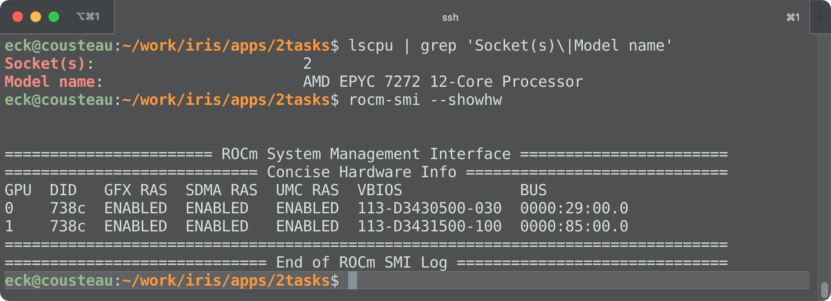
Machine: ExCL/Cousteau
2x AMD EPYC 7272 CPUs + 2x AMD MI100 GPUs

Slide 5
2tasks (Z[] = X[] + Y[]) on Cousteau
Mem X
Kernel 0
(float* dst, float* src)
{
dst[i] = src[i];
}
Task 0
AMD CPU
OMP
H2D(X)
Kernel0(Z, X)
Commands
Mem Y
AMD GPU
HIP
Kernel 1
(float* dst, float* src)
{
dst[i] += src[i];
}
Task 1
Mem Z
H2D(Y)
AMD GPU
HIP
Kernel1(Z, Y)
D2H(Z)

Slide 6
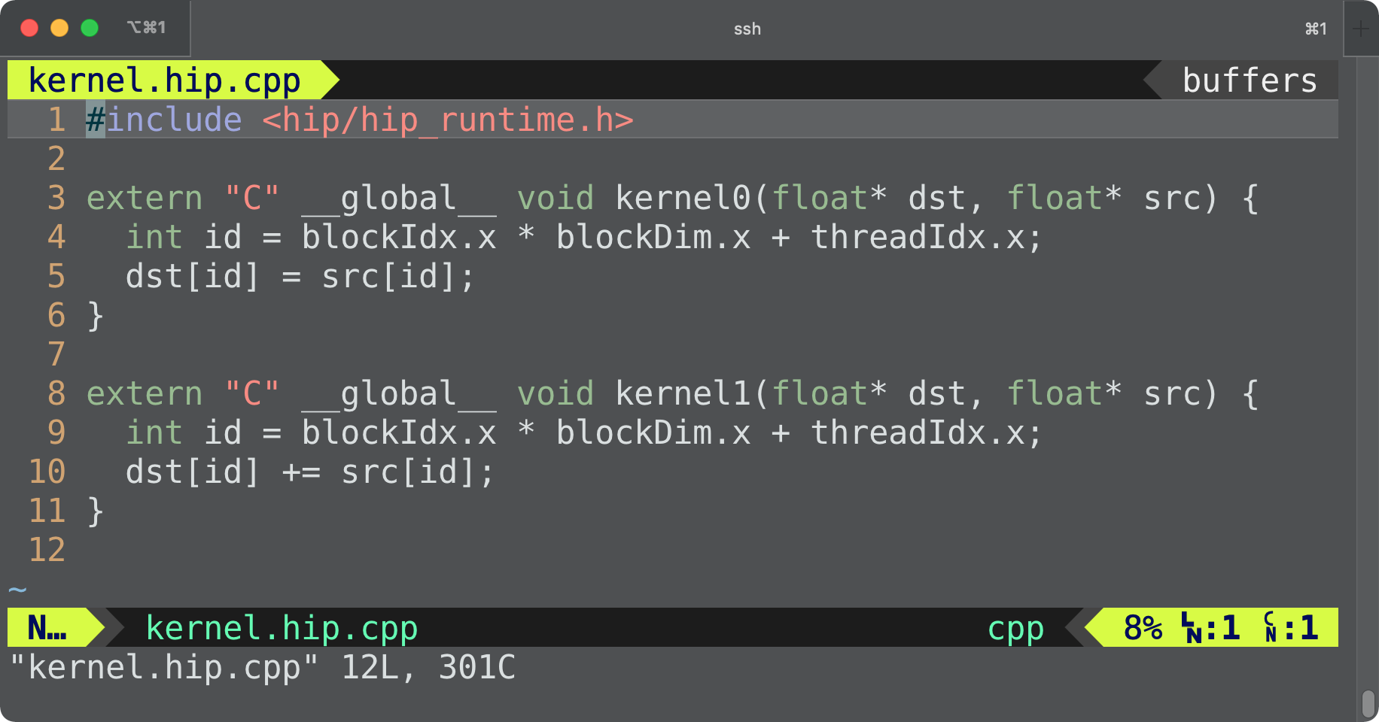
2tasks/kernel.hip.cpp

Slide 7
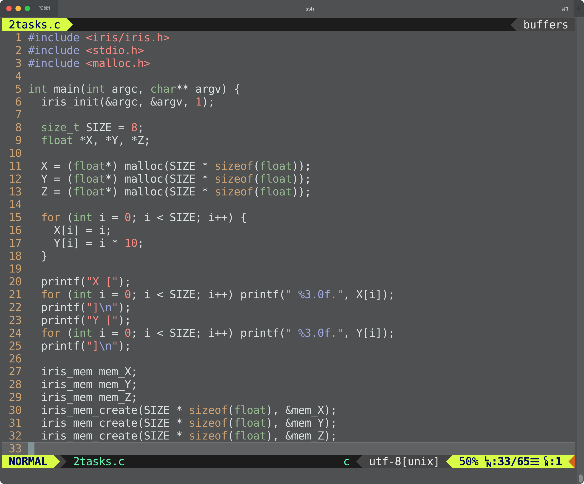
2tasks/2tasks.c
Mem X
Mem Y
Mem Z

Slide 8
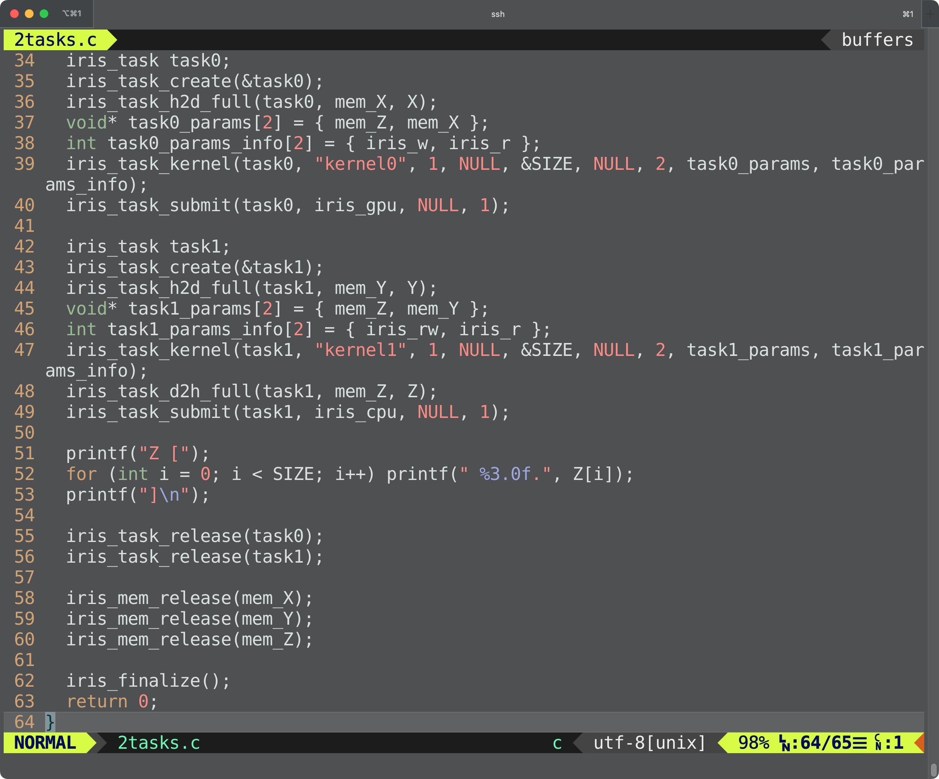
2tasks/2tasks.c
Task 0
AMD GPU
HIP
H2D(X)
Kernel0(Z, X)
Task 1
AMD CPU
OMP
H2D(Y)
Kernel1(Z, Y)
D2H(Z)

Slide 9
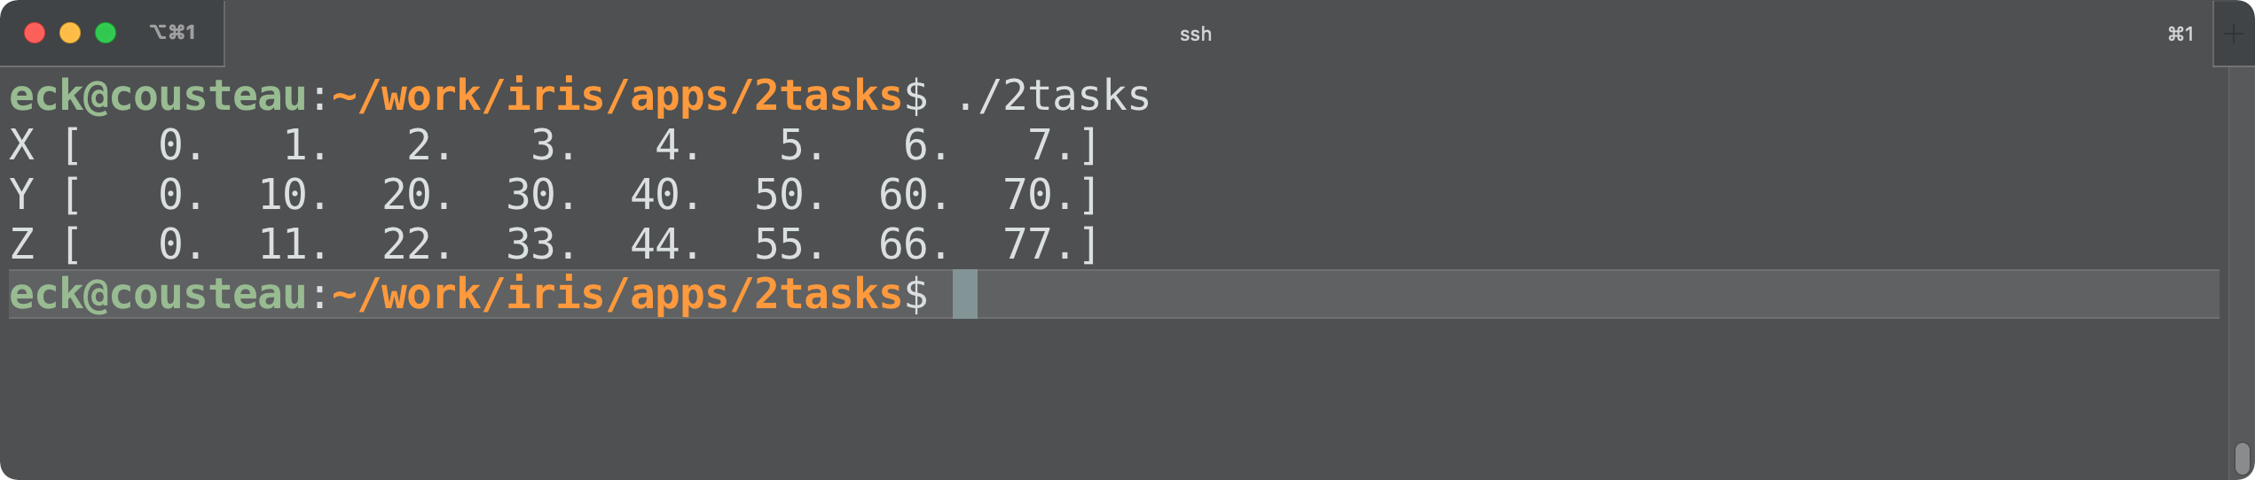
2tasks/2tasks.c
Z[] = X[] + Y[]

Slide 10
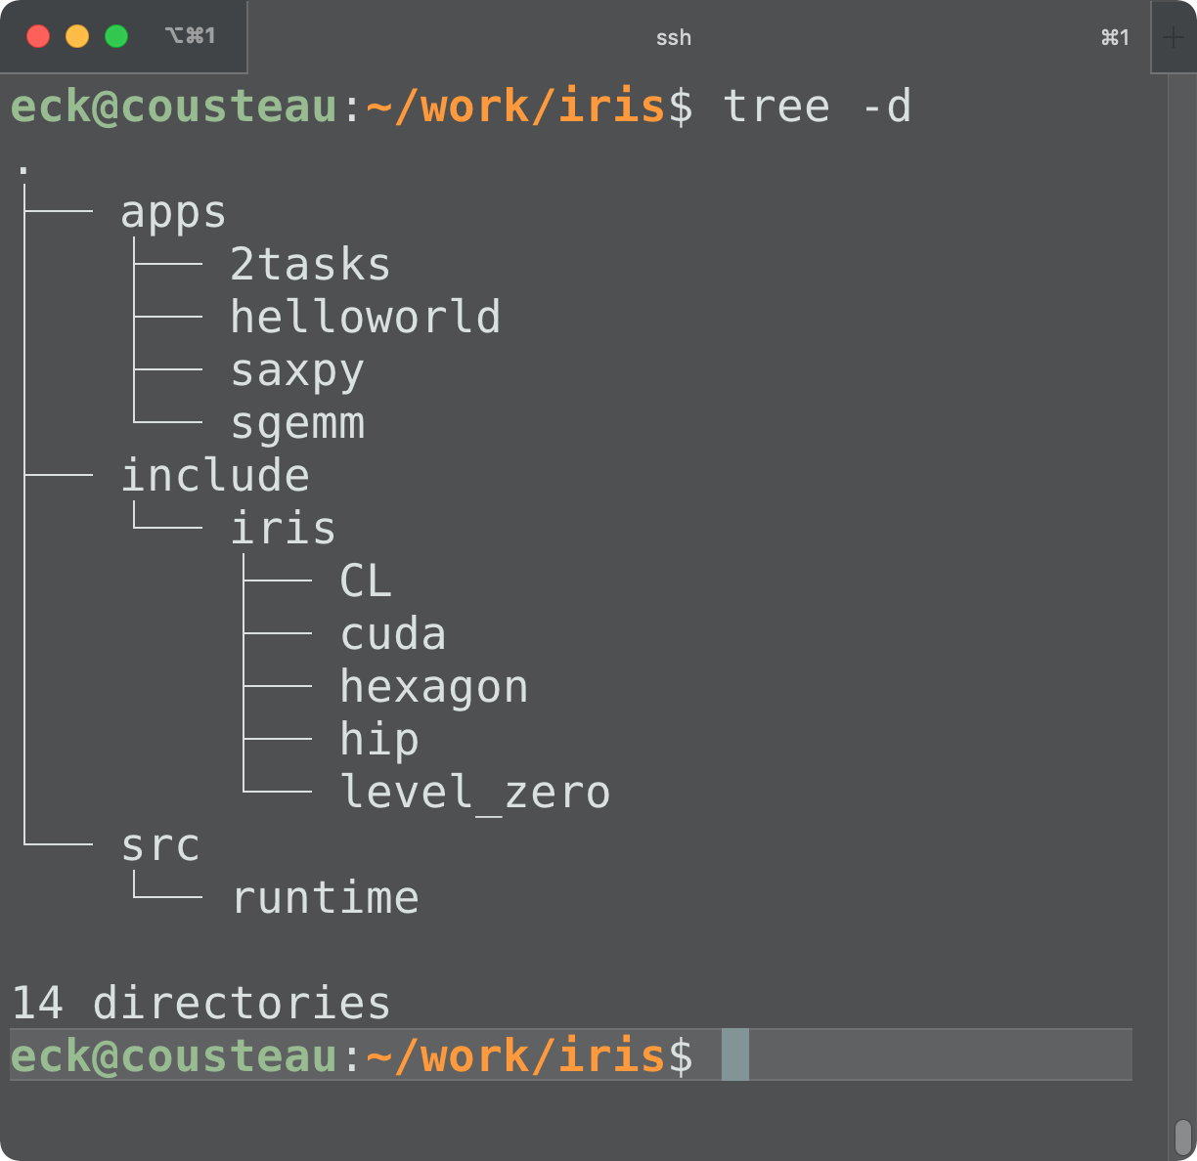
The IRIS Directory Structure
Directory | Contents
apps/* | example applications
include/iris | IRIS API headers (C, C++, Fortran, Python)
include/iris/CL, cuda, hexagon, hip, level_zero | headers of 3rd party programming platforms
src/runtime | IRIS runtime source code

Slide 11
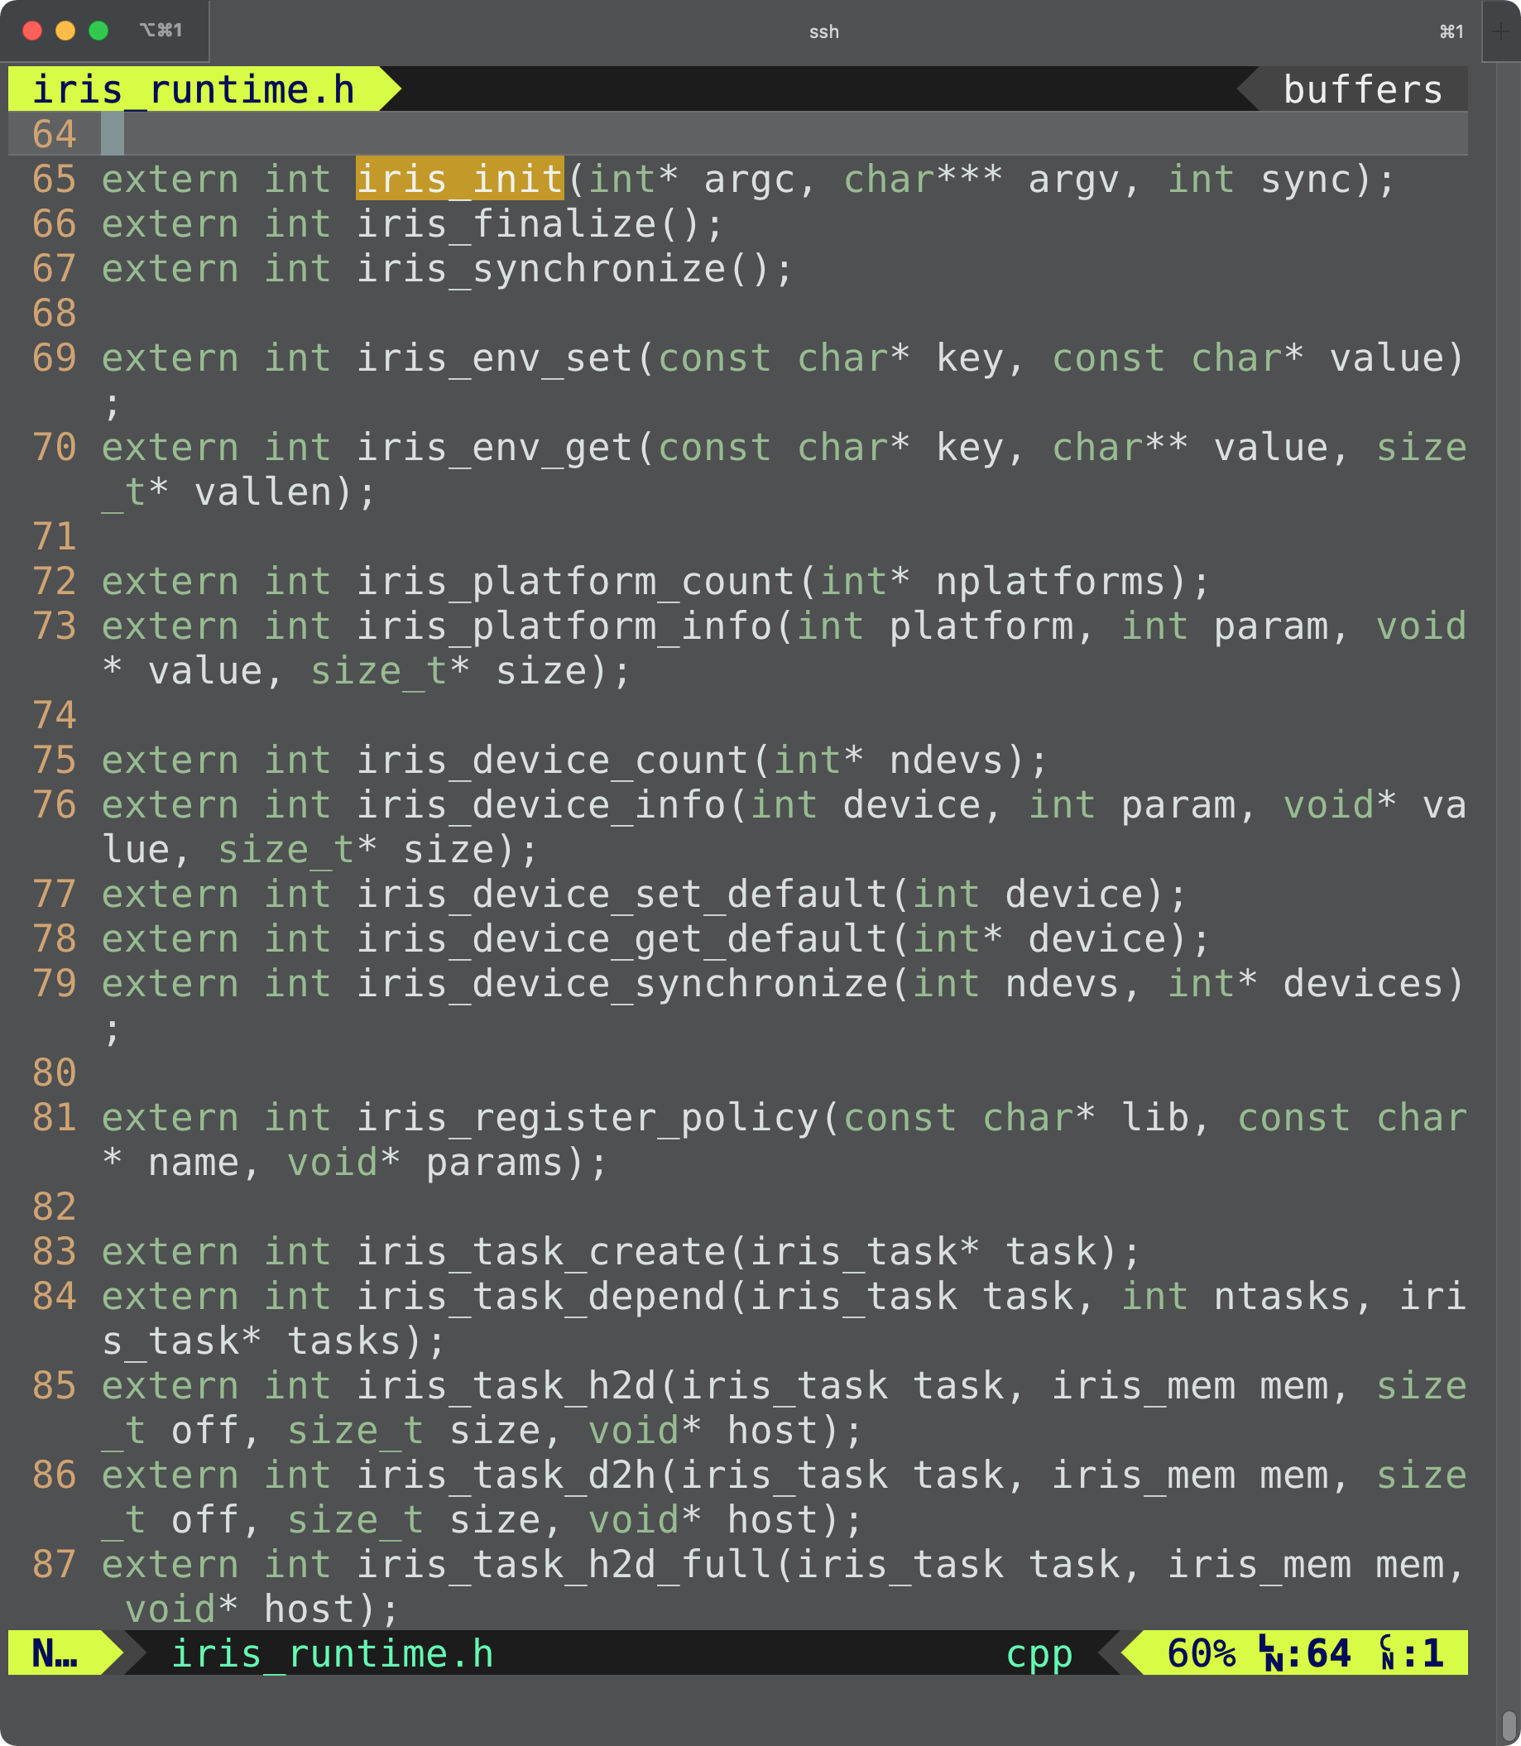
iris_init() @ include/iris/iris.h, iris_runtime.h

Slide 12
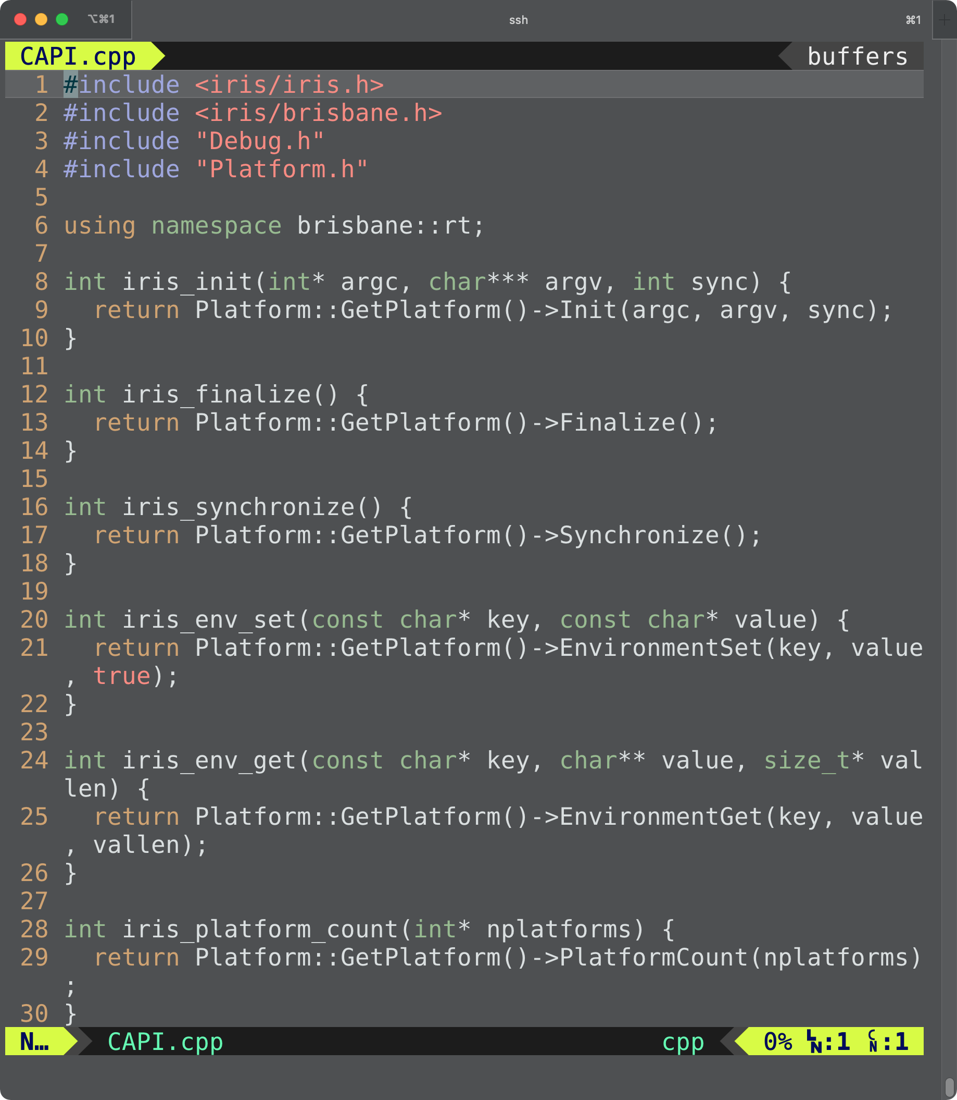
src/runtime/CAPI.cpp
All the IRIS C API functions are defined in CAPI.cpp
The IRIS C++, Fortran, Python APIs are just wrappers of CAPI.cpp
Every IRIS C API function calls a member function of Platform

Slide 13
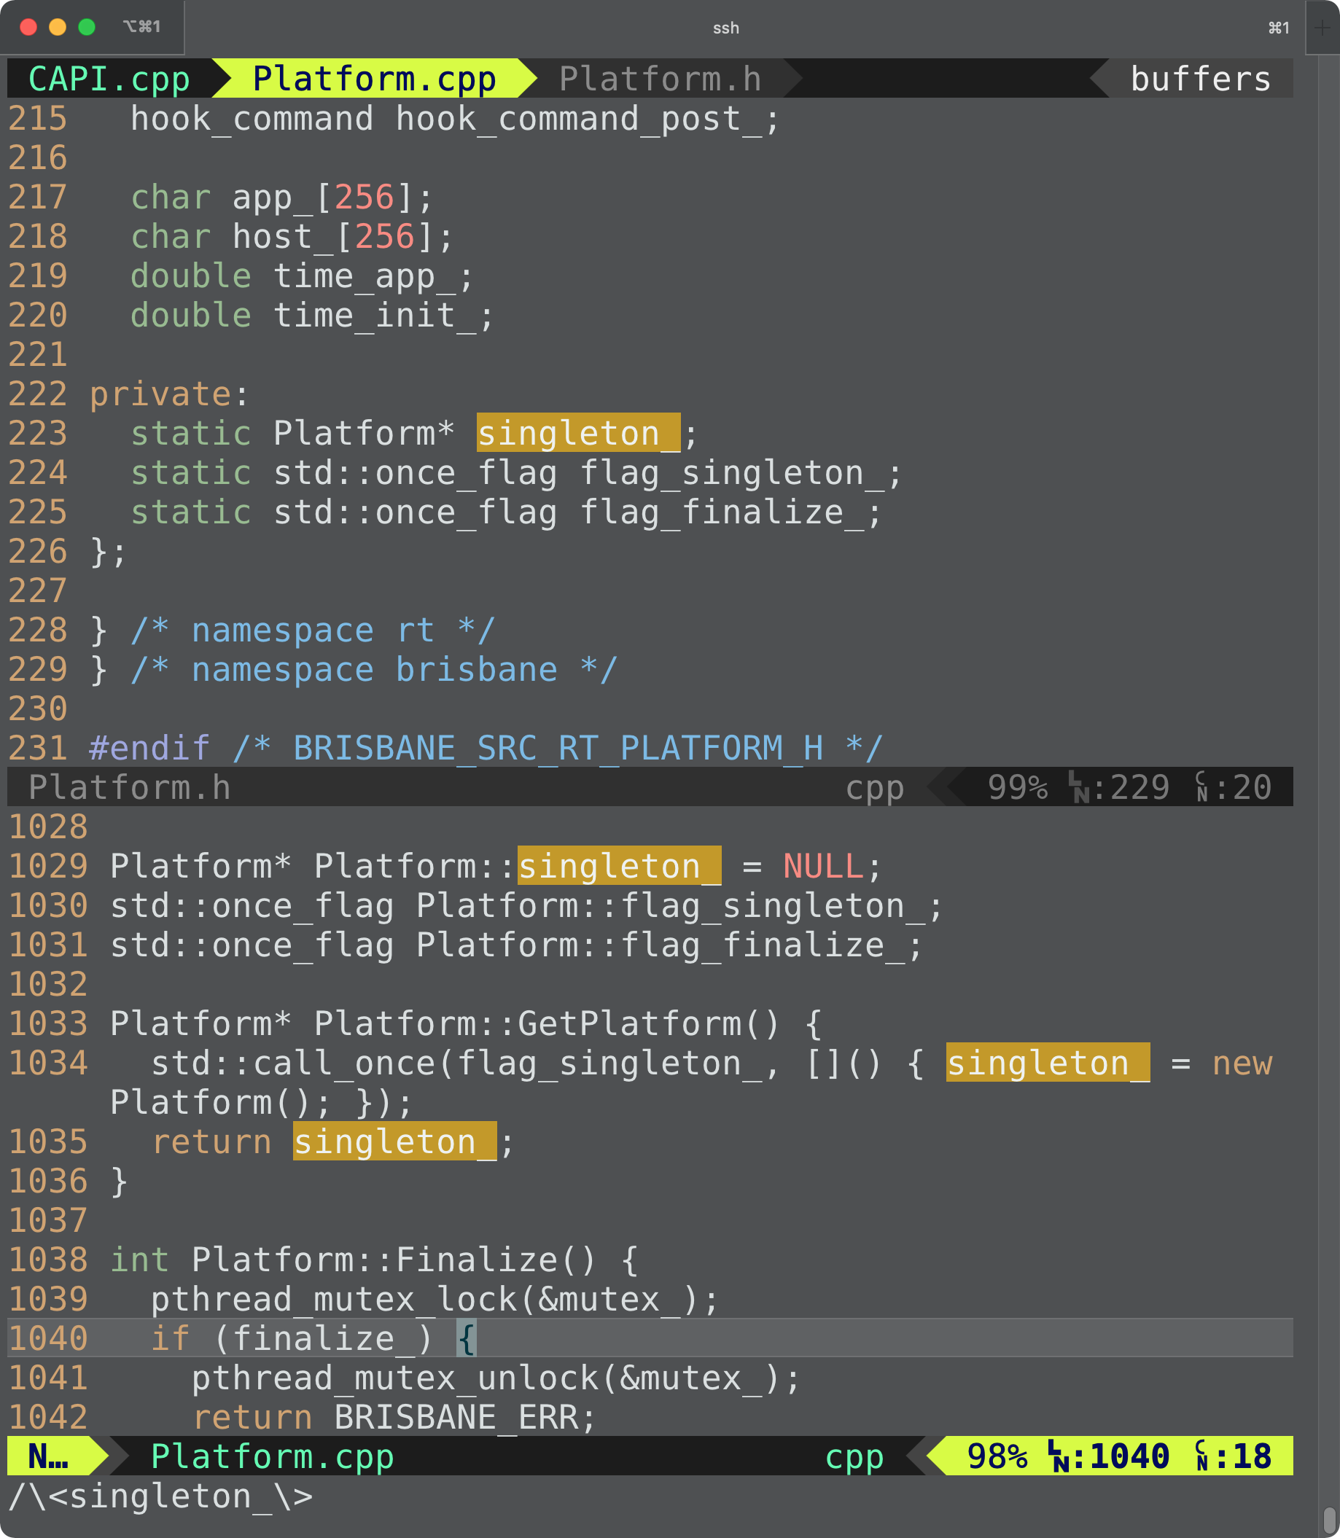
src/runtime/Platform.cpp
The IRIS Platform manages everything in the IRIS runtime
Devices, memories, kernels, tasks, scheduler, workers, loaders, consistency manager, queues
Platform is a singleton instance in the whole IRIS execution environment

Slide 14
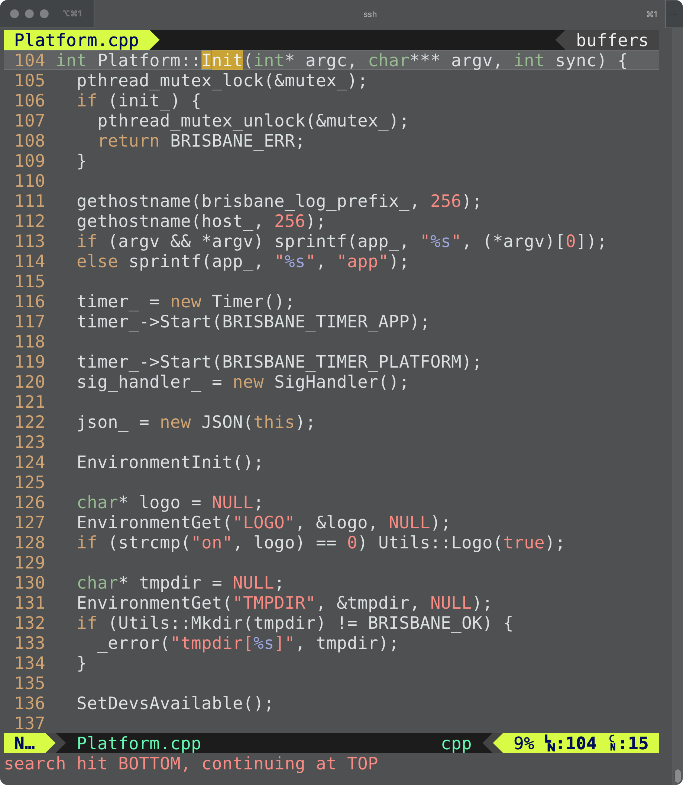
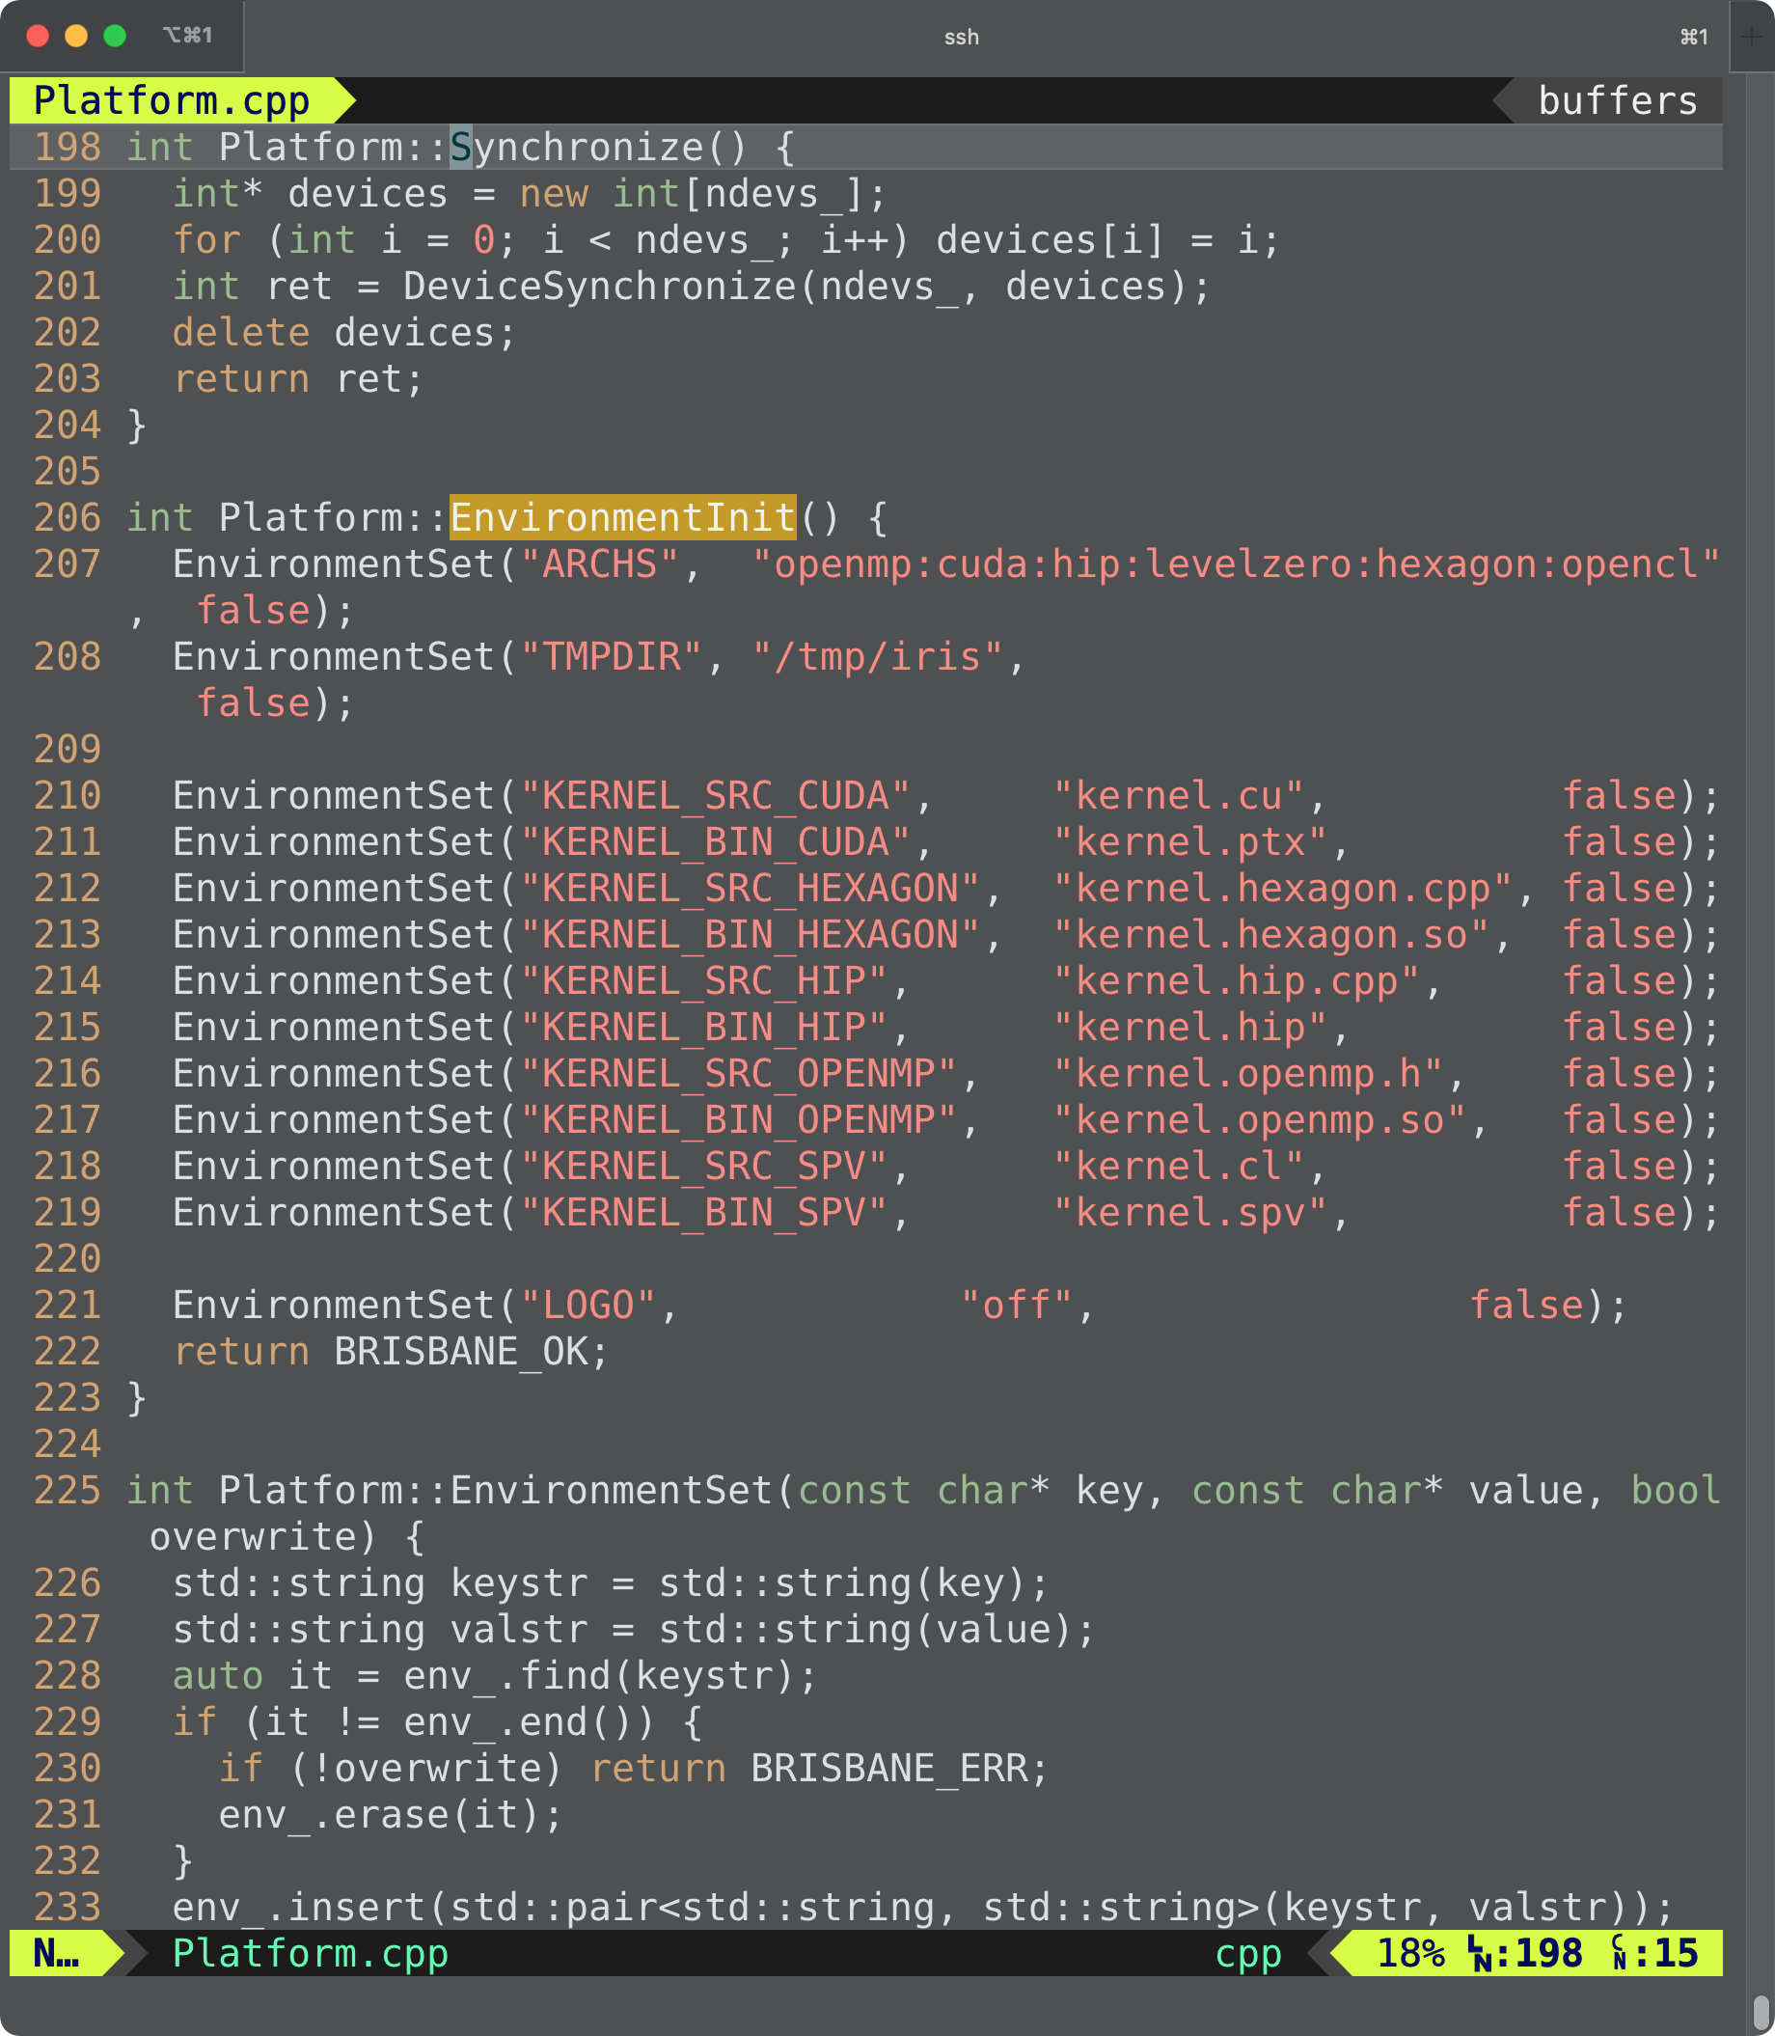
src/runtime/Platform.cpp :: Init()
You can overwrite the IRIS environment variables by
$ export IRIS_ARCHS=hip:openmp
iris_env_set("ARCHS", "hip:openmp");

Slide 15
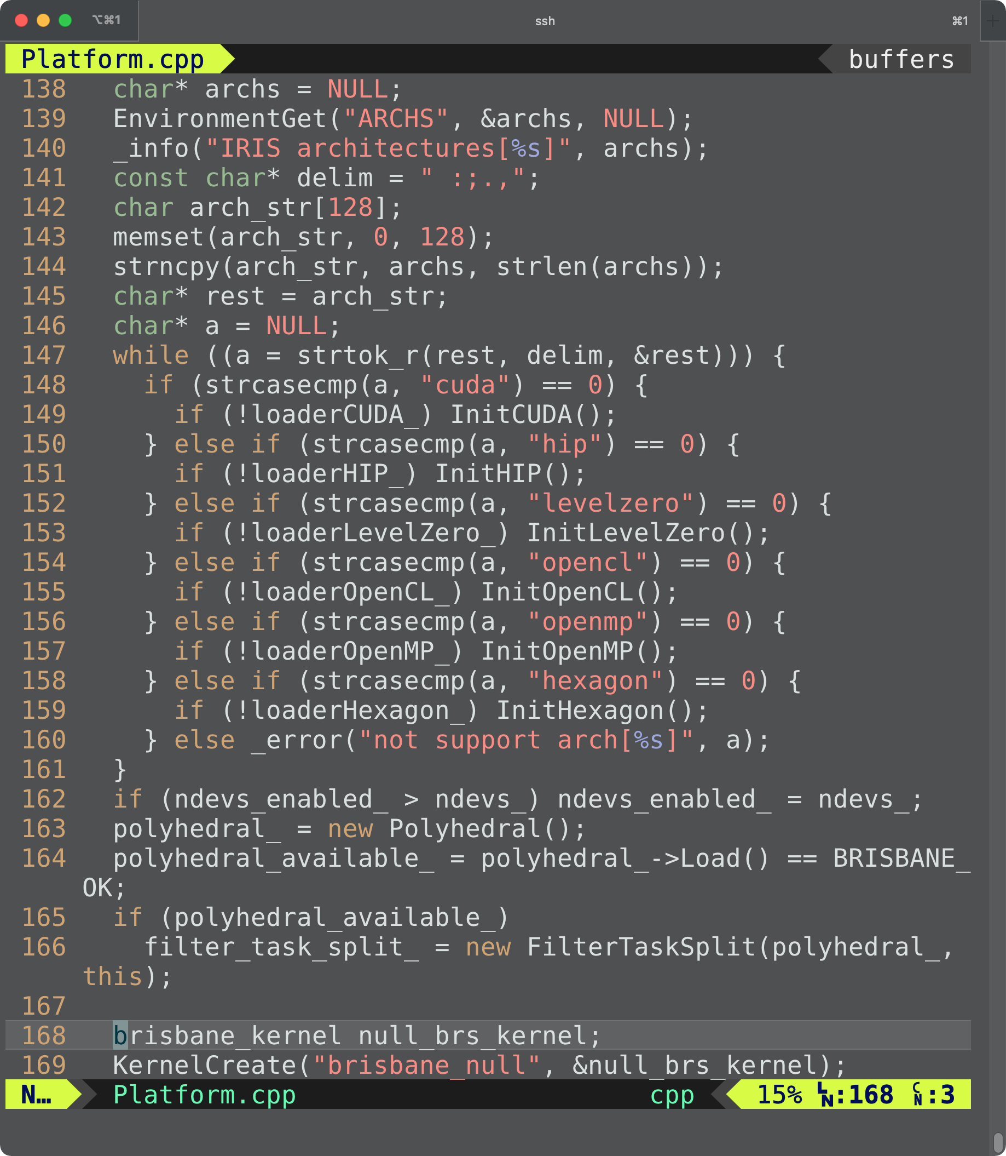
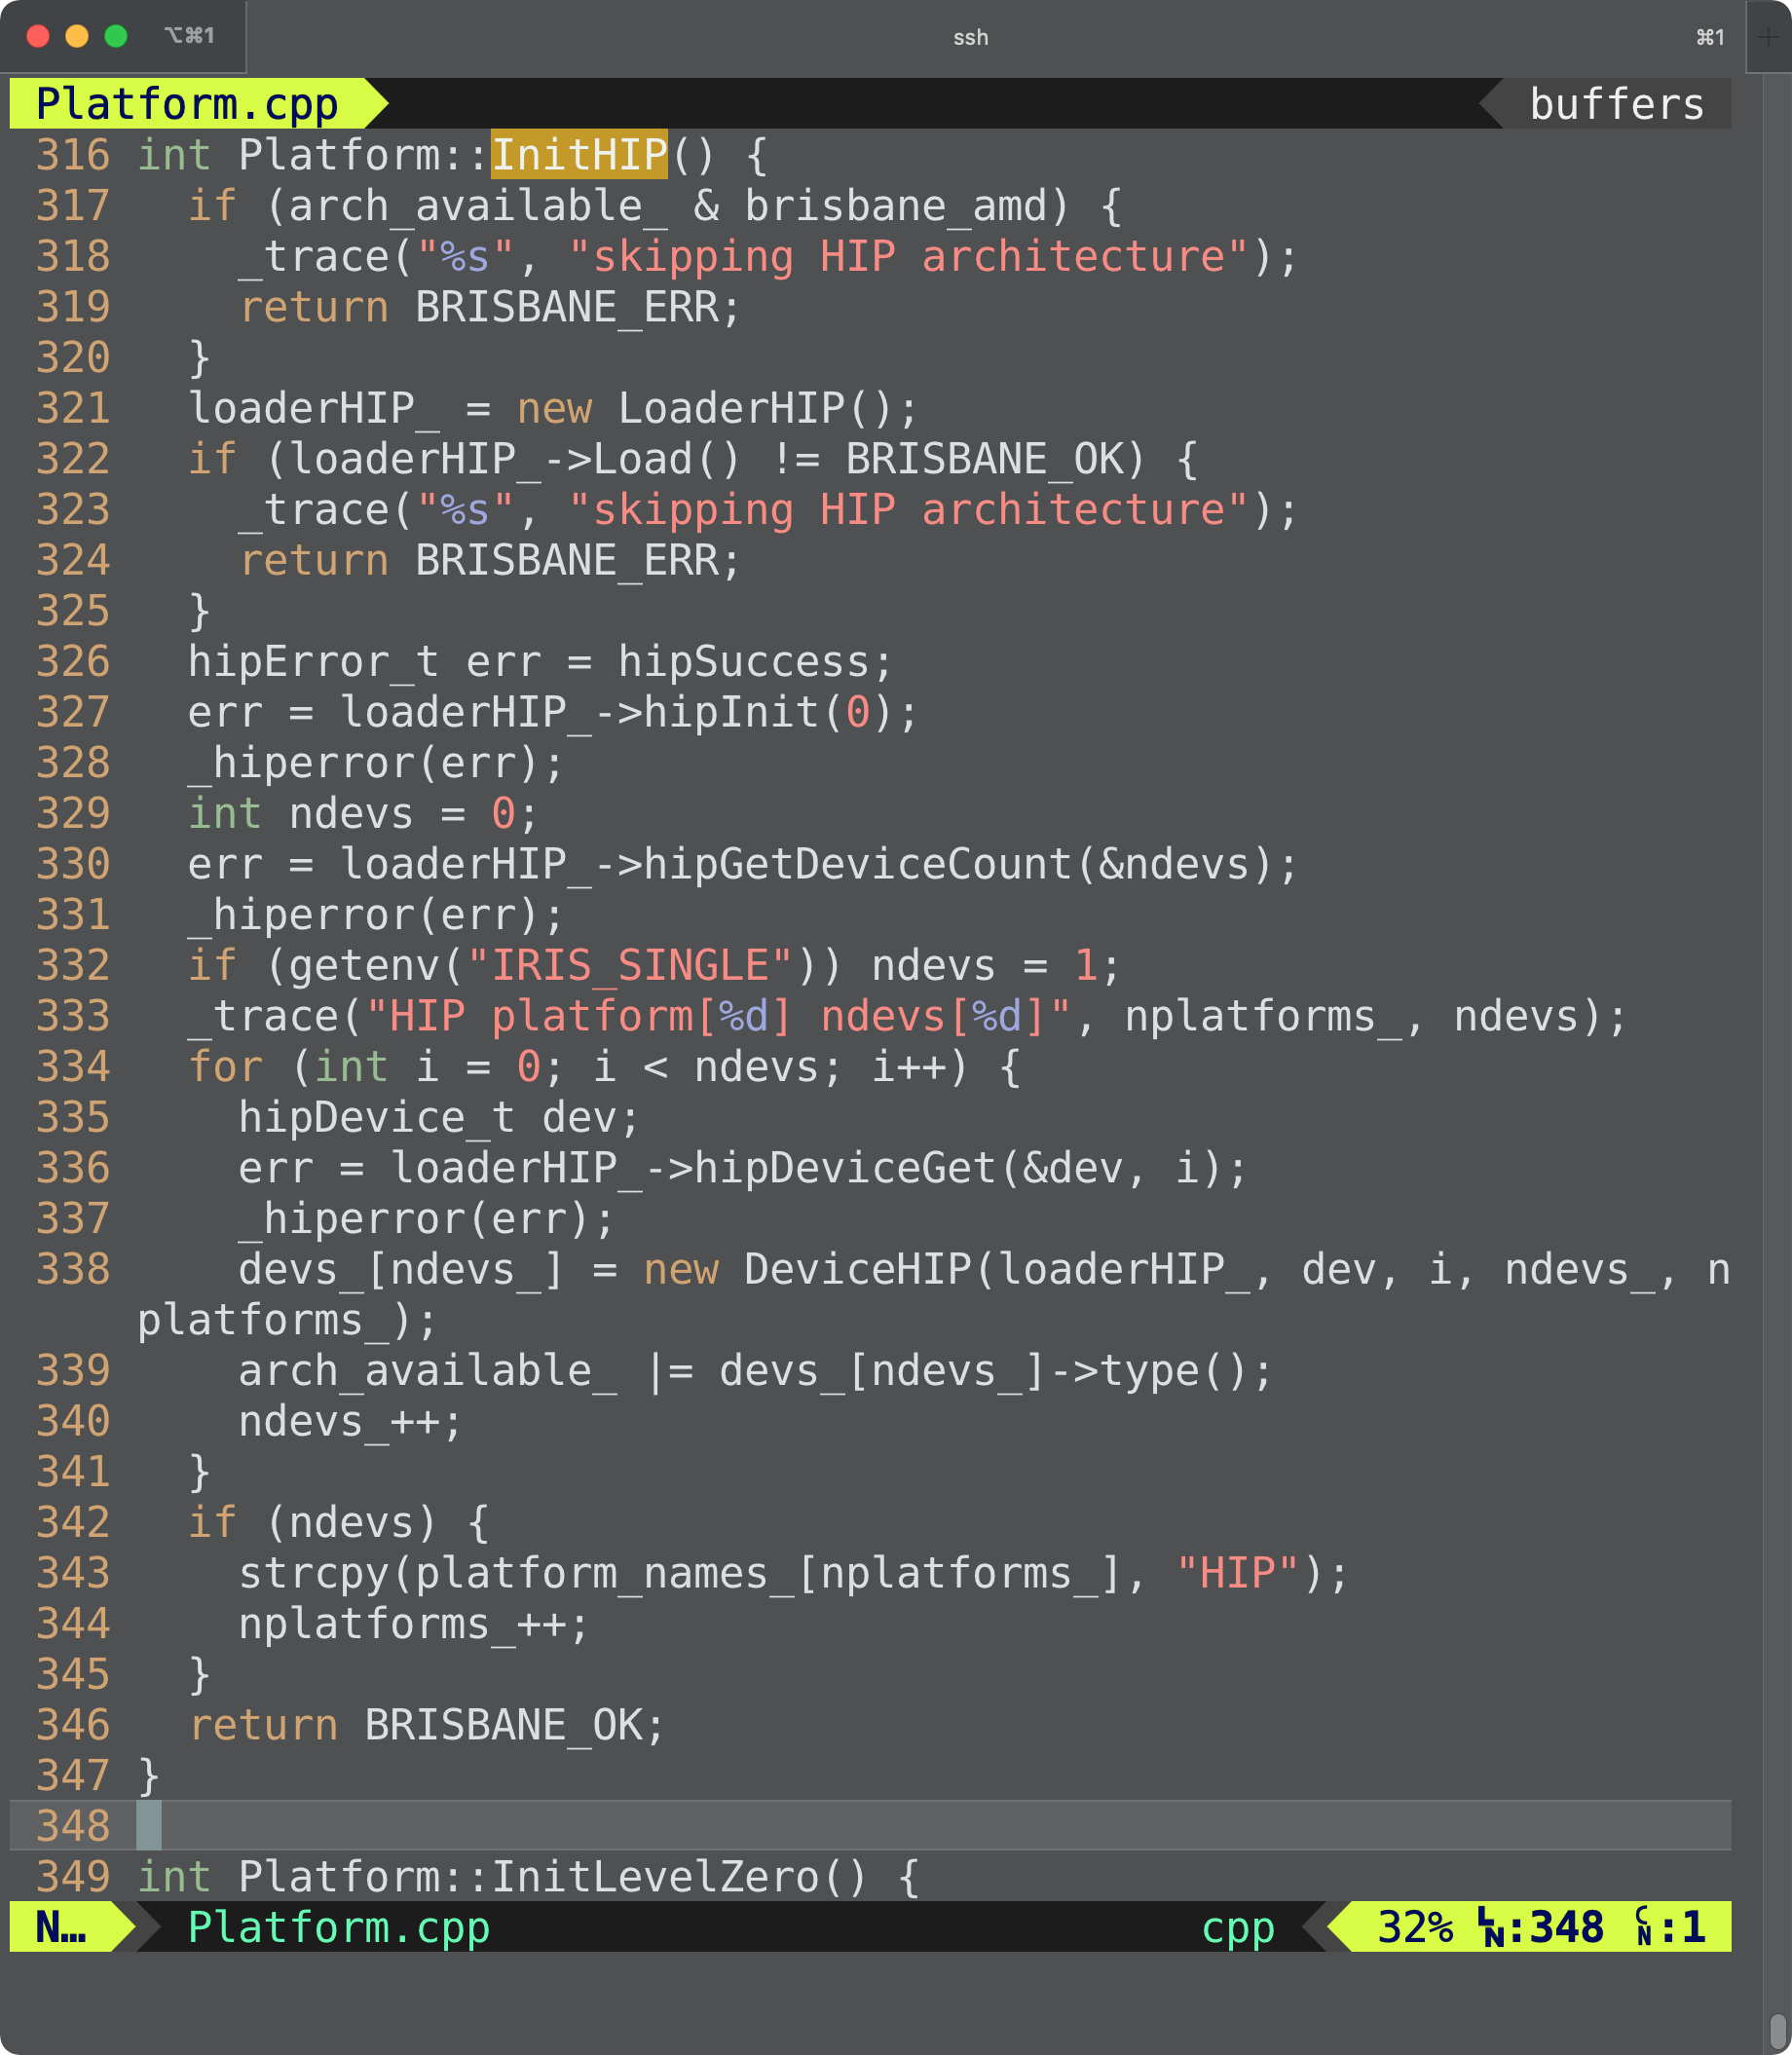
src/runtime/Platform.cpp :: InitHIP()

Slide 16
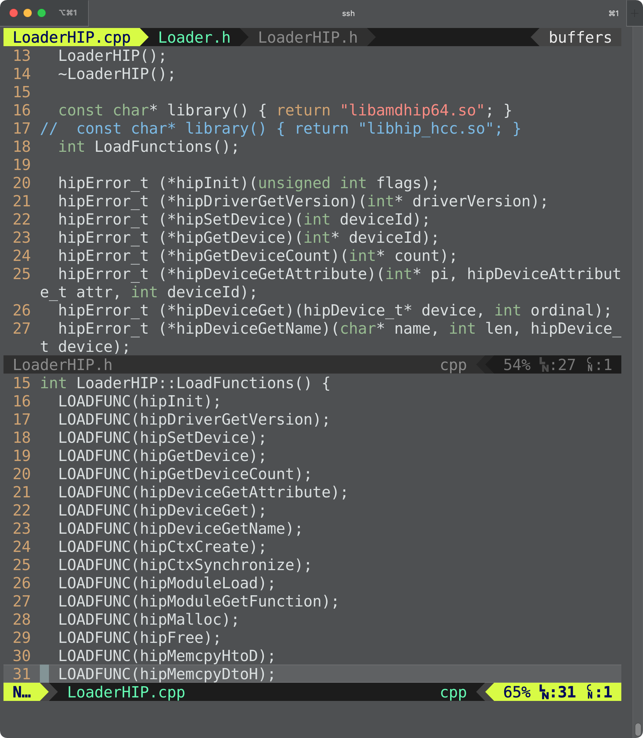
src/runtime/LoaderHIP.cpp
Seeking libamdhip64.so in $LD_LIBRARY_PATH and loading its HIP API functions

Slide 17
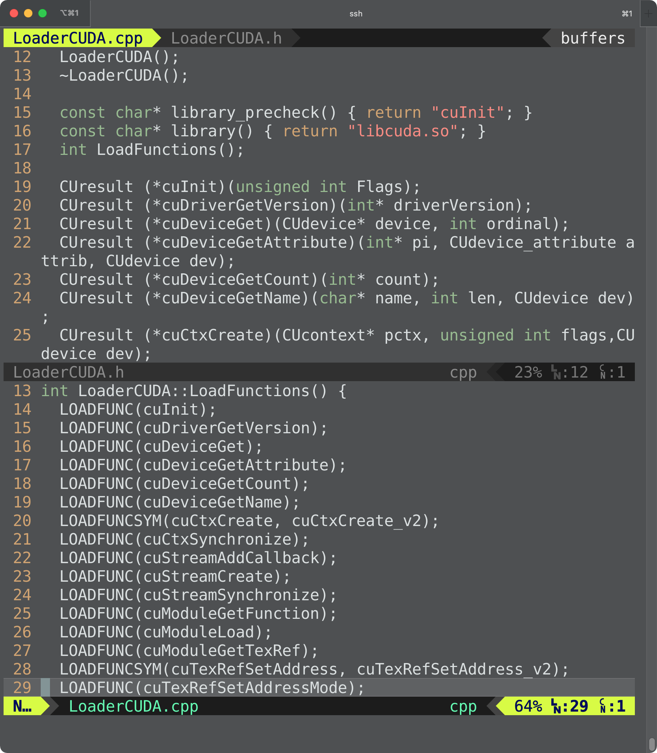
src/runtime/LoaderXXX.cpp
Loader Subclasses
LoaderCUDA
LoaderHexagon
LoaderHIP
LoaderLevelZero
LoaderOpenCL
LoaderOpenMP

Slide 18
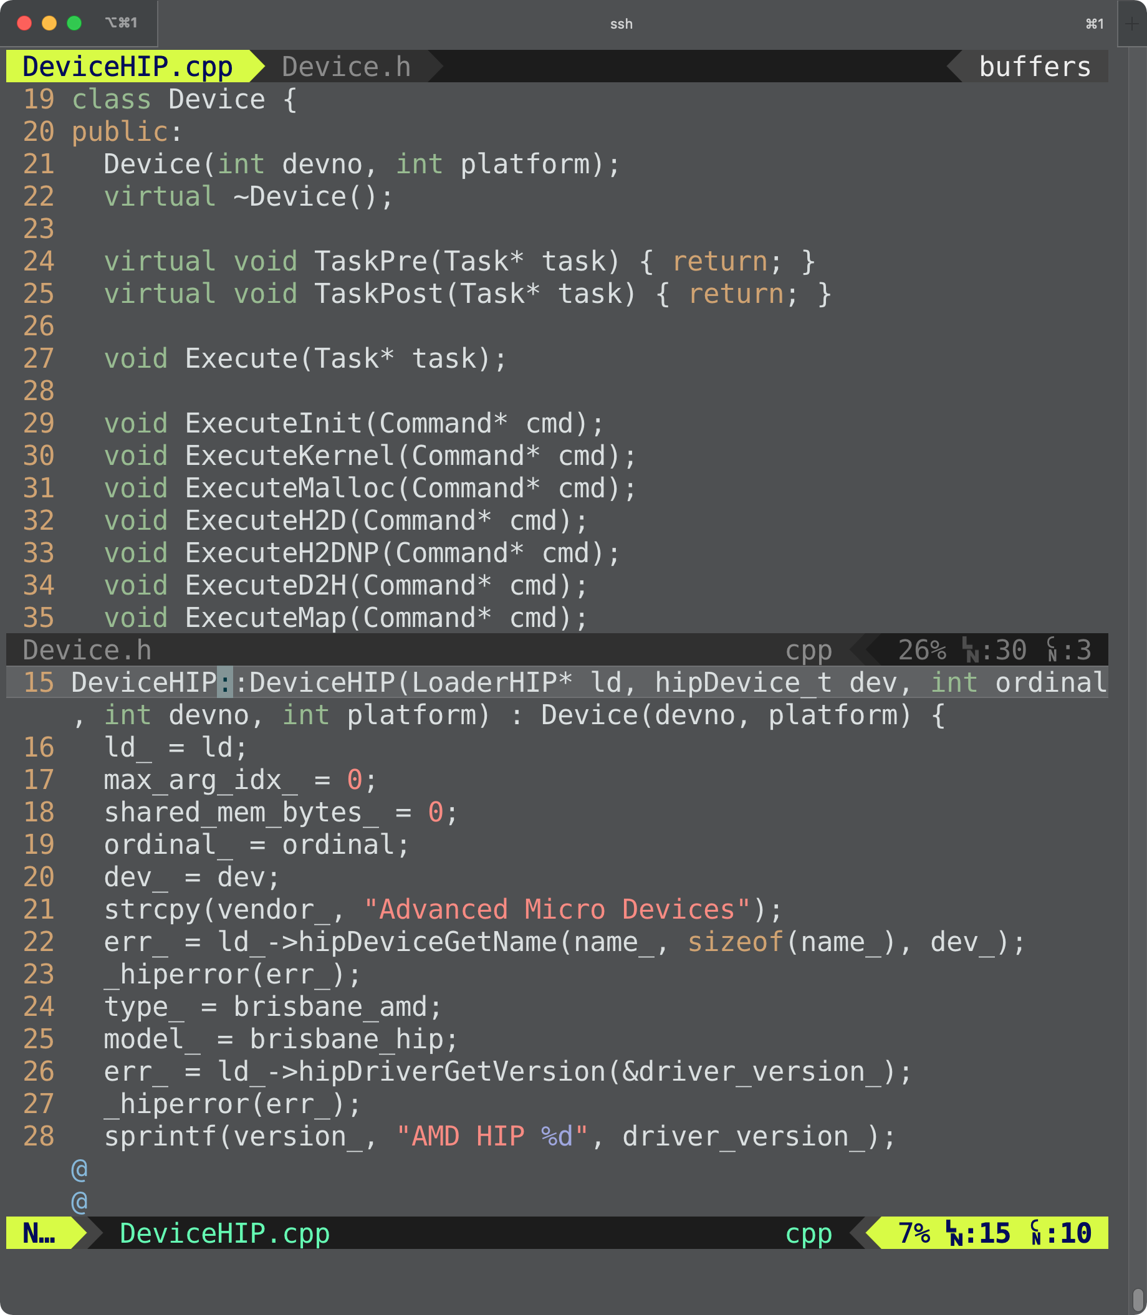
src/runtime/DeviceHIP.cpp
Device Subclasses
DeviceCUDA
DeviceHexagon
DeviceHIP
DeviceLevelZero
DeviceOpenCL
DeviceOpenMP

Slide 19
Without DPL: Not Portable Executable
a1.out
libiris.so
a2.out
libiris.so
libomp.so
libomp.so
libcuda.so
libhip.so
libOpenCL.so
Oswald
File Server
Frontier
Intel
libomp
NV
libcuda
Intel
libOpenCL
IRIS
libiris
a1.out
a2.out
AMD
libomp
AMD
libhip

Slide 20
Dynamic Platform Loader: Portable Executable
a.out
libiris.so
$ CC app.c -o a.out -liris
a.out
libiris.so
libomp.so
DPL automatically loads all available platforms on run time.
Private linkchain
libomp.so
libcuda.so
libhip.so
libOpenCL.so
Oswald
File Server
Frontier
Intel
libomp
NV
libcuda
Intel
libOpenCL
IRIS
libiris
a.out
AMD
libomp
AMD
libhip

Slide 21
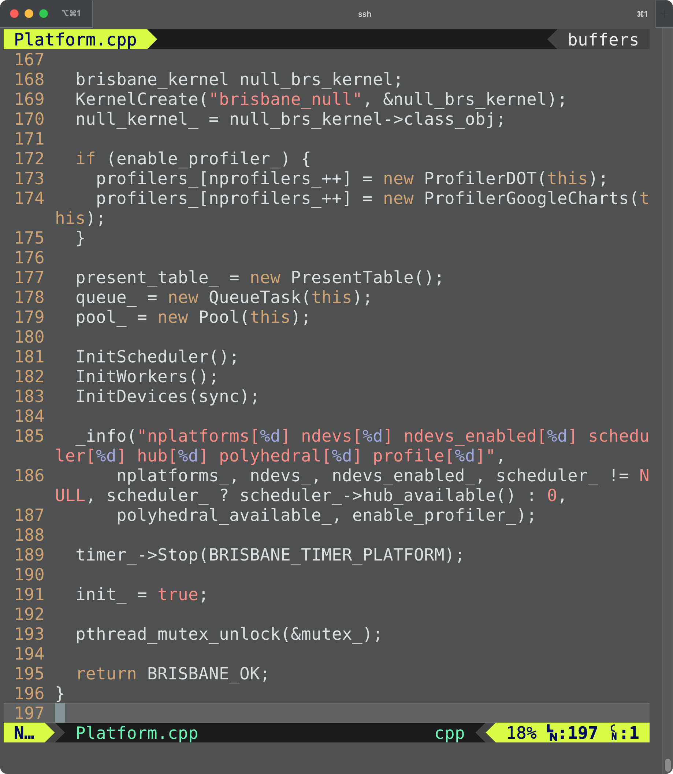
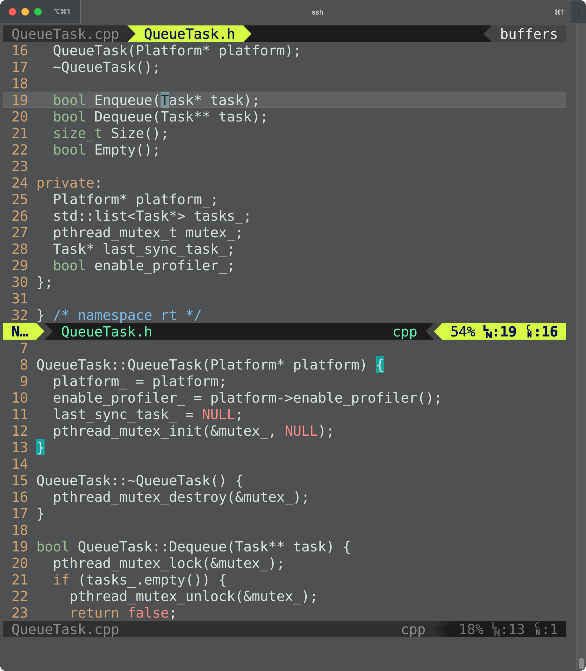
src/runtime/QueueTask.cpp
QueueTask: Application Task Queue
Out-or-order queue

Slide 22
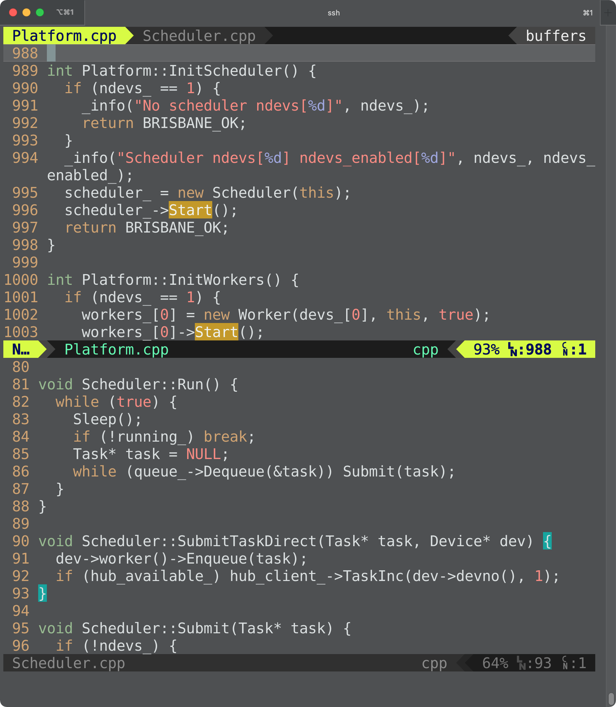
src/runtime/Scheduler.cpp
Scheduler
a pthread instance
scheduling the Application Task Queue

Slide 23
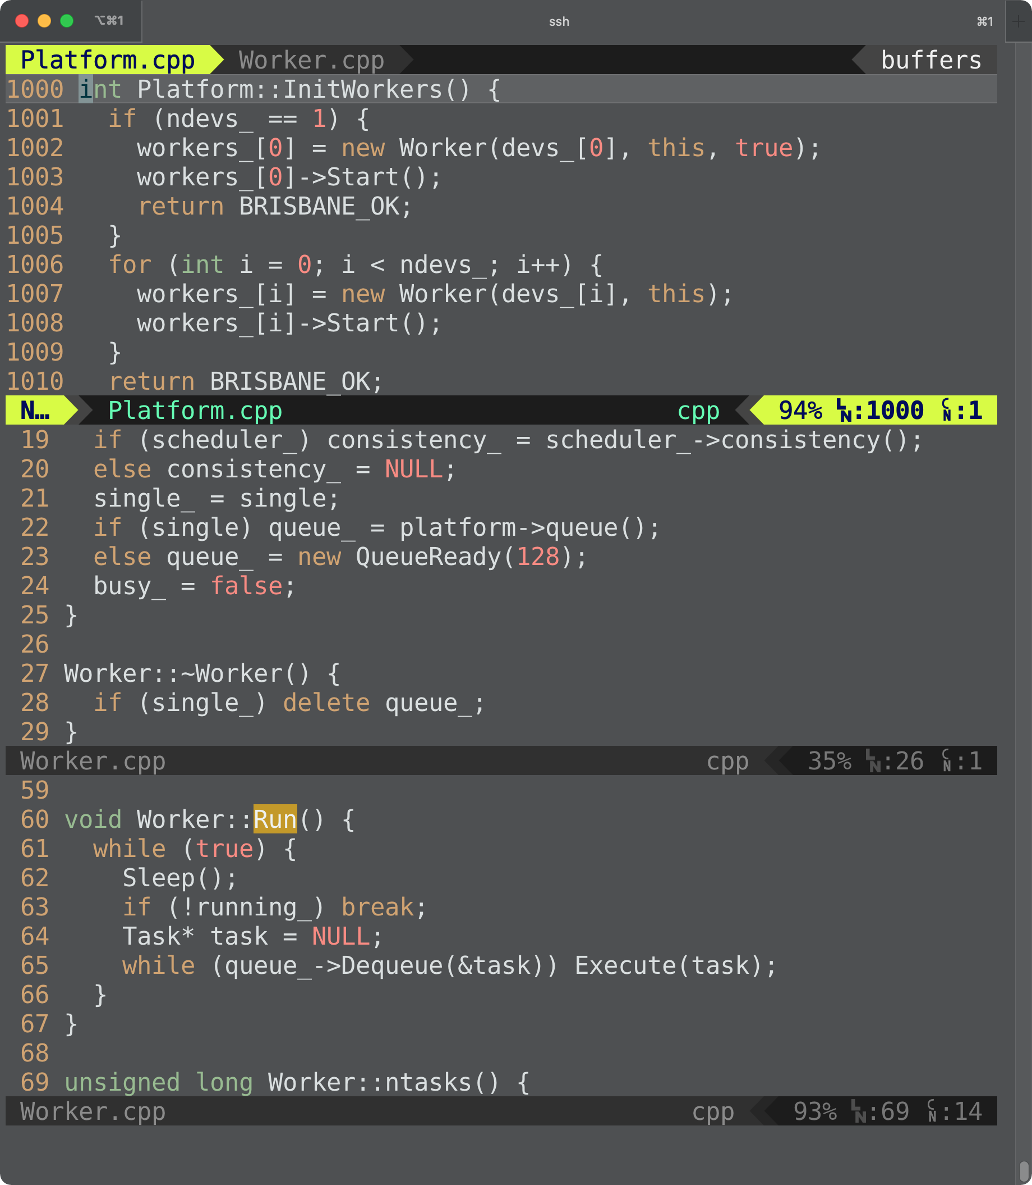
src/runtime/Worker.cpp
Worker
a pthread instance
N workers for
N devices
scheduling a Ready Queue (Multiple Producers Single Consumer Lock-free In-order Queue)

Slide 24
The IRIS Platform So Far
Application Queue
QueueTask.cpp
User Application
IRIS Objects
IRIS Threads
Platform Libraries
Submit
Dequeue
Scheduler
Scheduler.cpp
libgomp.so
Load
LoaderOpenMP
LoaderOpenMP.cpp
Submit
Ready Queue
QueueReady.cpp
Worker
Worker.cpp
DeviceOpenMP (0)
DeviceOpenMP.cpp
Dequeue
Execute
Ready Queue
QueueReady.cpp
Worker
Worker.cpp
DeviceHIP (1)
DeviceHIP.cpp
Ready Queue
QueueReady.cpp
Worker
Worker.cpp
DeviceHIP (2)
DeviceHIP.cpp
libamdhip64.so
LoaderHIP
LoaderHIPcpp

Slide 25
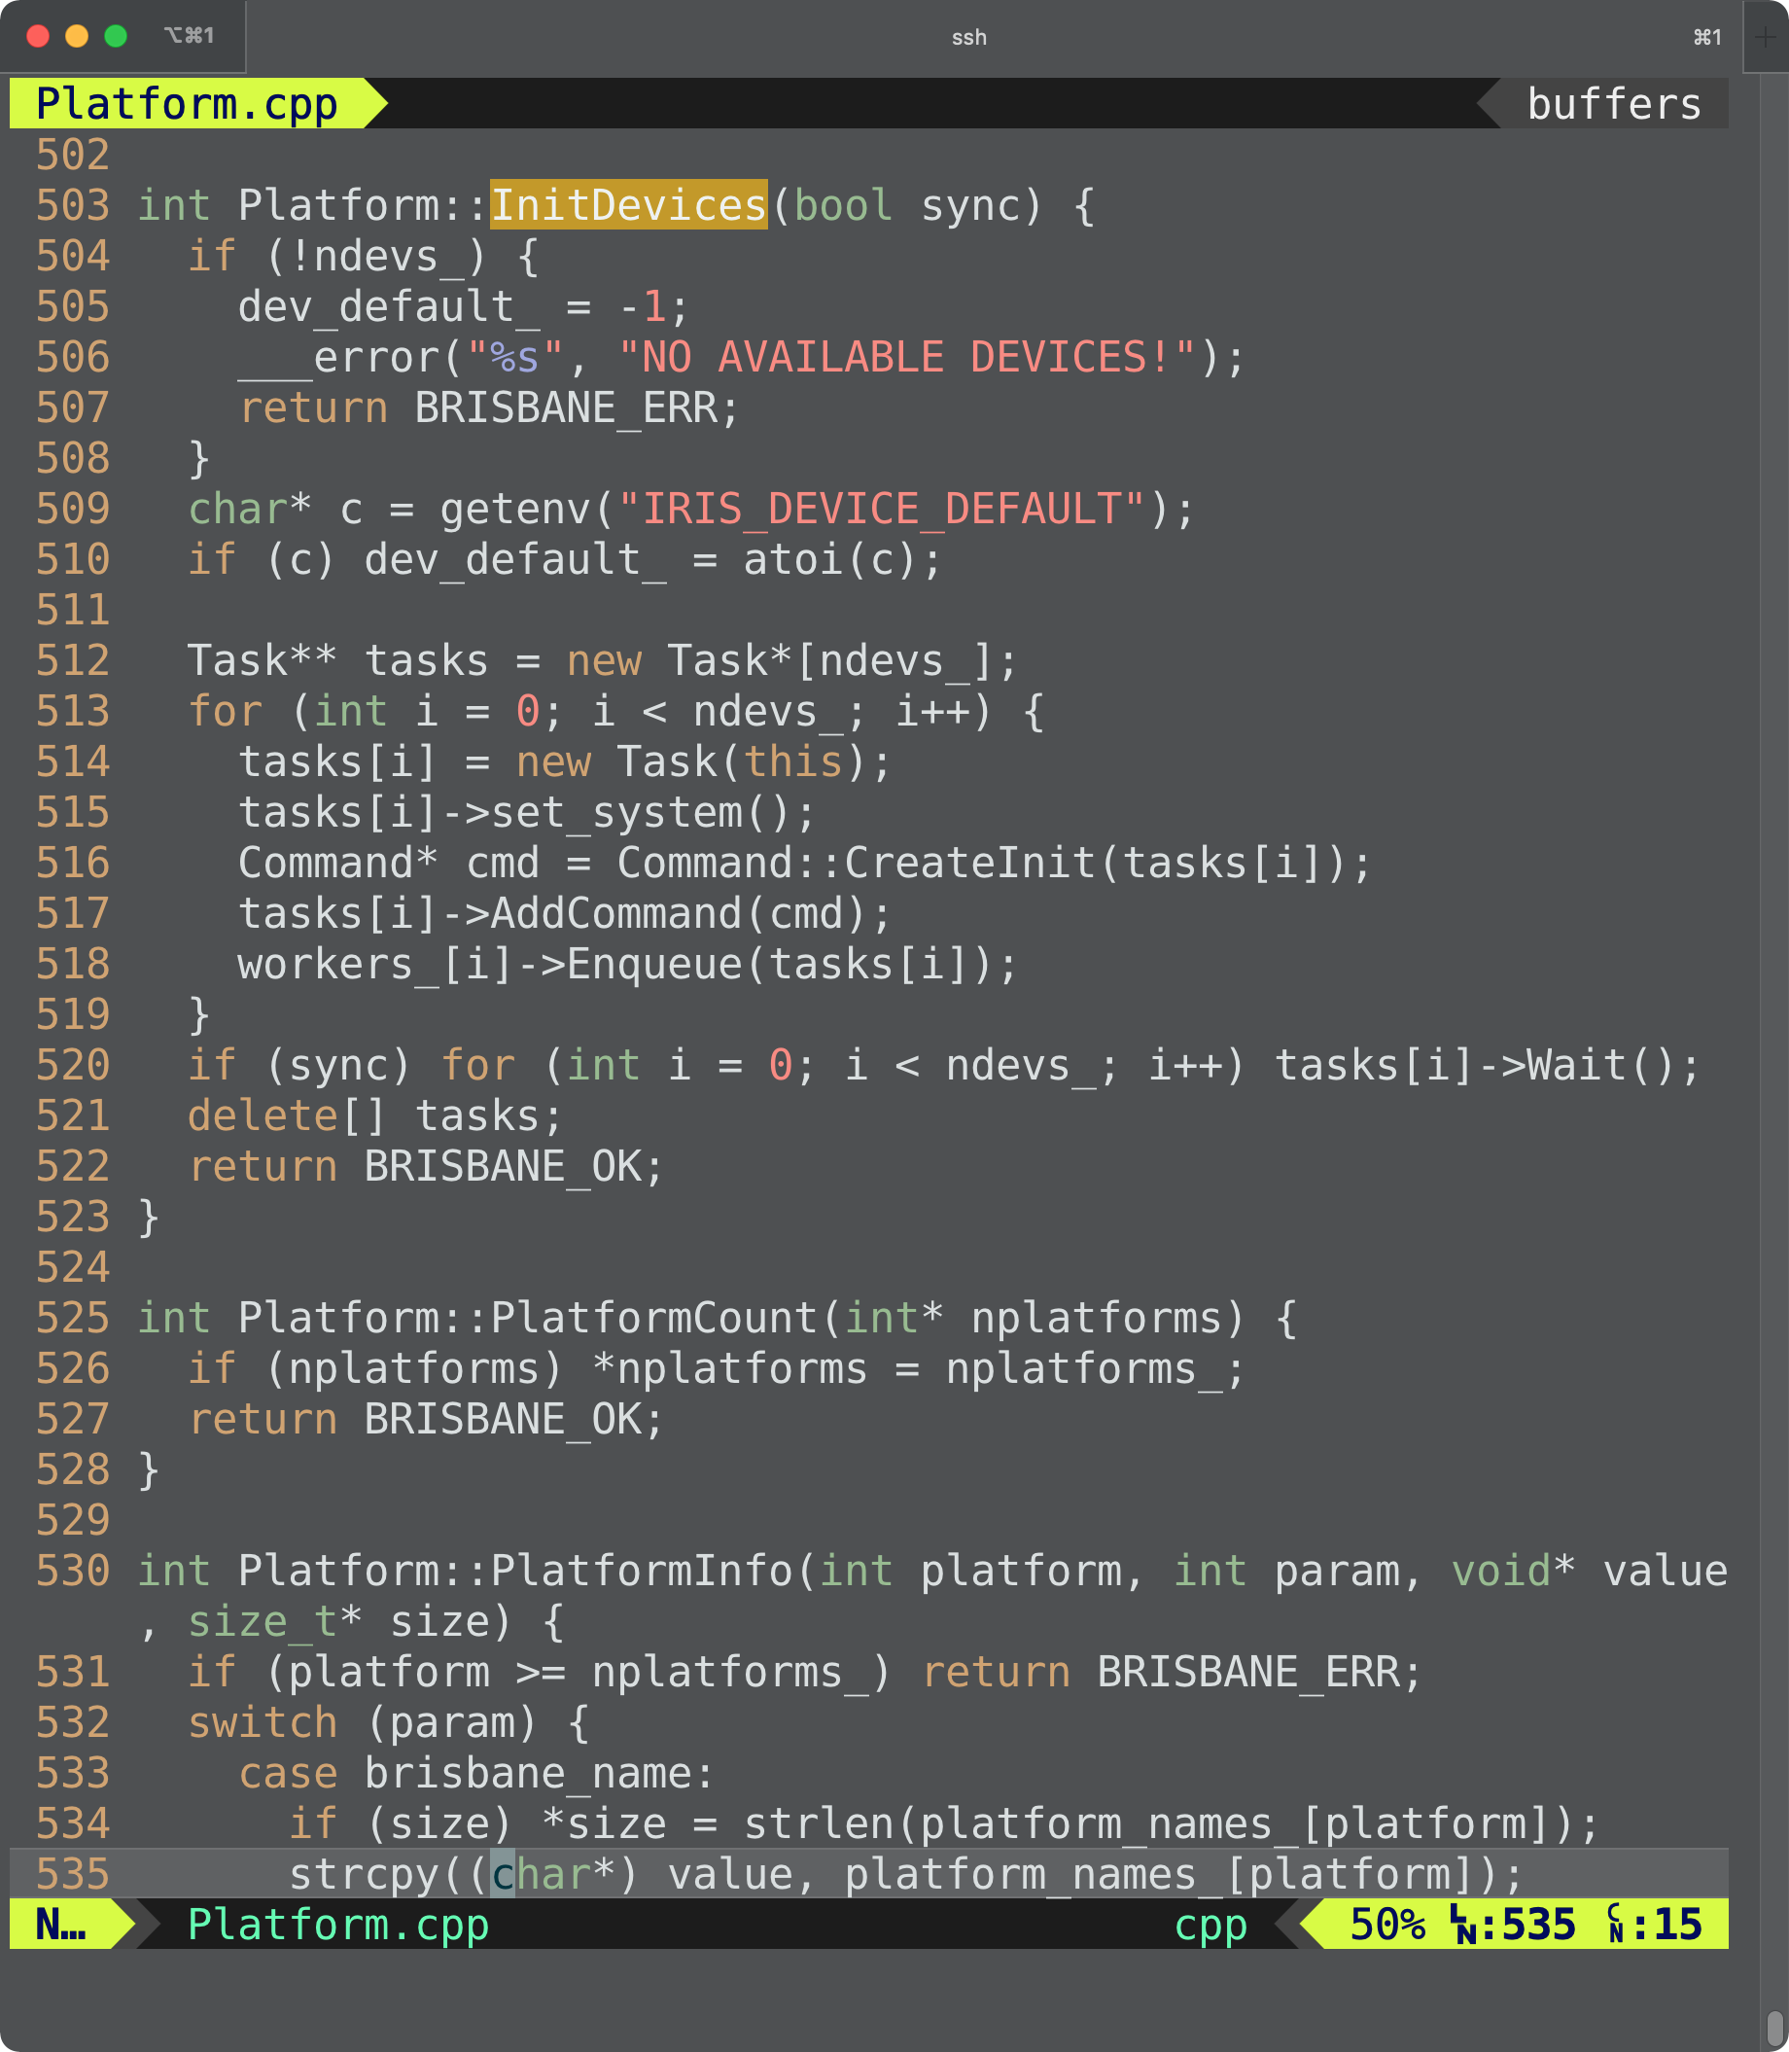
src/runtime/Platform.cpp

Slide 26
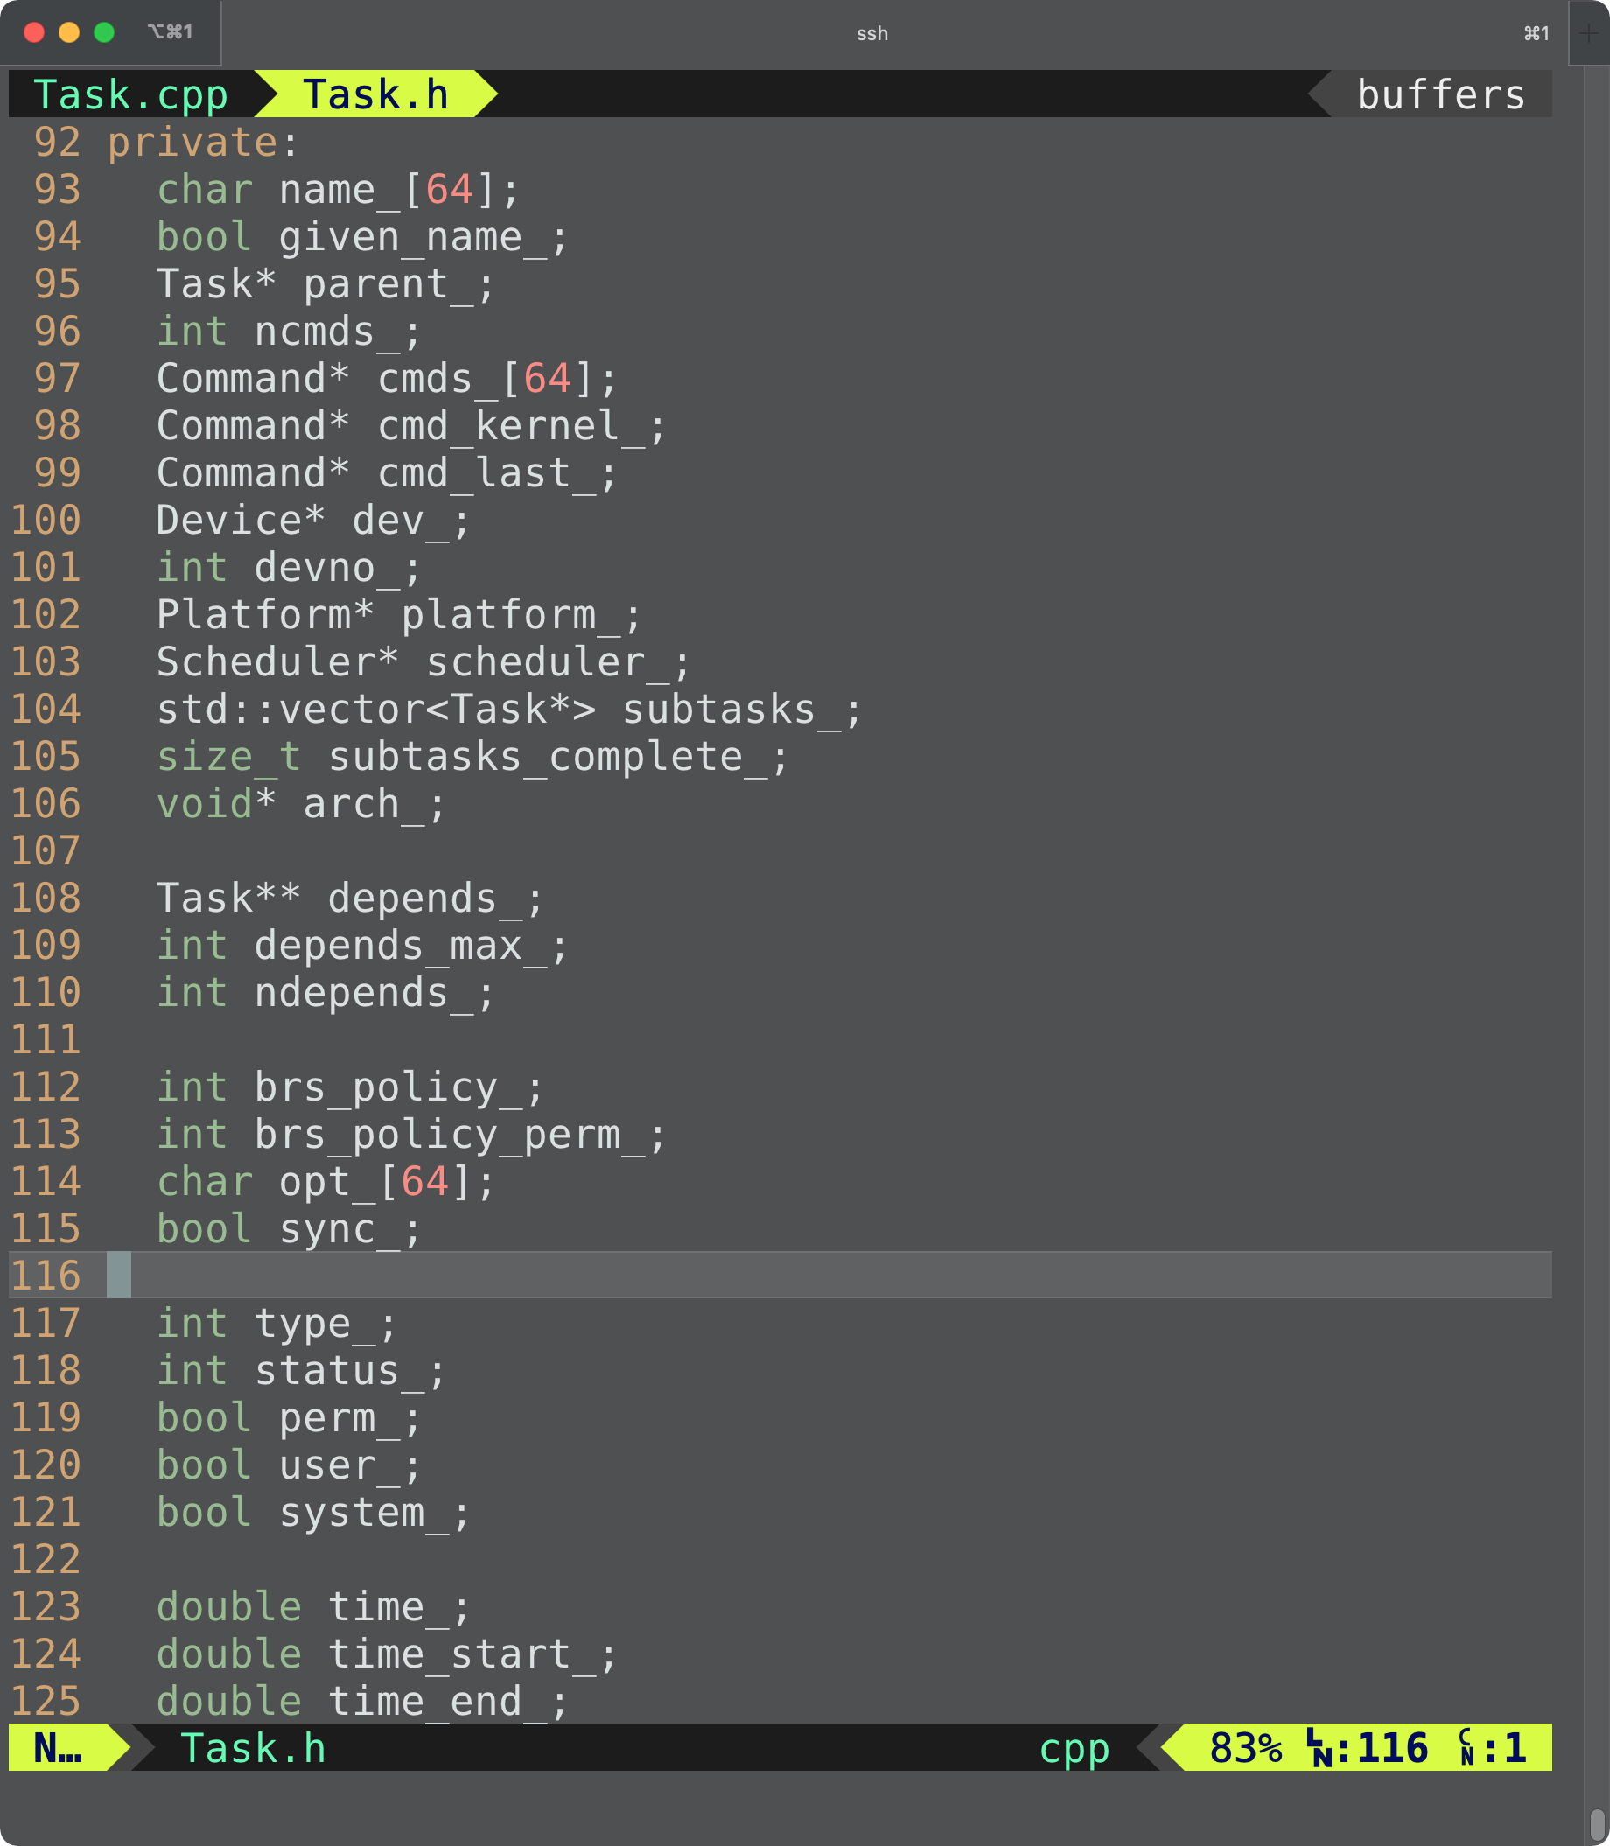
src/runtime/Task.h

Slide 27
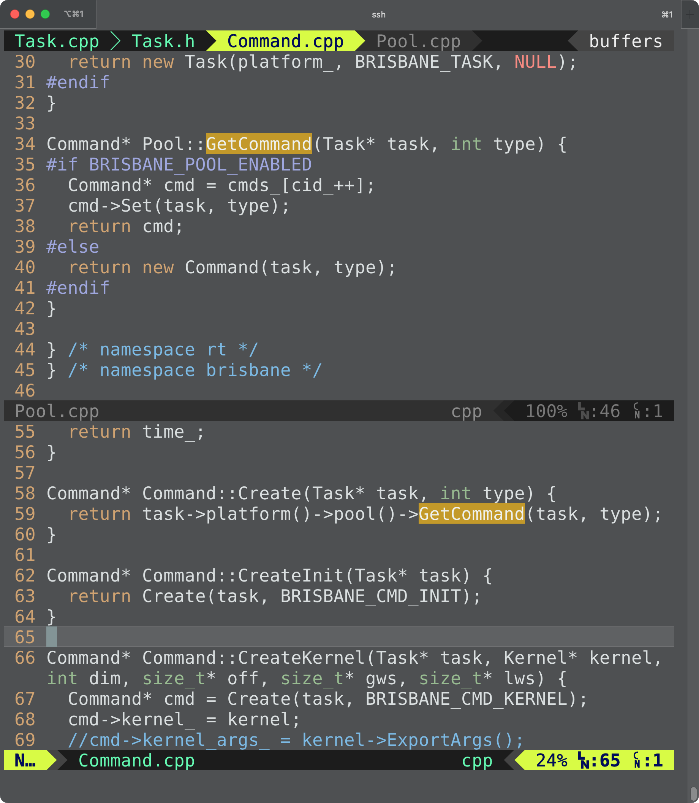
src/runtime/Command.cpp

Slide 28
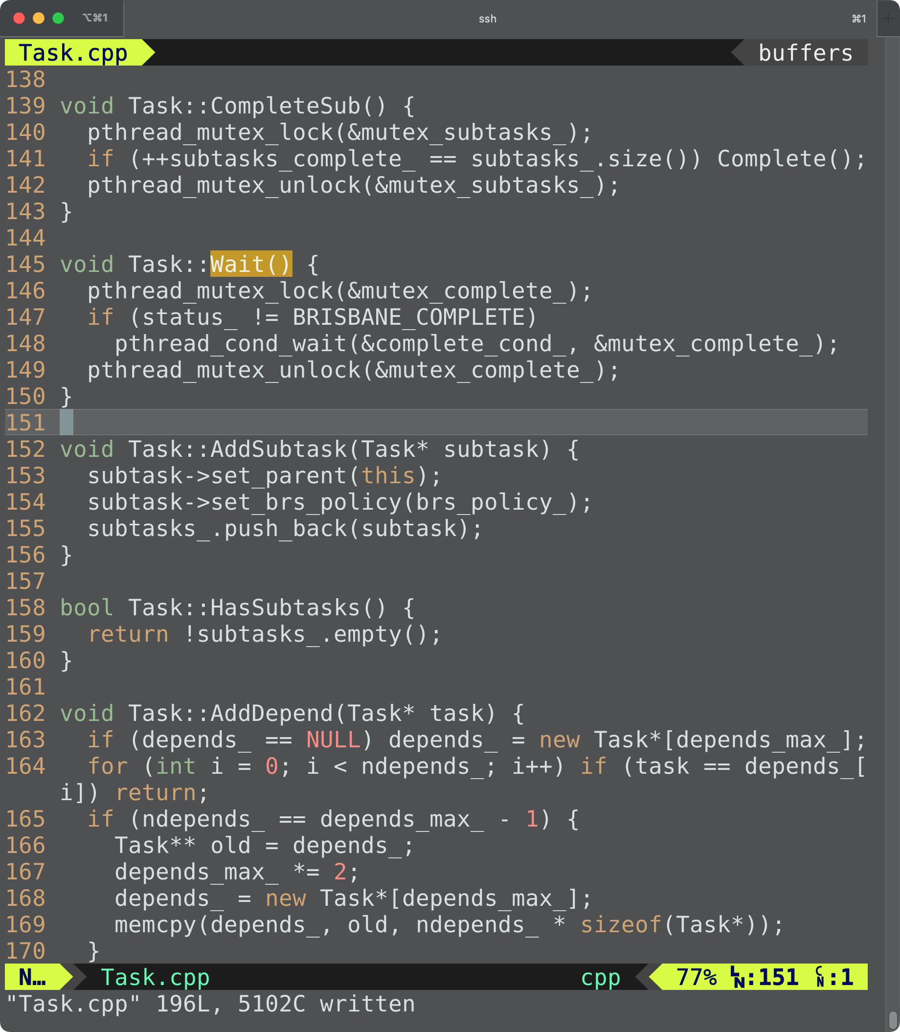
src/runtime/Task.cpp

Slide 29
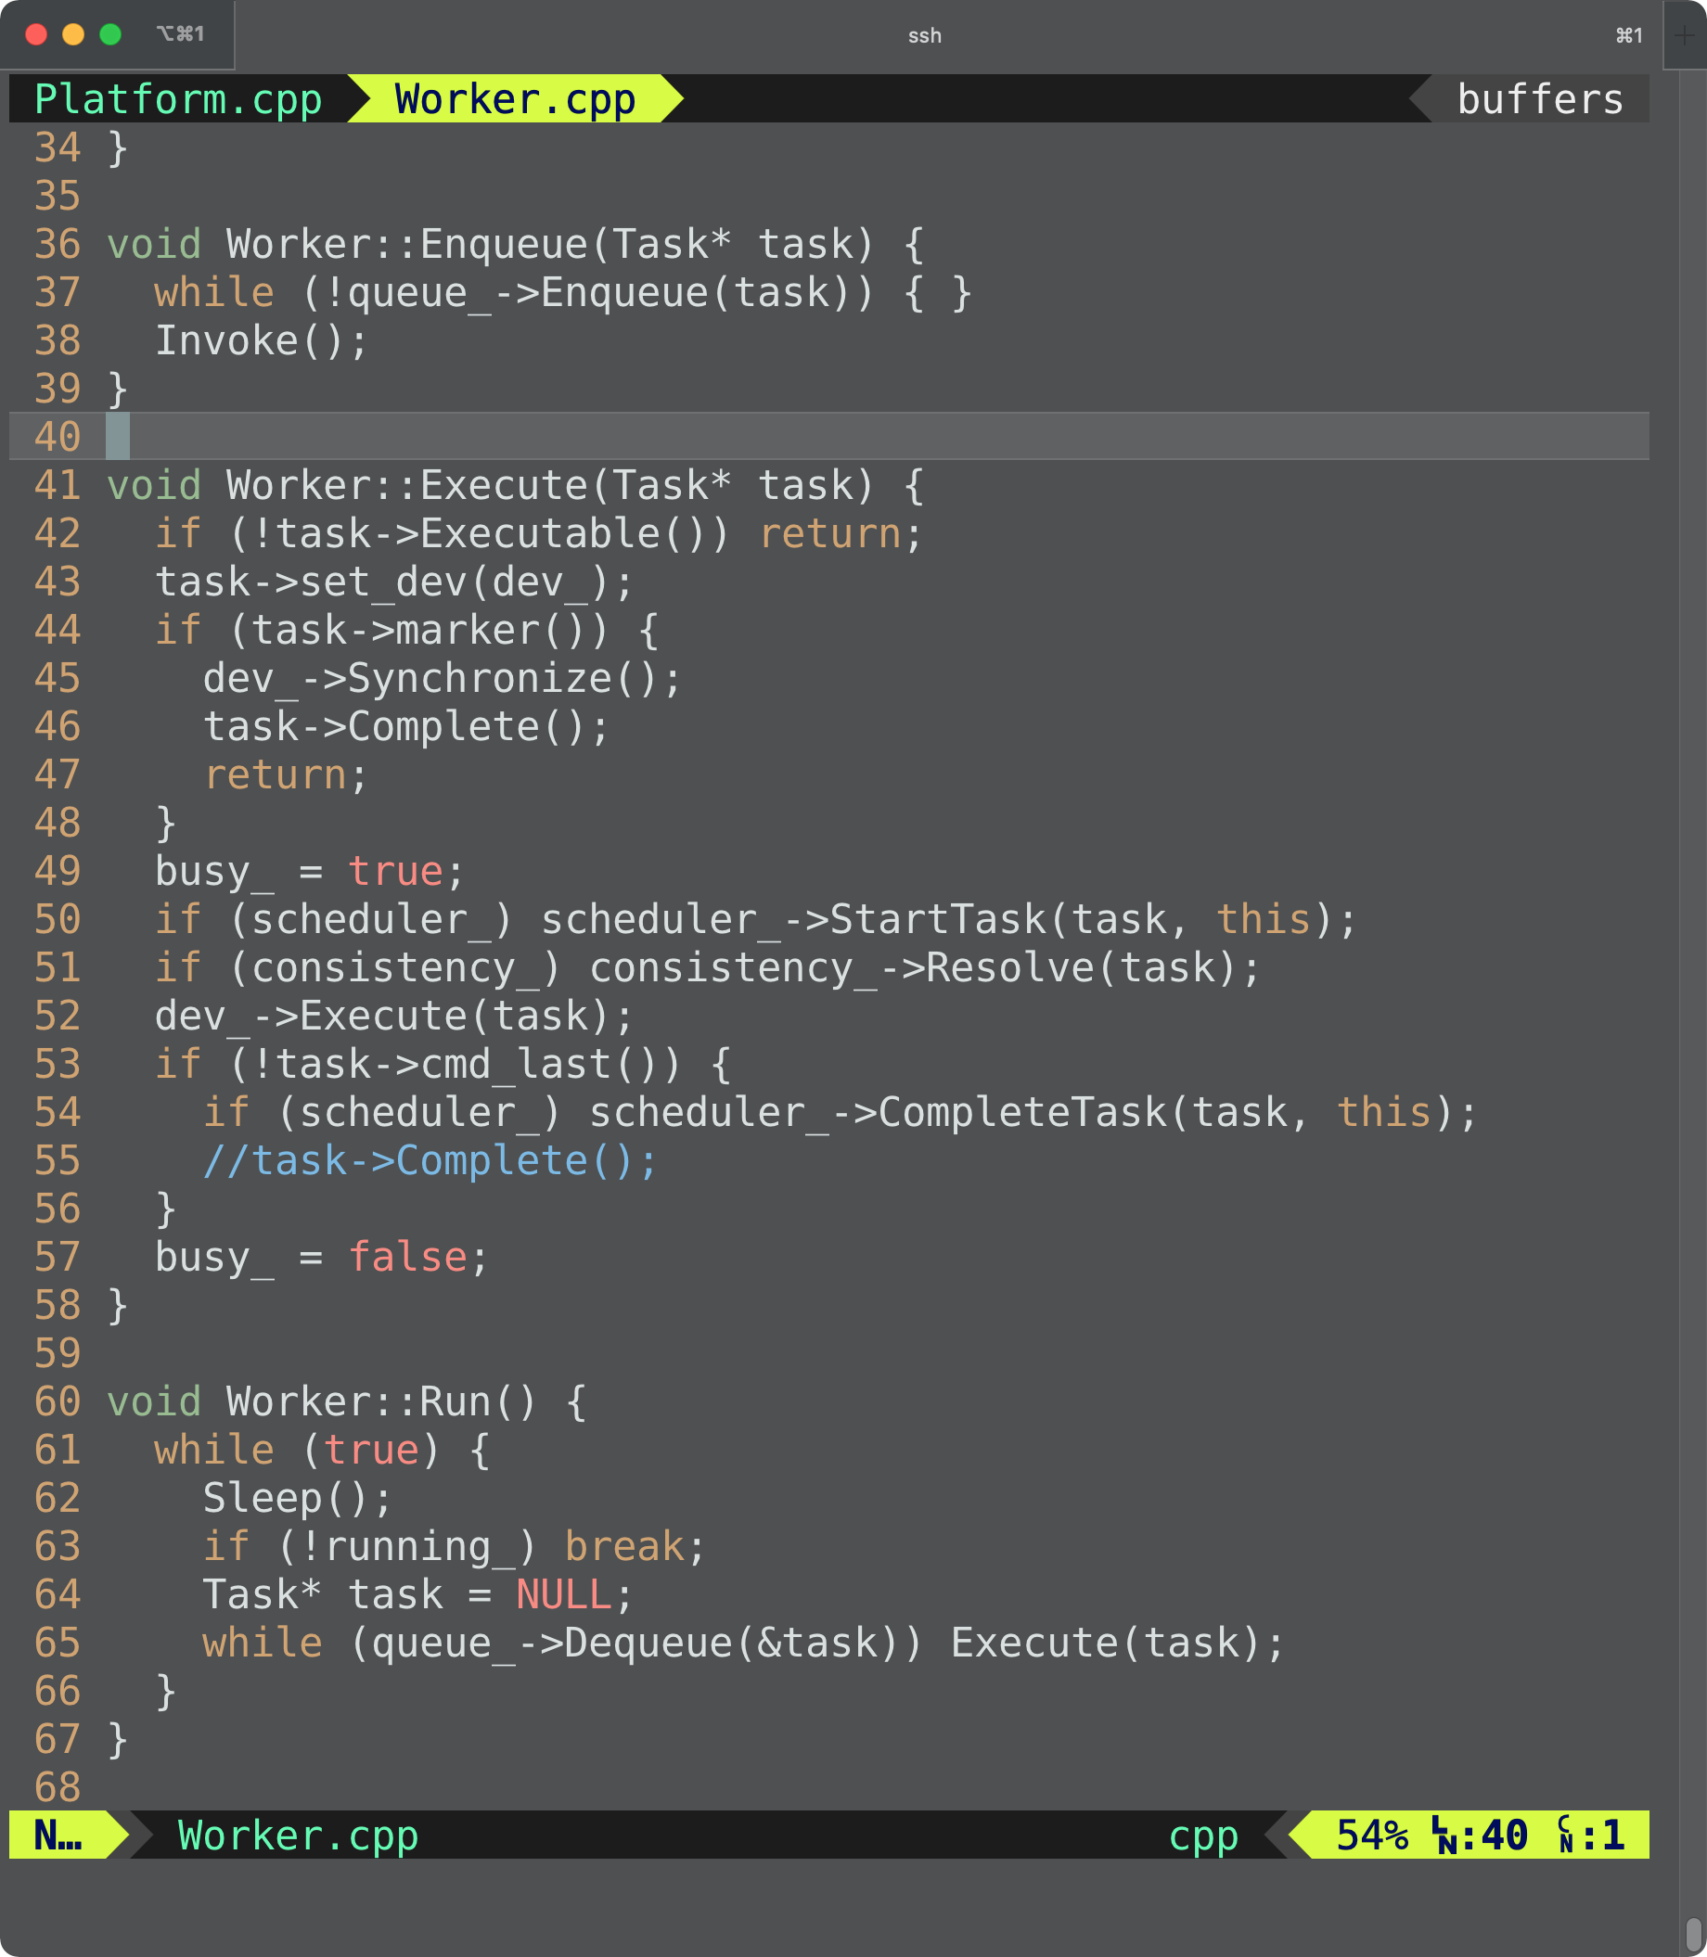
src/runtime/Worker.cpp

Slide 30
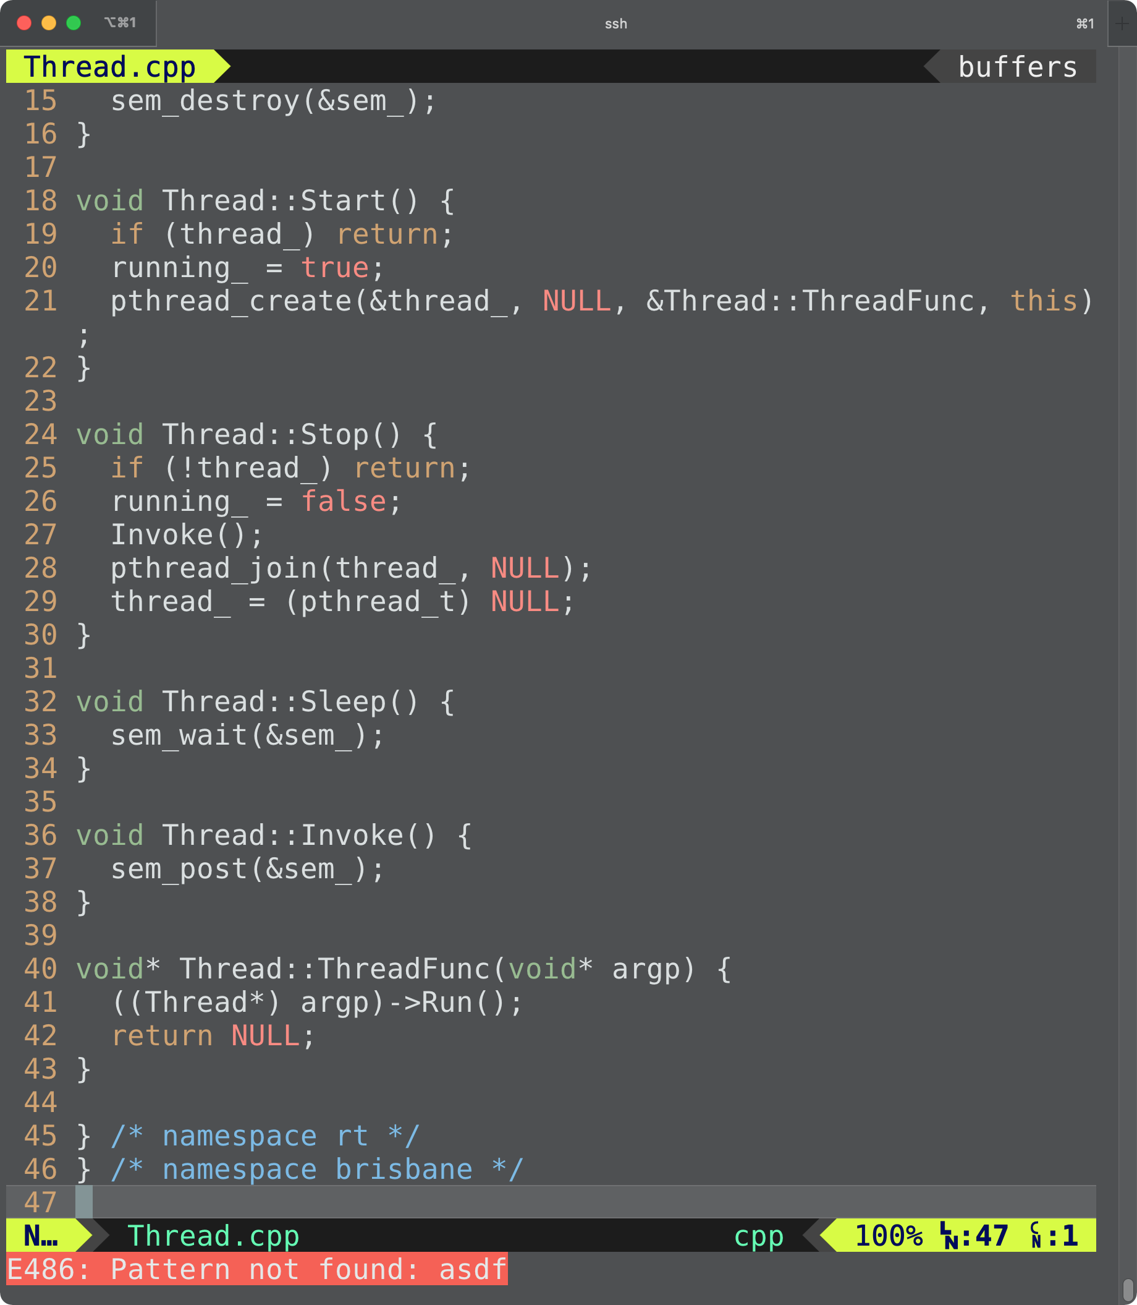
src/runtime/Thread.cpp

Slide 31
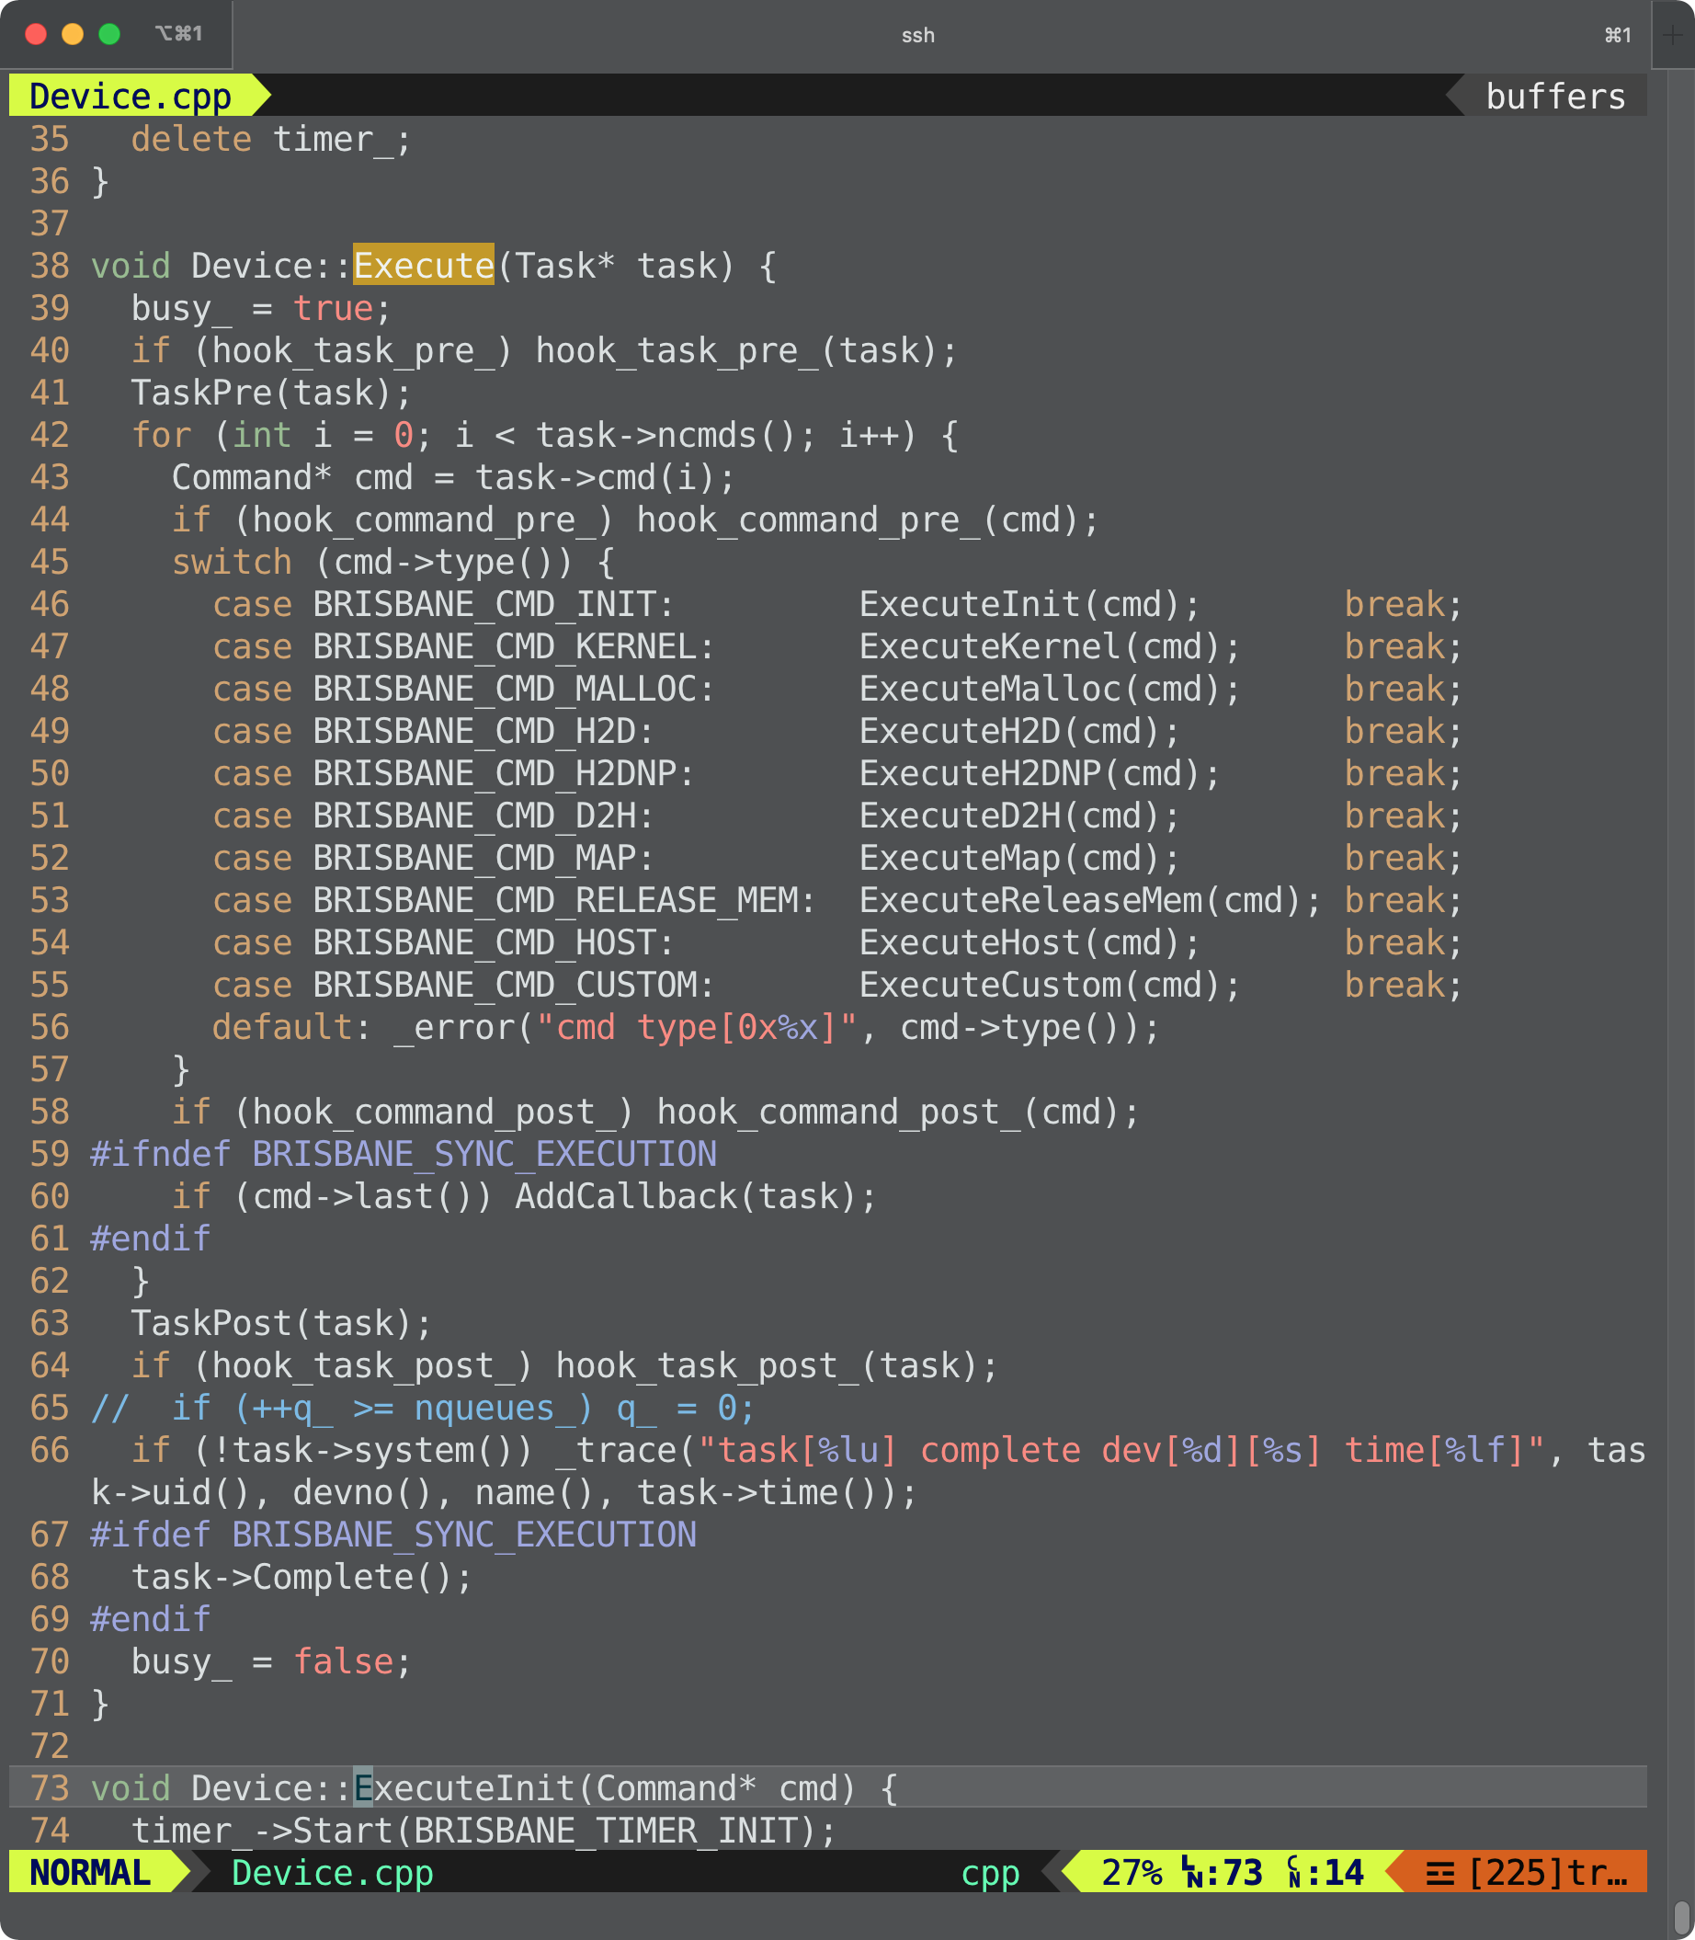
src/runtime/Device.cpp

Slide 32
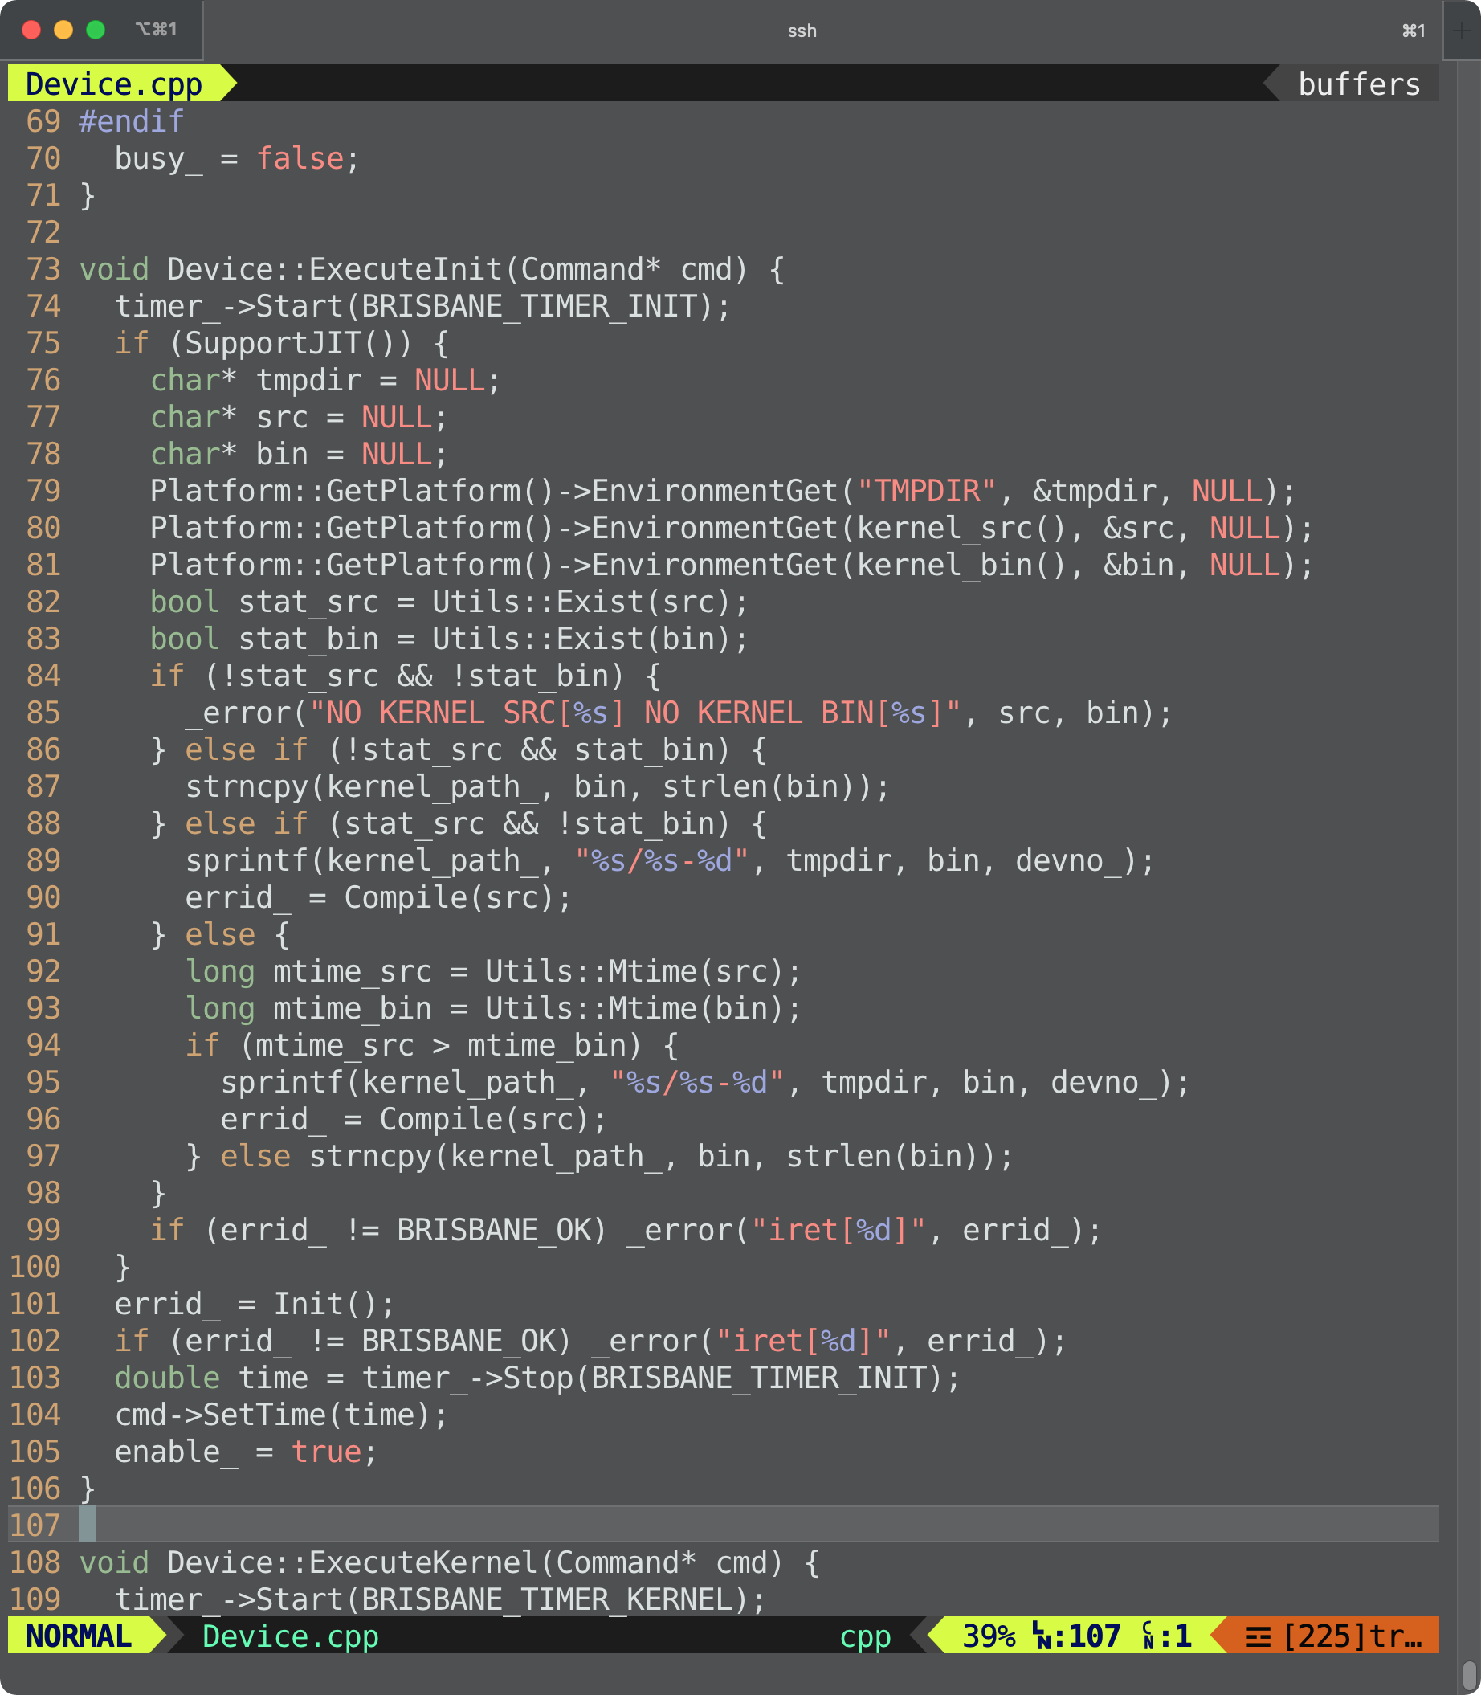
src/runtime/Device.cpp

Slide 33
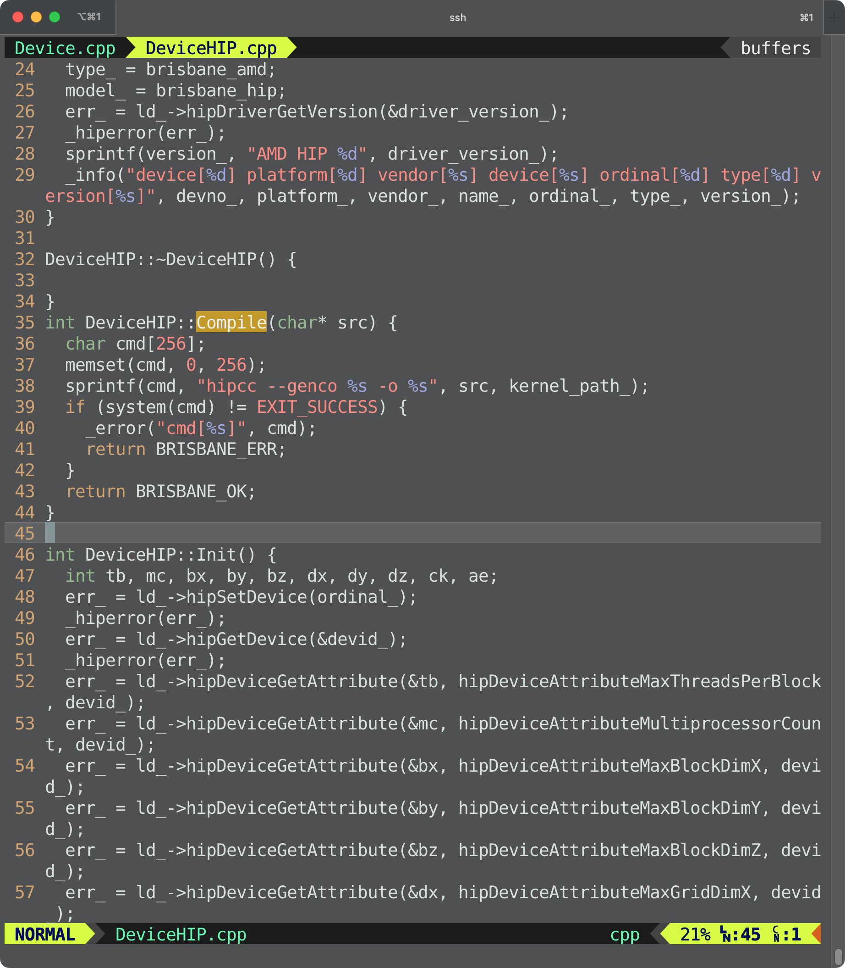
src/runtime/DeviceHIP.cpp

Slide 34
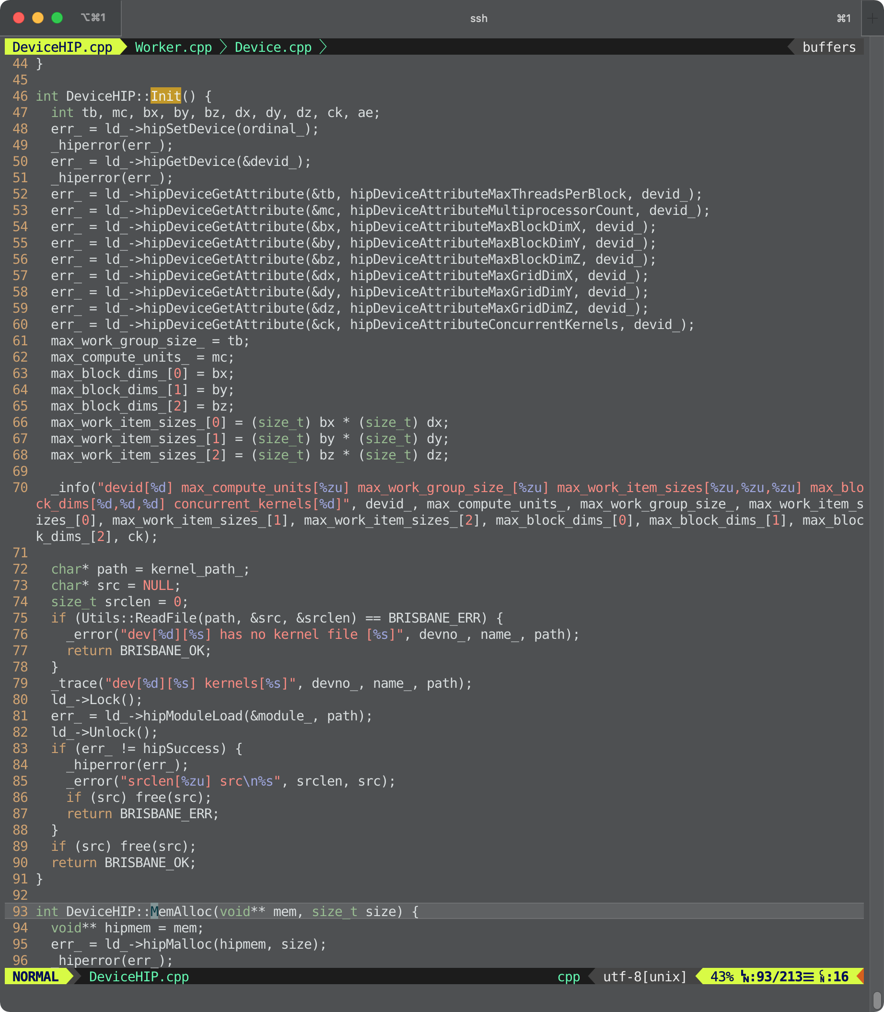
src/runtime/DeviceHIP.cpp

Slide 35
src/runtime/Platform.cpp
All Devices
Compiled kernels
Loaded kernels
Initialized underlying platform objects

Slide 36
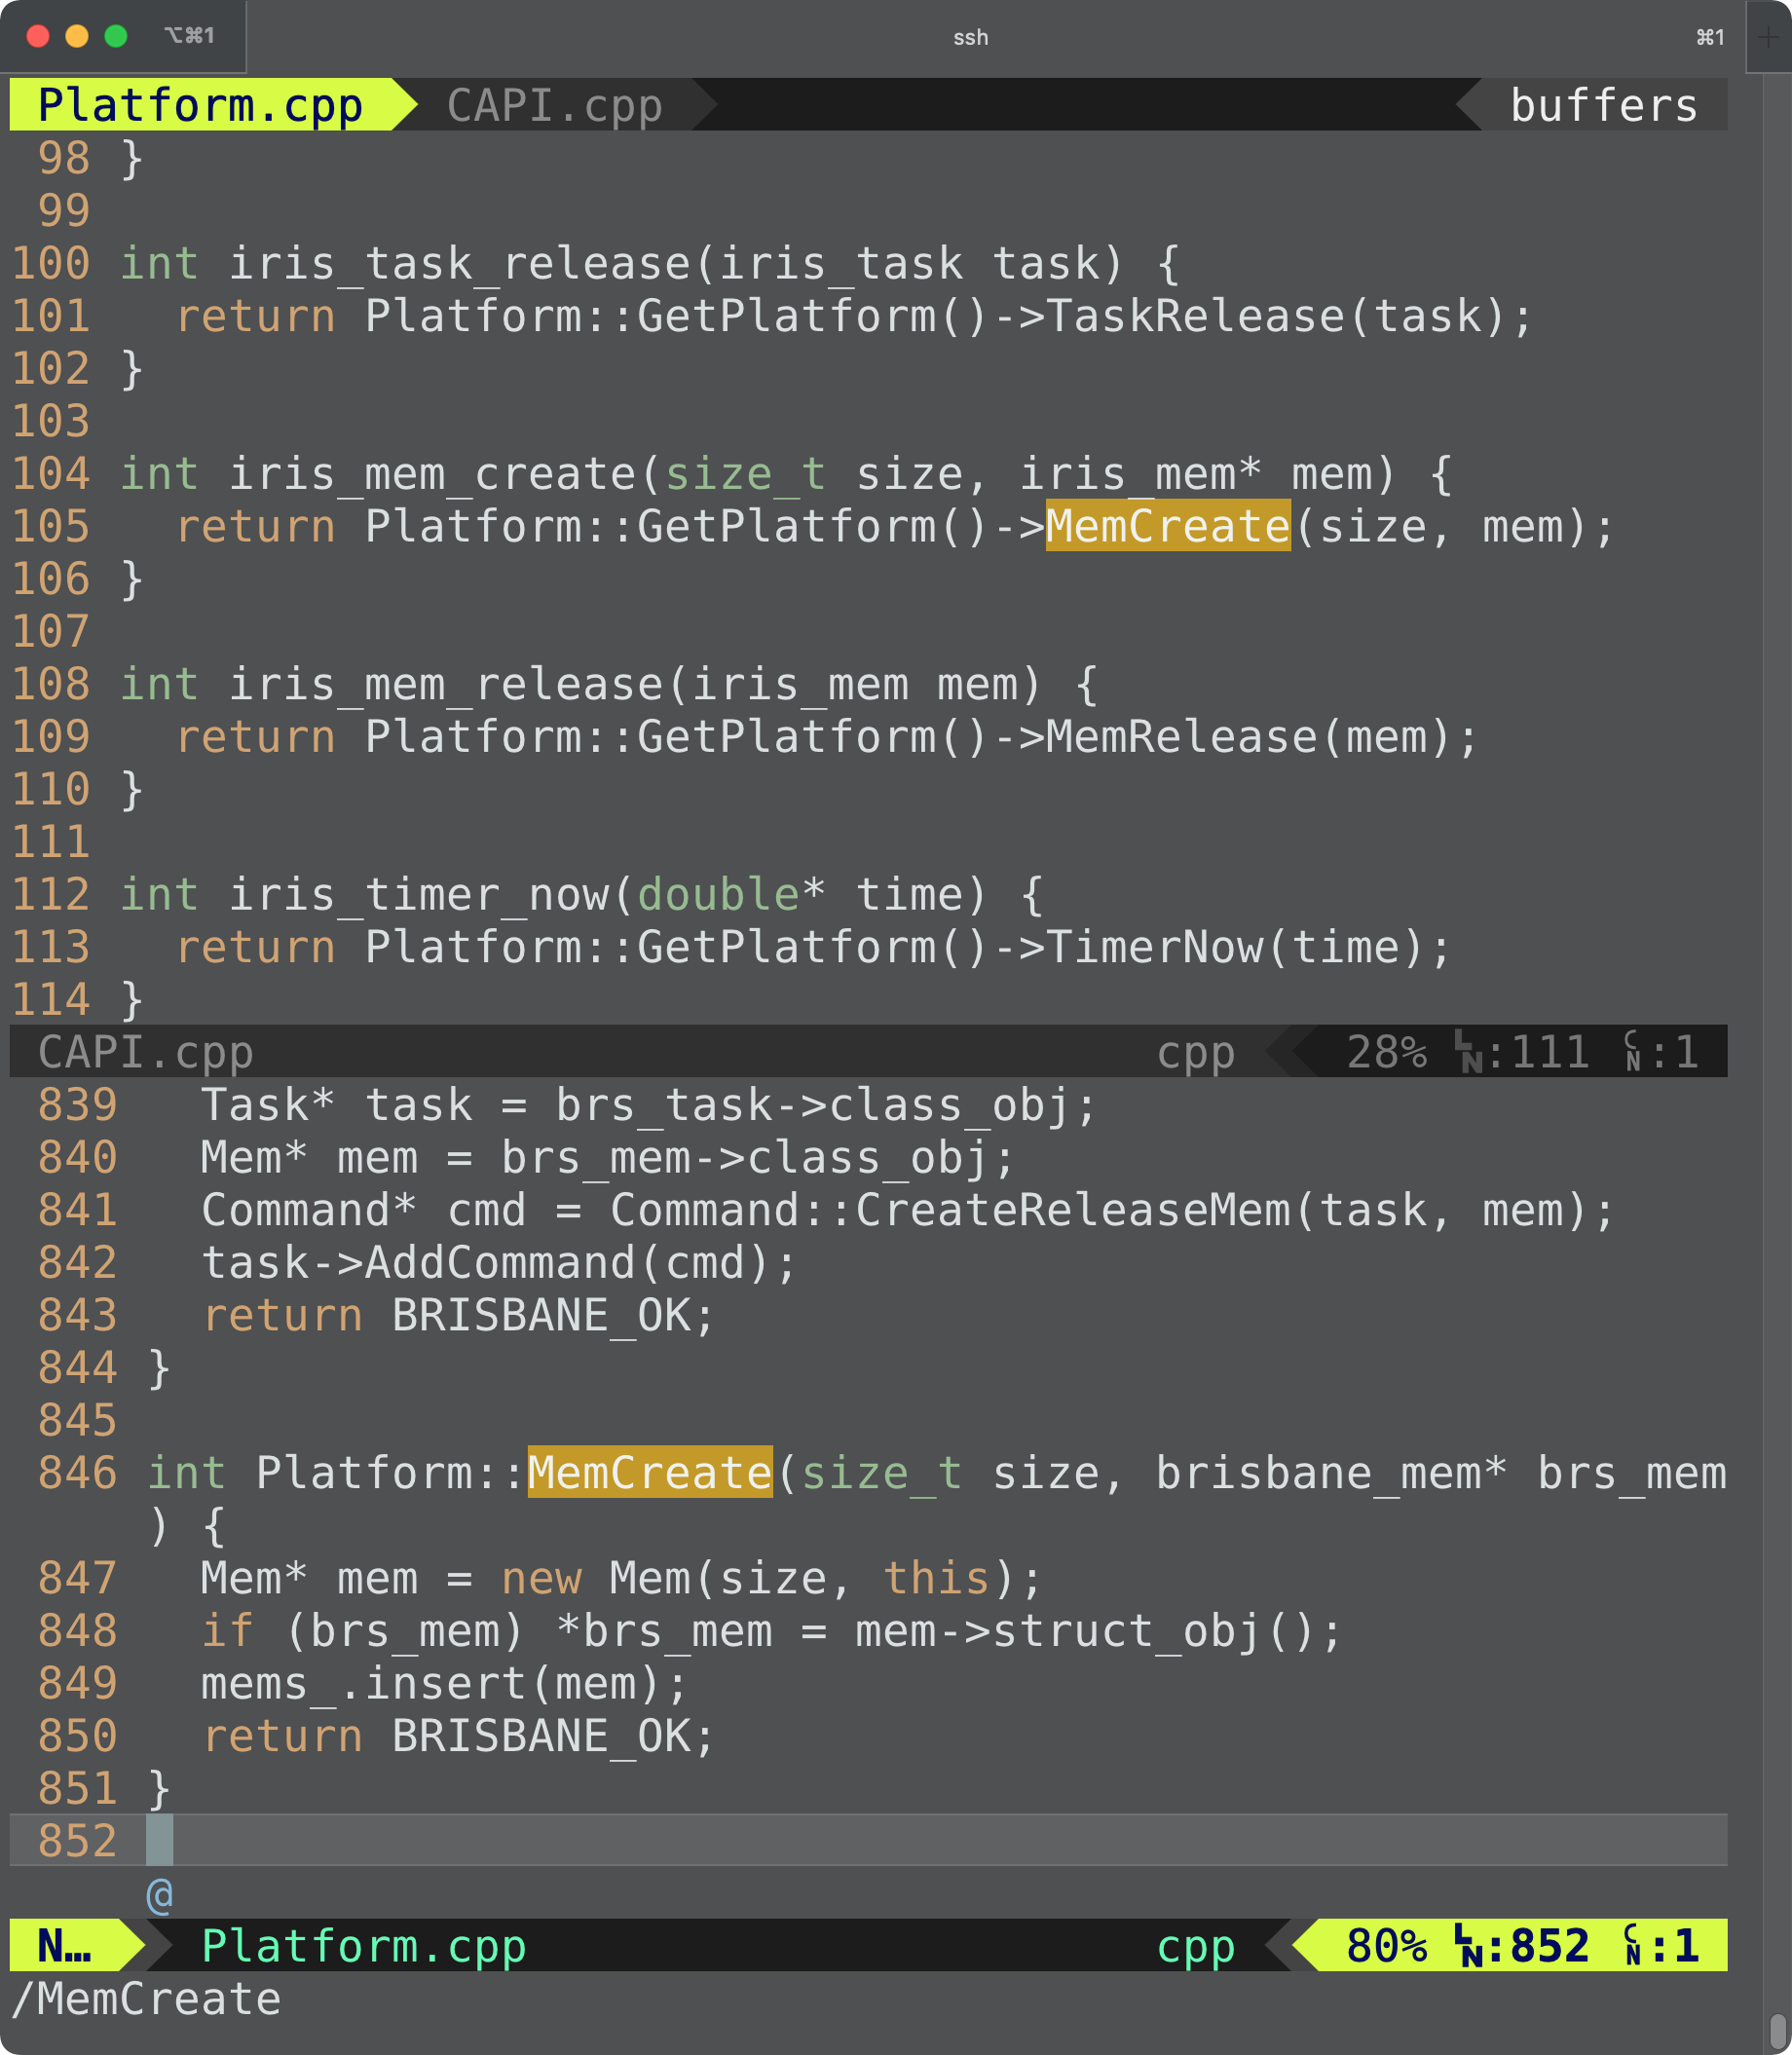
iris_mem_create()
IRIS Memory
A logical handle for multiple physical device memory spaces
Can be shared across multiple devices

Slide 37
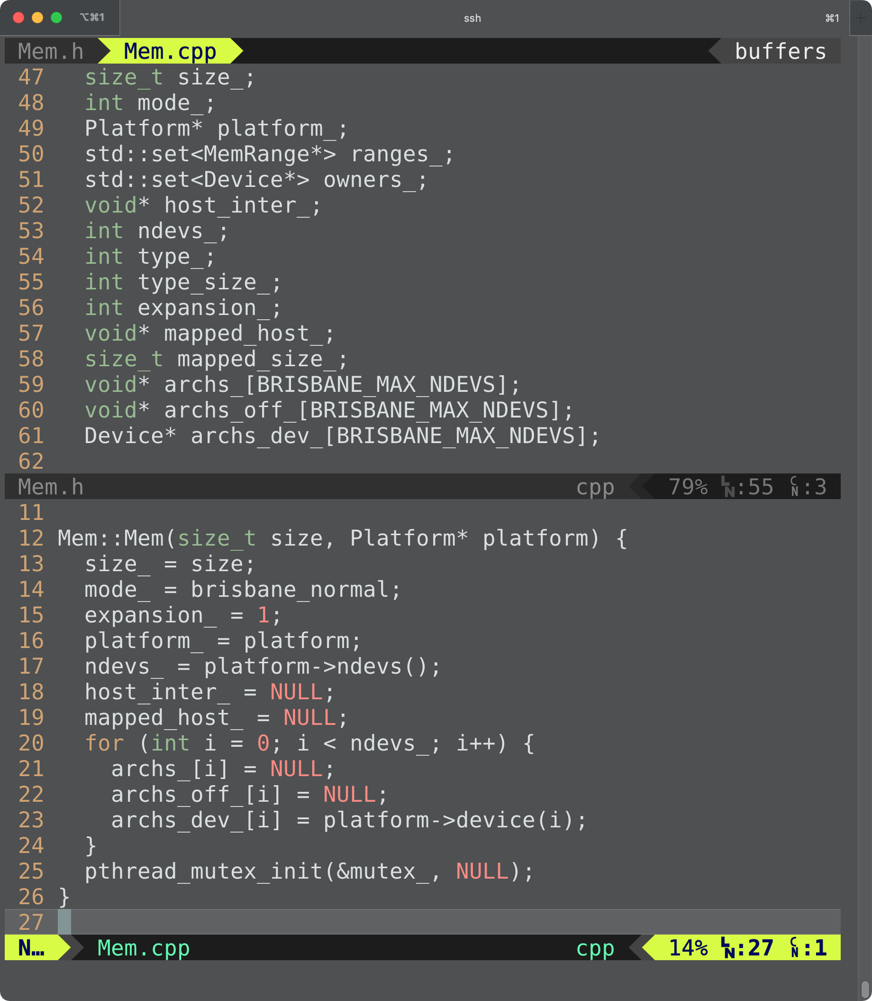
src/runtime/Mem.cpp

Slide 38
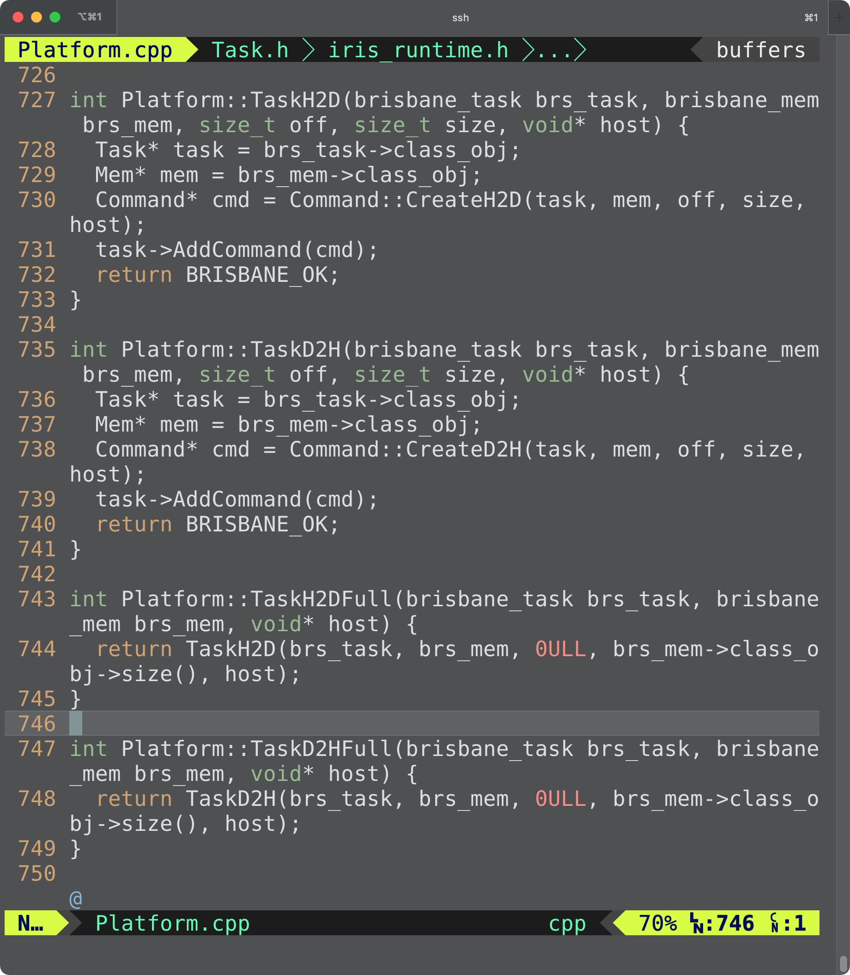
iris_task_h2d_full()

Slide 39
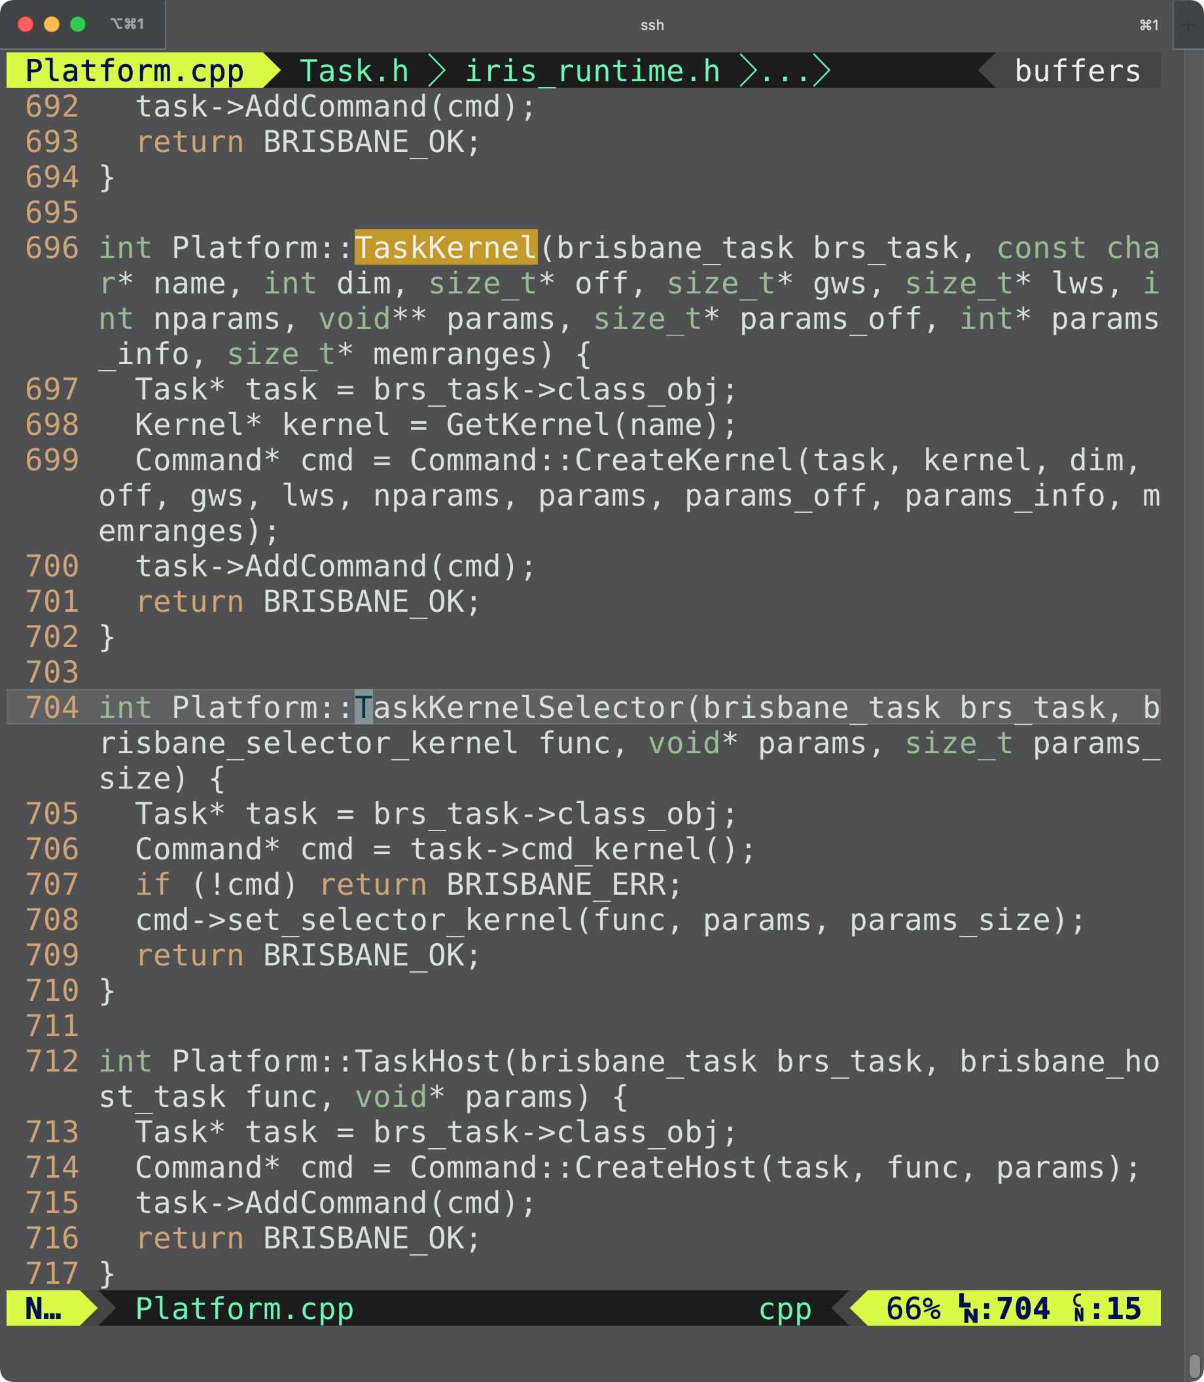
iris_task_kernel()

Slide 40
iris_task_submit()
Task 0
AMD GPU
HIP
H2D(X)
Kernel0(Z, X)

Slide 41
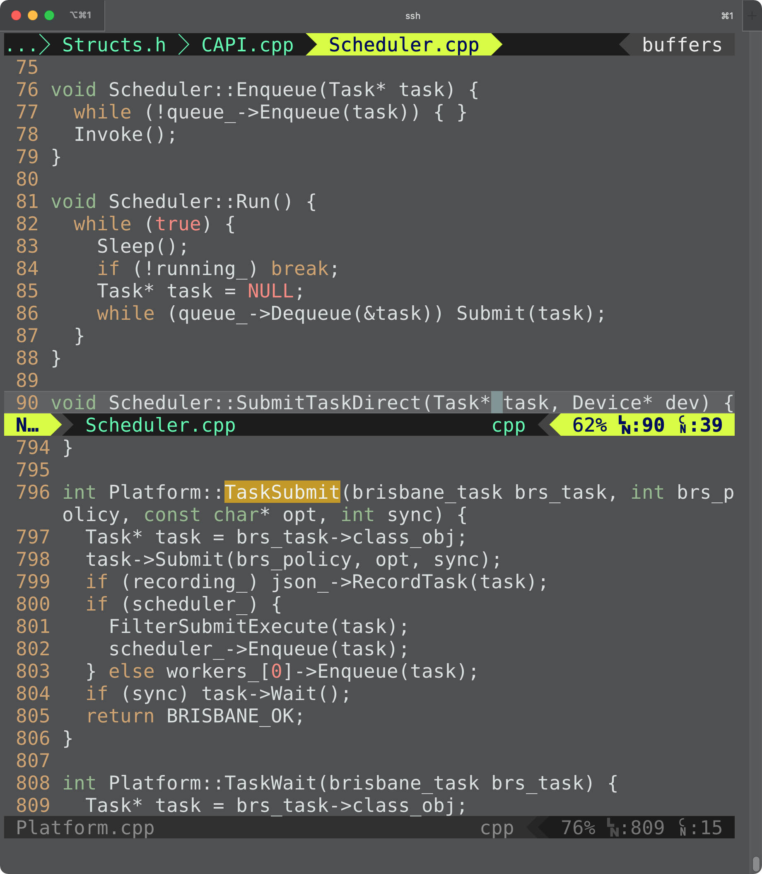
iris_task_submit()

Slide 42
iris_task_submit()

Slide 43
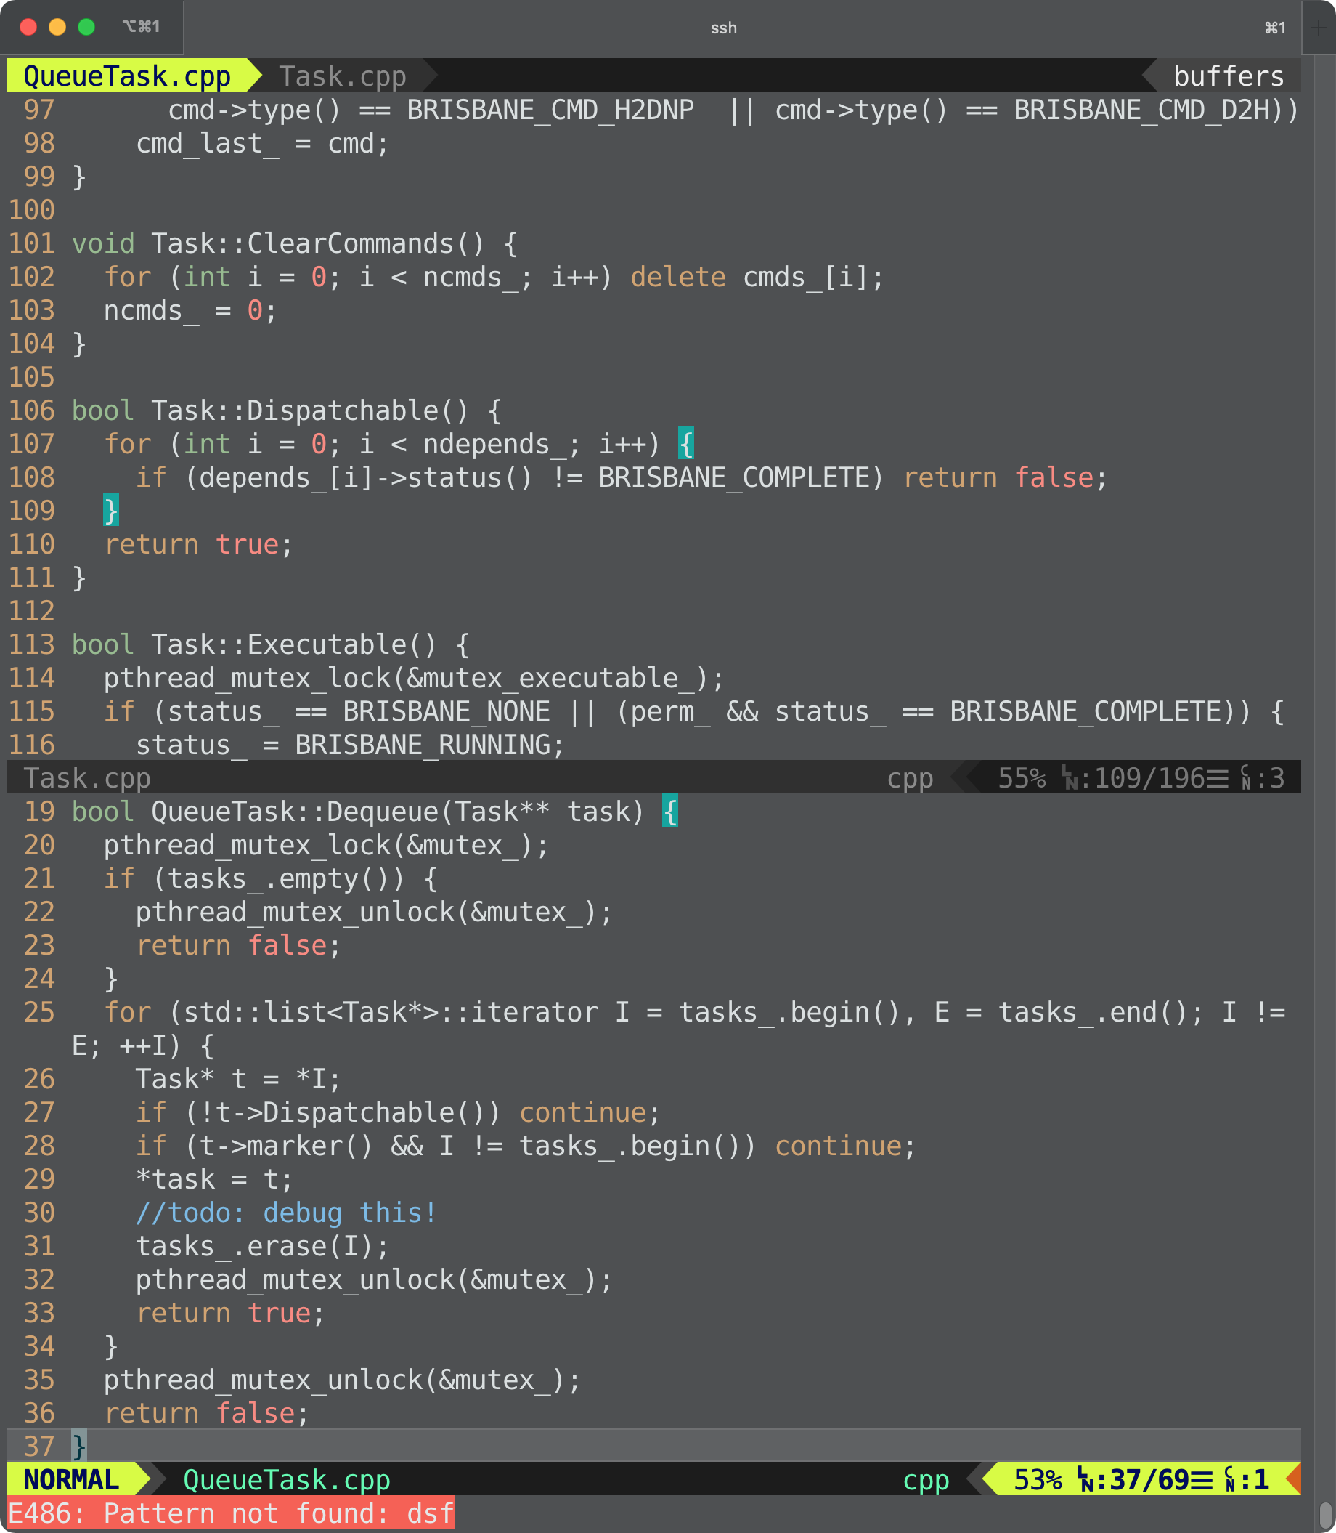
src/runtime/QueueTask.cpp

Slide 44
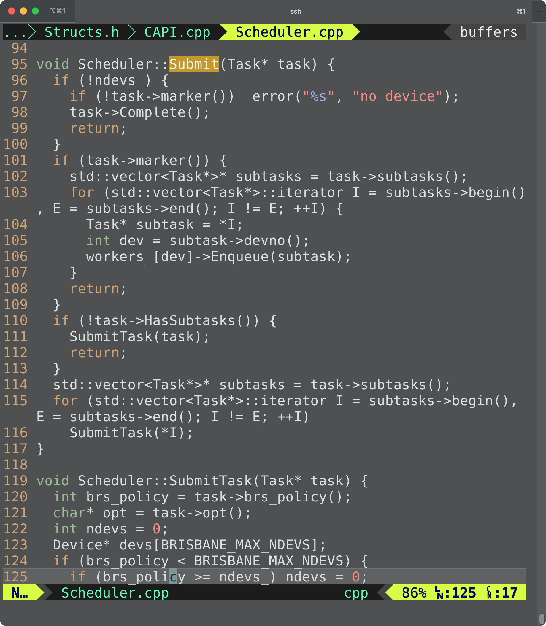
src/runtime/Scheduler.cpp

Slide 45
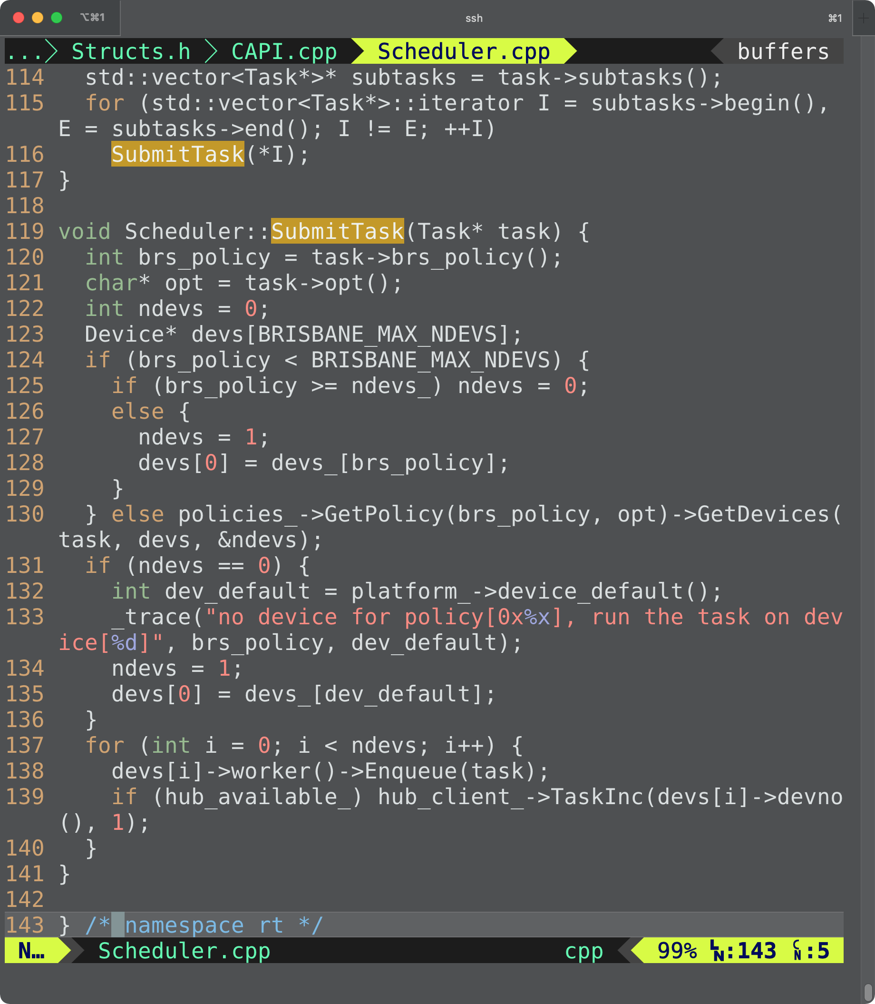
src/runtime/Scheduler.cpp

Slide 46
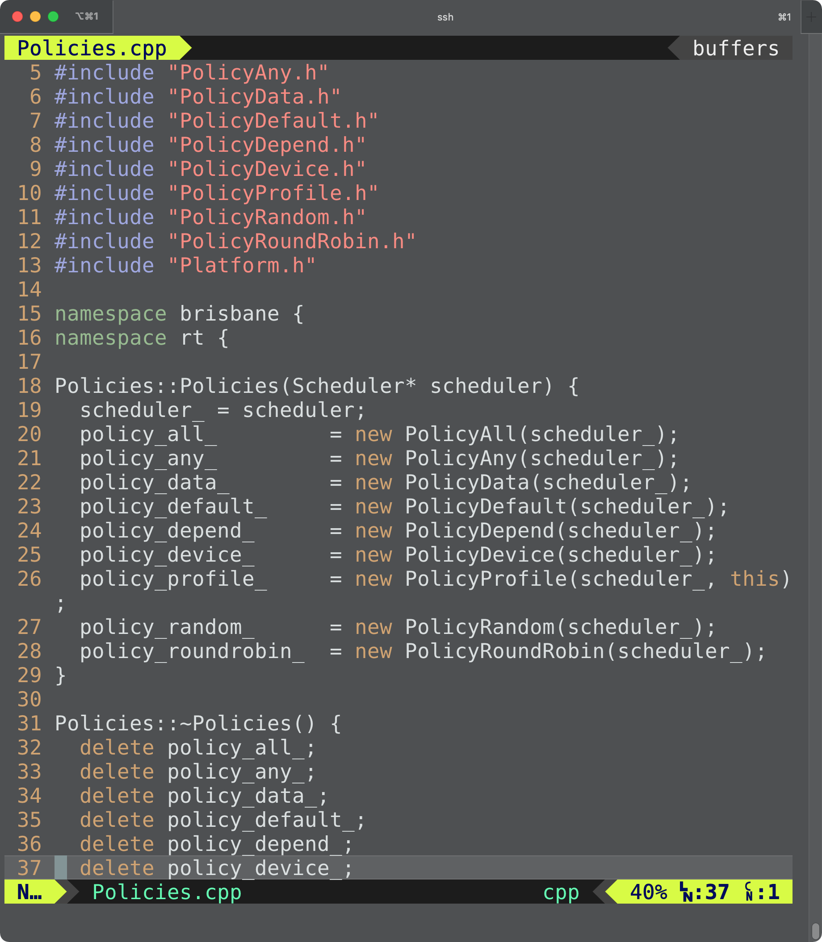
src/runtime/Policies.cpp

Slide 47
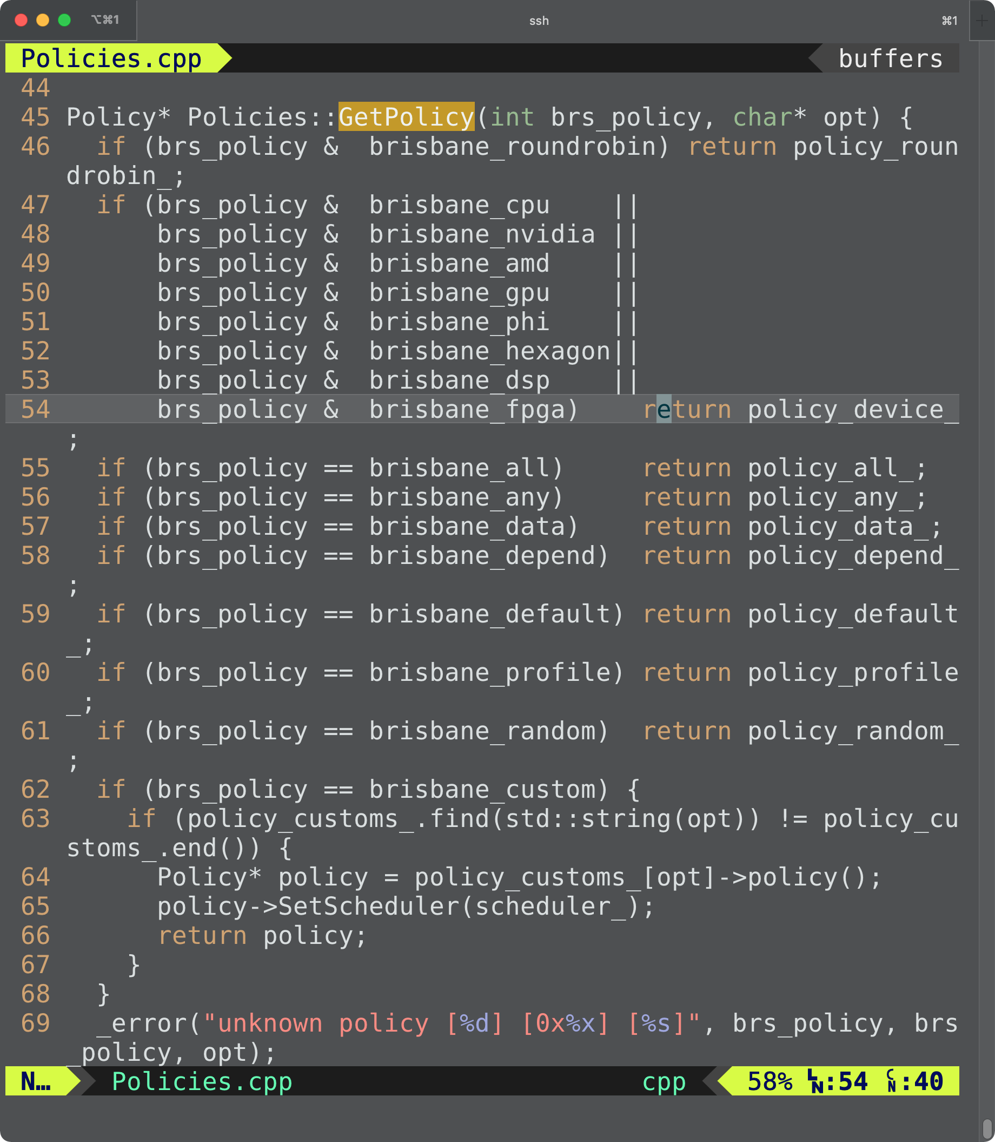
src/runtime/Policies.cpp

Slide 48
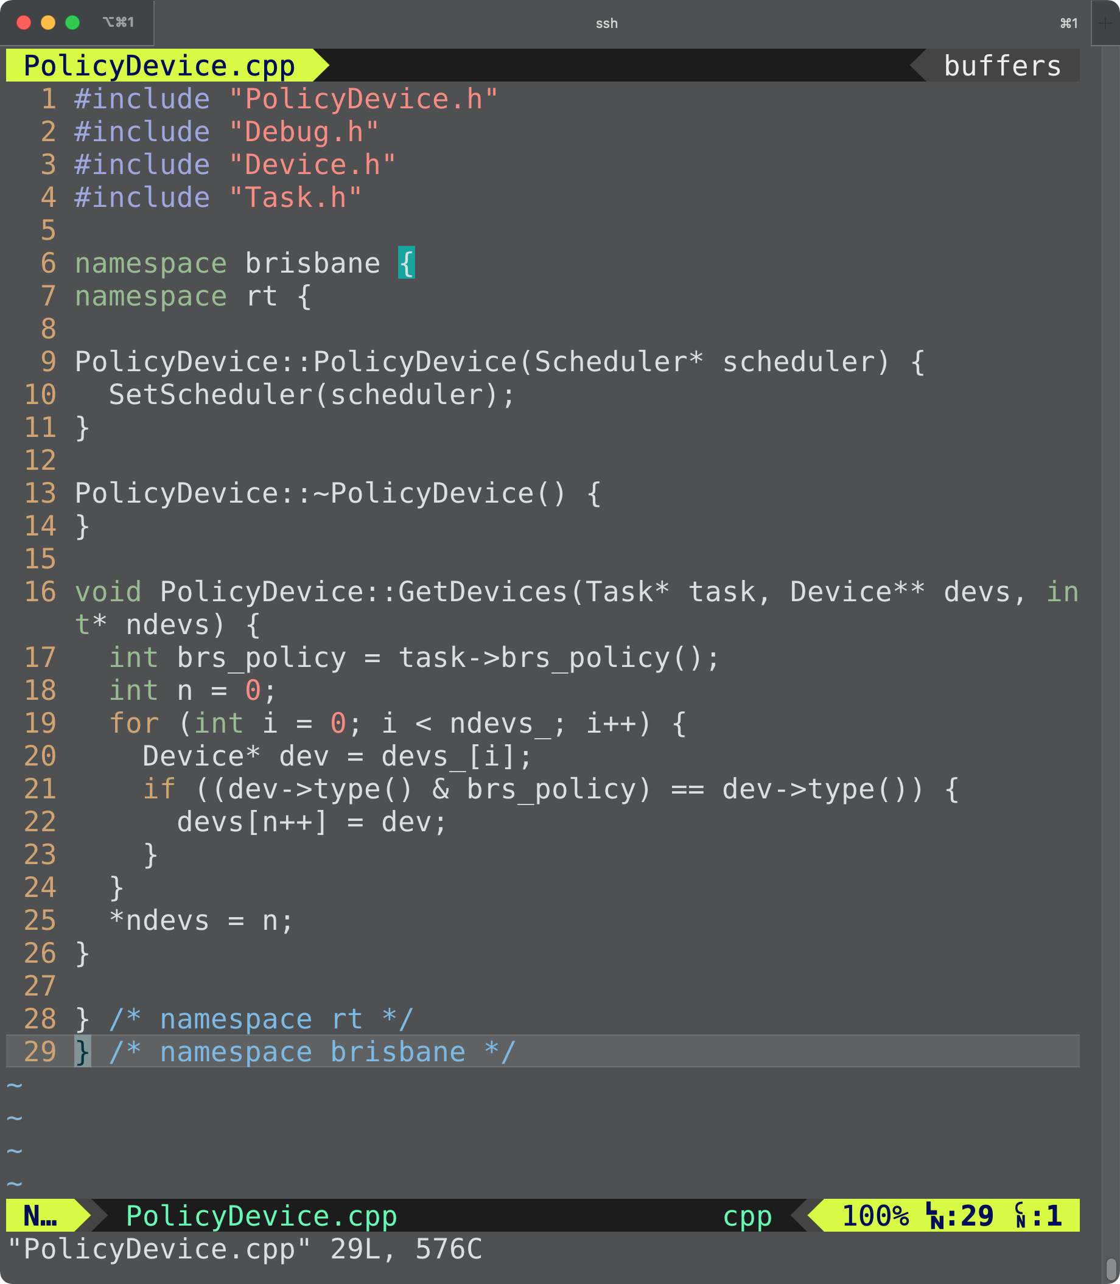
src/runtime/PolicyDevice.cpp

Slide 49
src/runtime/PolicyDevice.cpp

Slide 50
src/runtime/Device.cpp

Slide 51
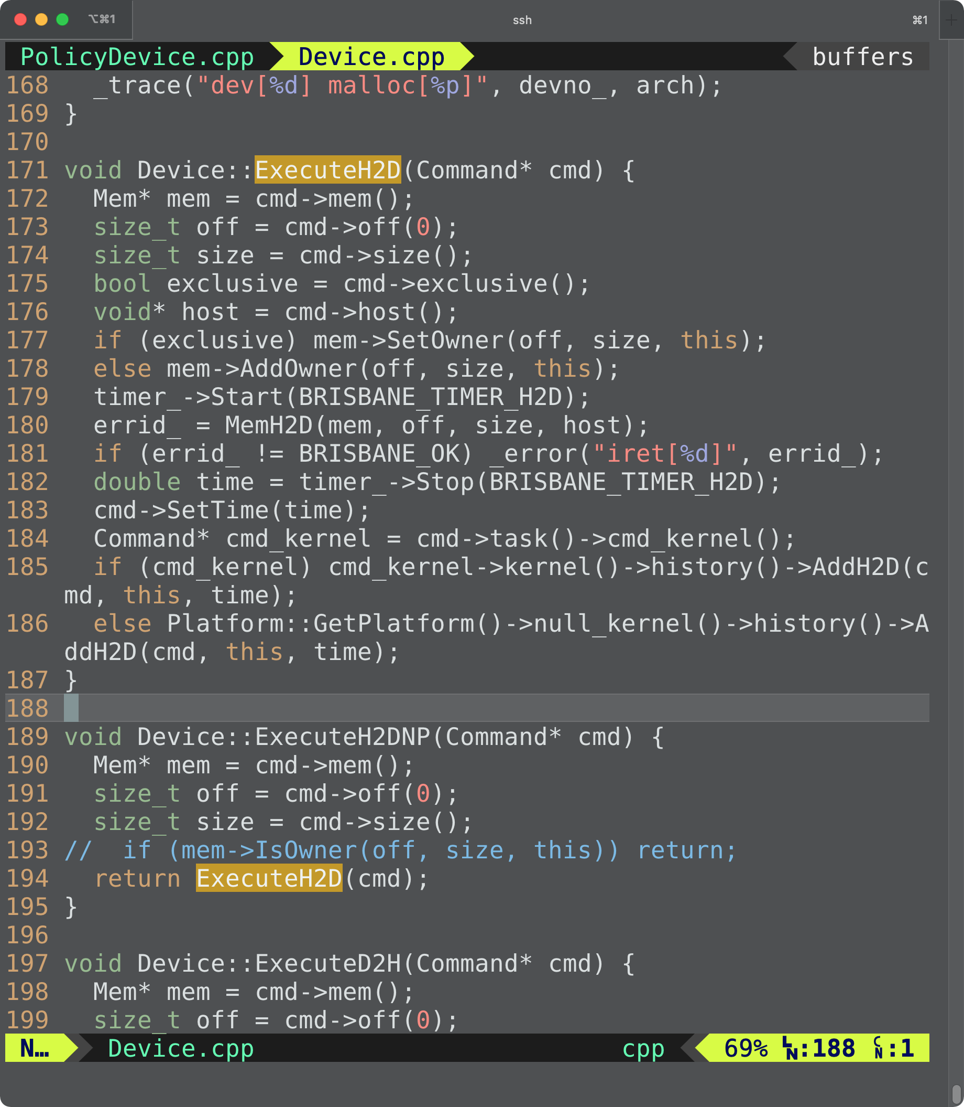
src/runtime/Device.cpp

Slide 52
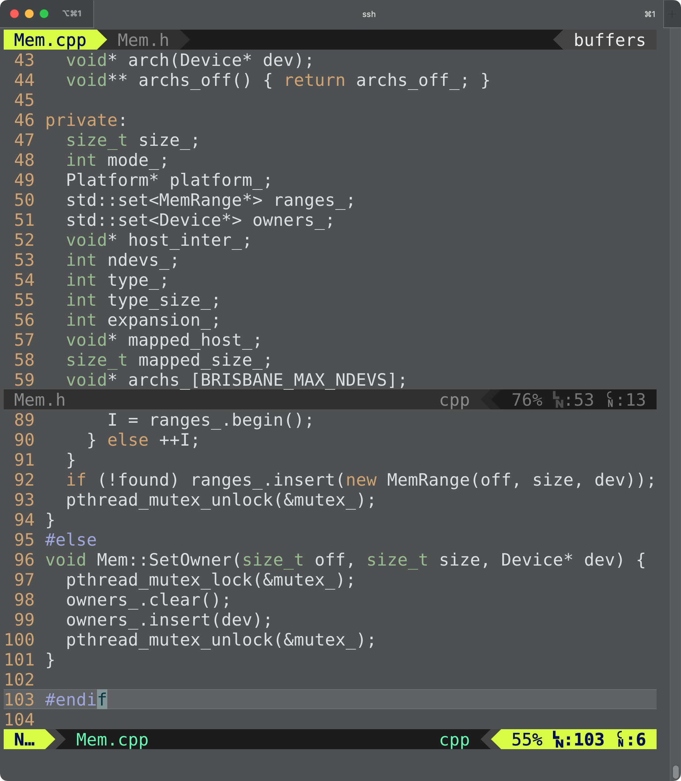
Owner List of IRIS Memory
An IRIS memory has an owner list
An owner list can have zero or more owners
Empty when the memory is created
An owner of an IRIS memory is a device that has the latest copy of the IRIS memory content in its device memory

Slide 53
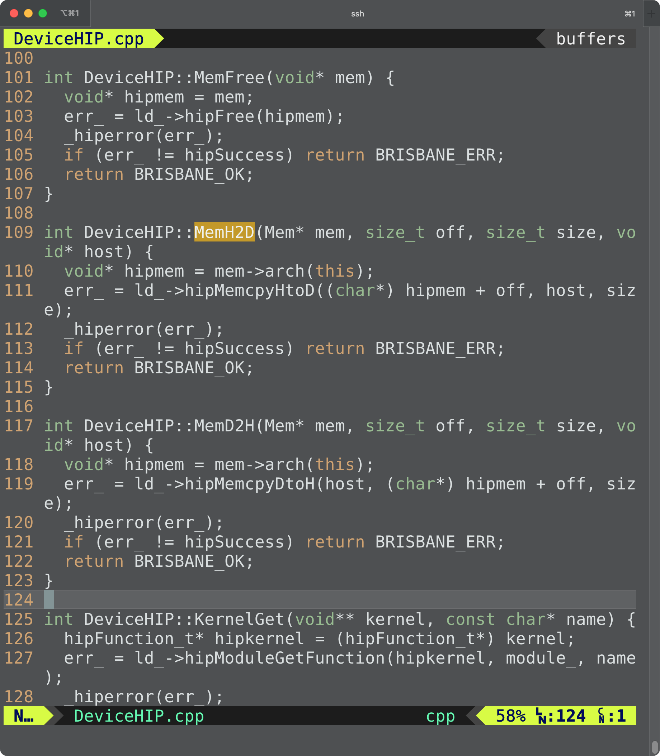
src/runtime/DeviceHIP.cpp

Slide 54
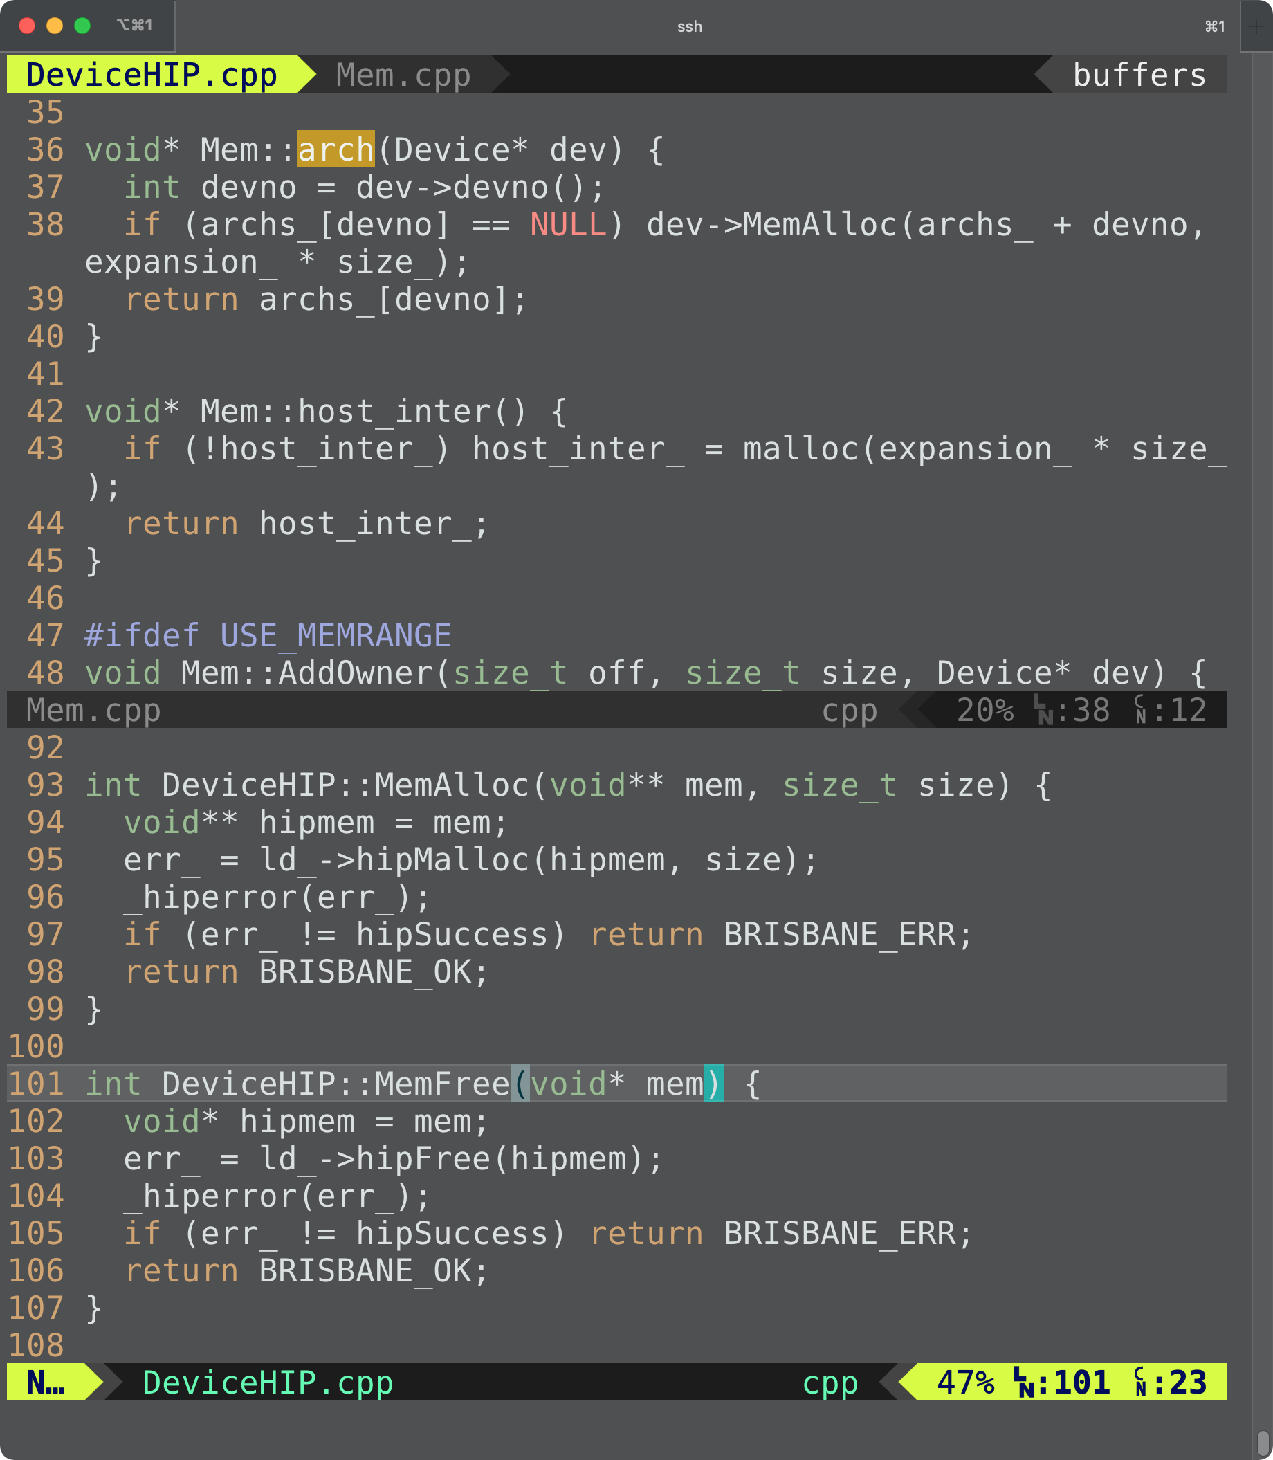
src/runtime/DeviceHIP.cpp

Slide 55
IRIS Memory Arch Table
Memory
archs_[] | API | Device
0 | posix_memalign(size_) | AMD CPU [0]
1 | hipMalloc(size_) | AMD GPU [1]
2 | hipMalloc(size_) | AMD GPU [2]

Slide 56
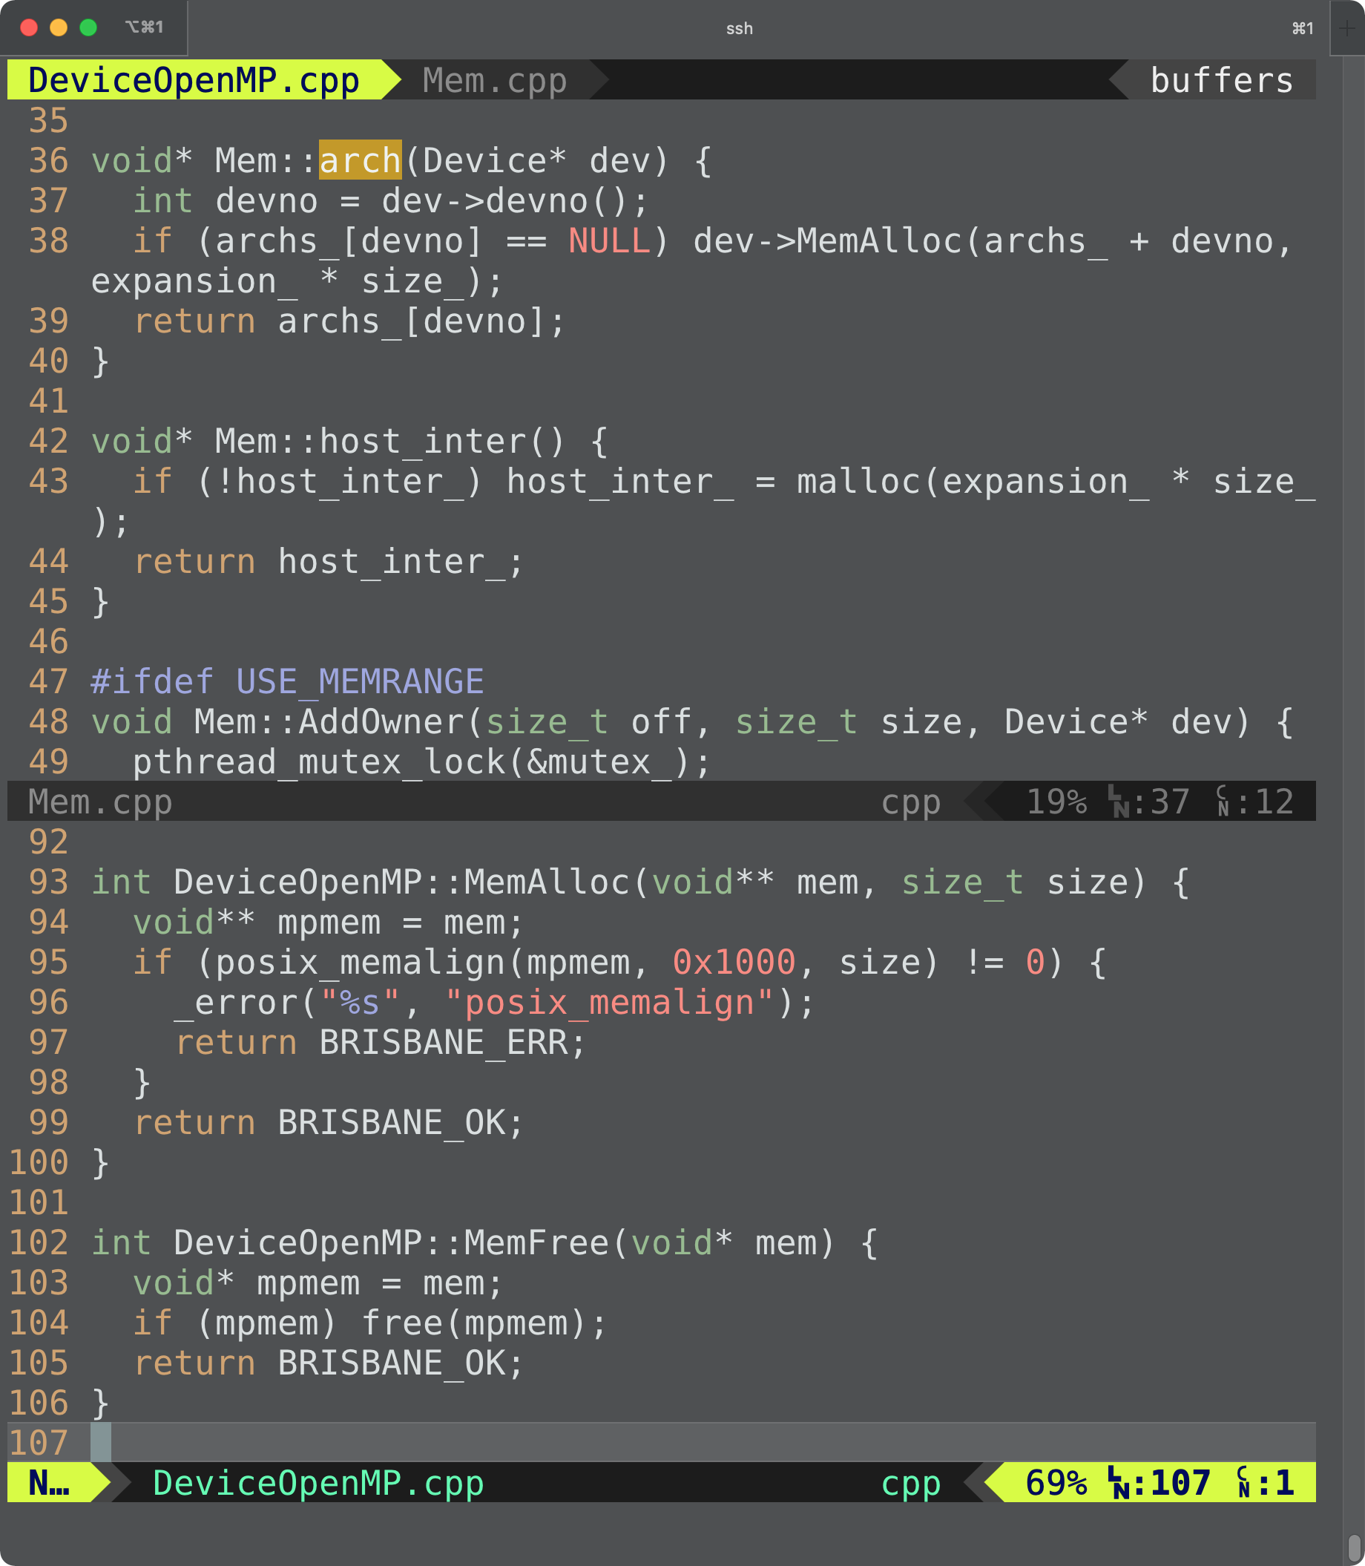
IRIS Memory Arch Table
Memory
archs_[] | API | Device
0 | posix_memalign(size_) | AMD CPU [0]
1 | hipMalloc(size_) | AMD GPU [1]
2 | hipMalloc(size_) | AMD GPU [2]

Slide 57
src/runtime/DeviceHIP.cpp

Slide 58
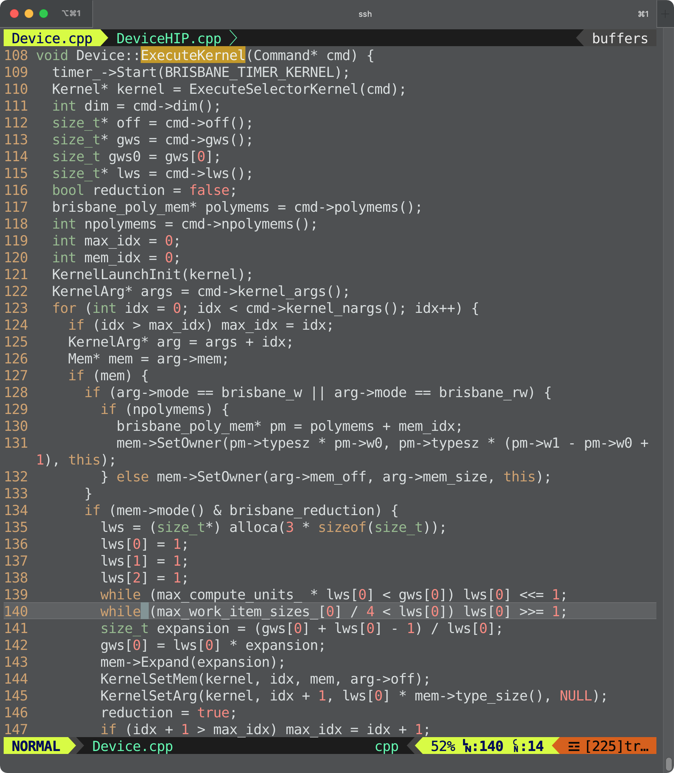
src/runtime/Device.cpp

Slide 59
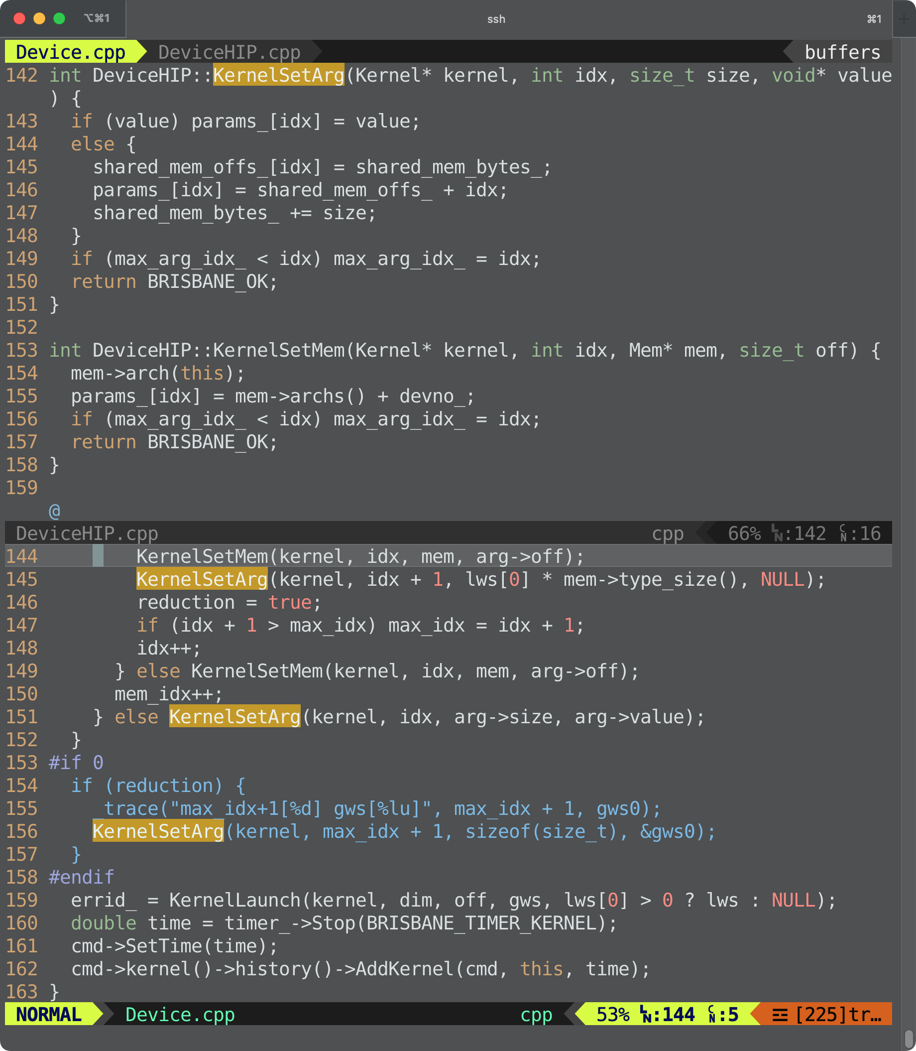
src/runtime/DeviceHIP.cpp

Slide 60
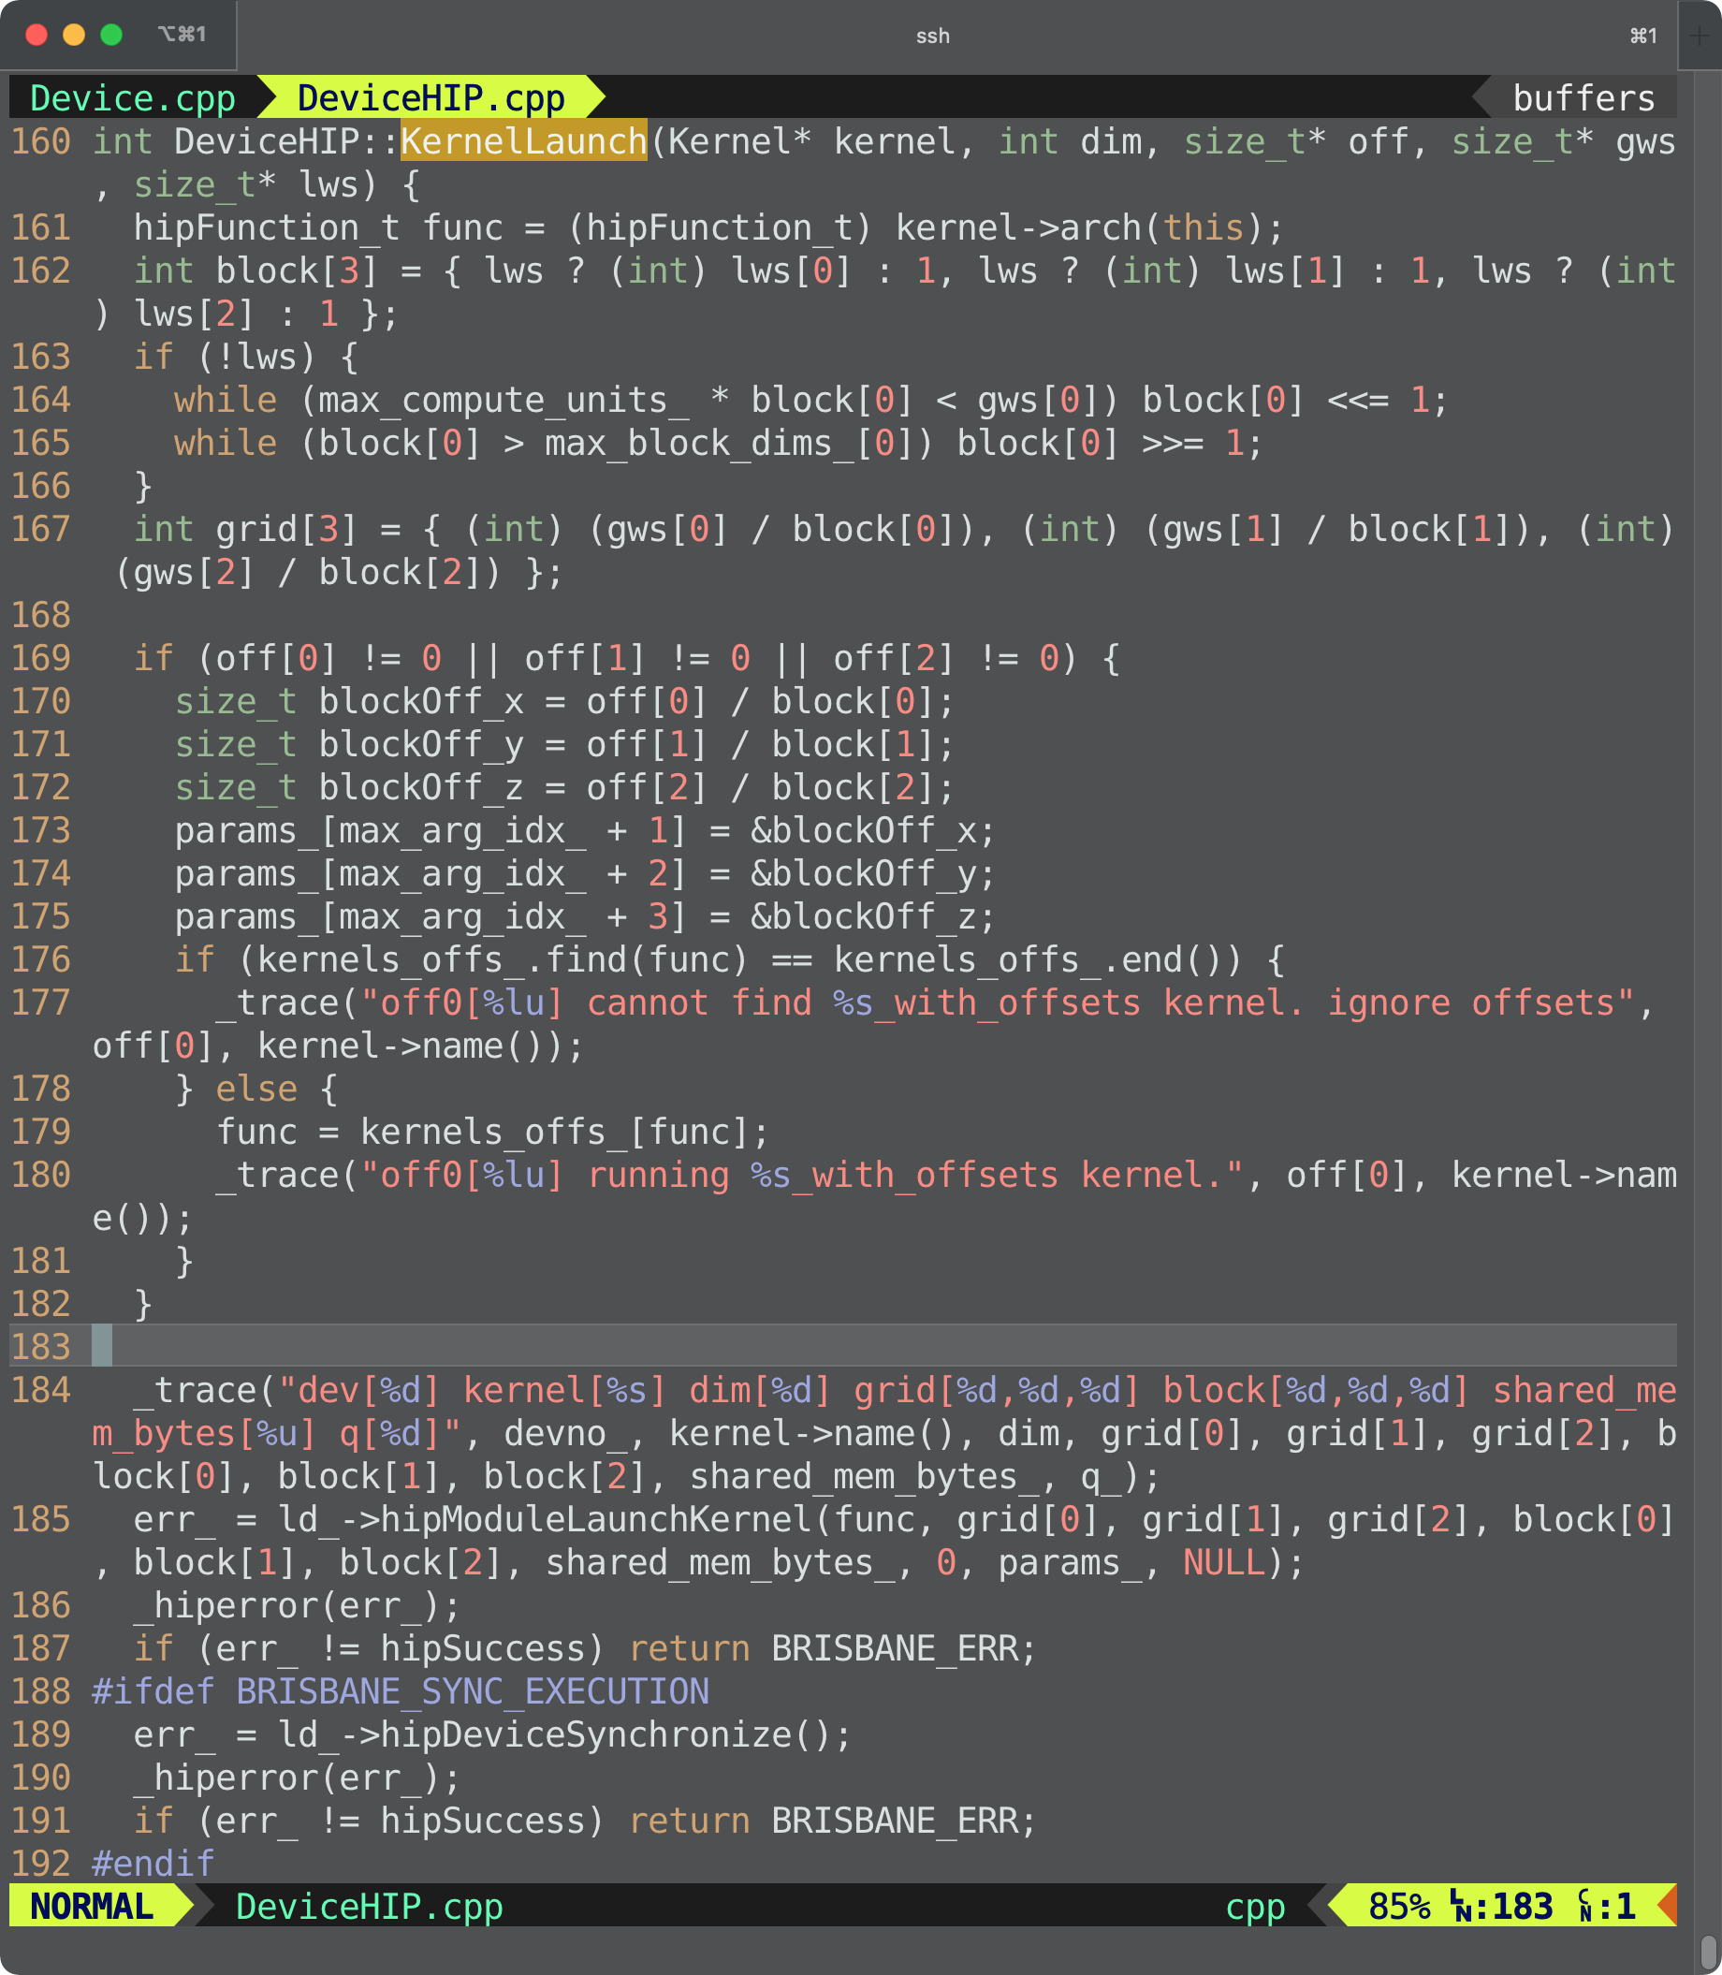
src/runtime/DeviceHIP.cpp

Slide 61

IRIS Kernel Arch Table
Kernel
archs_[] | API | Device
0 | void* | AMD CPU [0]
1 | hipFunction_t | AMD GPU [1]
2 | hipFunction_t | AMD GPU [2]

Slide 62

src/runtime/Device.cpp

Slide 63
iris_task_submit()
Task 1
AMD CPU
OMP
H2D(Y)
Kernel1(Z, Y)
D2H(Z)

Slide 64

src/runtime/Consistency.cpp
Task 0
AMD GPU
HIP
H2D(X)
Kernel0(Z, X)
Z = X
Z: RAW dependency b/w Task 0 (GPU) and Task 1 (CPU)
Z += Y
Task 1
AMD CPU
OMP
H2D(Y)
Kernel1(Z, Y)
D2H(Z)

Slide 65

src/runtime/Consistency.cpp

Slide 66

src/runtime/Consistency.cpp

Slide 67

iris_task_finalize()

Slide 68
src/runtime/Platform.cpp

Slide 69

src/runtime/Platform.cpp

Slide 70

src/runtime/Platform.cpp

Slide 71

cmake -DCMAKE_TYPE=DEBUG

